Slide 1
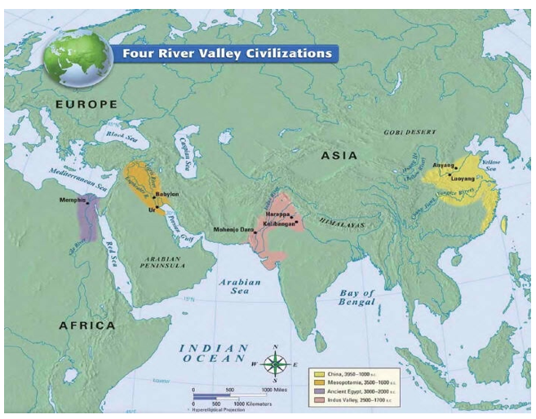
Early world history
EARLY CIVILIZATIONS AND CLASSICAL CIVILIZATIONS

Slide 2
Brief Overview
New York Social Studies Framework Connection
Key Social Studies Terms to Look for:
9.1 DEVELOPMENT OF CIVILIZATION: The development of agriculture enabled the rise of the first civilizations, located primarily along river valleys; these complex societies were influenced by geographic conditions, and shared a number of defining political, social, and economic characteristics.(Standards: 2, 3, 4; Themes: TCC, GEO, ECO, TECH)
9.3 CLASSICAL CIVILIZATIONS: EXPANSION, ACHIEVEMENT, DECLINE: Classical civilizations in Eurasia and Mesoamerica employed a variety of methods to expand and maintain control over vast territories. They developed lasting cultural achievements. Both internal and external forces led to the eventual decline of these empires.(Standards: 2, 3, 5; Themes: MOV, TCC, GEO, GOV, CIV)
Neolithic Revolution
Agriculture
Technology
Civilization
Polytheism
Cultural diffusion

Slide 5
480-323 BCE

Slide 6
27 BCE – 476 CE

Slide 7
t

Slide 8
