Slide 1
Regents Global history and geography
The intellectual revolutions of Europe

Slide 2
Brief Overview
New York Social Studies Framework Connection
Key Social Studies Terms to Look for:
9.9 ANSFORMATION OF WESTERN EUROPE AND RUSSIA: Western Europe and Russia transformed politically, economically, and culturally ca. 1400–1750. This transformation included state building, conflicts, shifts in power and authority, and new ways of understanding their world. (Standards: 2, 3, 5; Themes: ID, MOV, TCC, GOV, CIV, TECH, EXCH)9.9a
10.2: ENLIGHTENMENT, REVOLUTION, AND NATIONALISM: The Enlightenment called into question traditional beliefs and inspired widespread political, economic, and social change. This intellectual movement was used to challenge political authorities in Europe and colonial rule in the Americas. These ideals inspired political and social movements.(Standards: 2, 3, 5; Themes: MOV, TCC, GEO, SOC, GOV, CIV)
Scientific Revolution
Enlightenment
Natural rights
Enlightened despot
Separation of powers
Checks and balances

Slide 3
Scientific Revolution (1500s-1600s)
Scientific Revolution - sudden and dramatic change in how people viewed the world
During the Scientific Revolution, science and reason (logic) were used to explain how the world worked. People no longer turned only to the Bible and the Catholic Church for answers

Slide 4
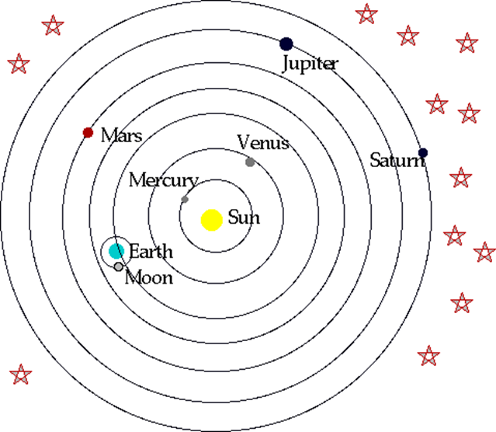
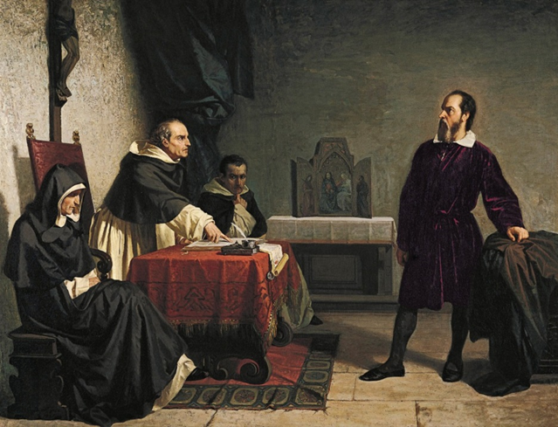
Scientific Revolution- Key People
Copernicus
Astronomer who developed the Heliocentric Theory
The idea that the planets revolve around the sun
Galileo Galilei
Astronomer who proved that Copernicus was correct
He was put on trial by the Catholic Church because his ideas contradicted (went against) its teachings

Slide 5
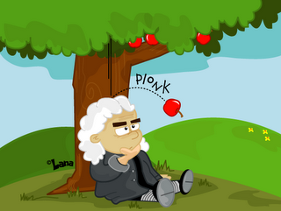
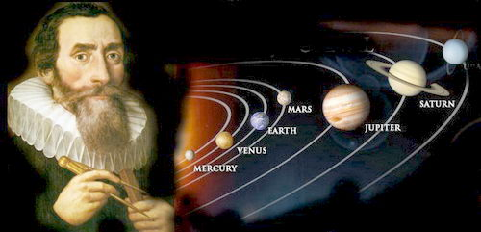
Scientific Revolution- Key People
Sir Isaac Newton
Mathematician and astronomer who developed calculus and the theory of gravity
Descartes
Mathematician, scientist, and philosopher
Created rationalism (reason)
The philosophy of questioning everything about the world around them
Johannes Kepler
Astronomer who helped discover how planets move

Slide 6
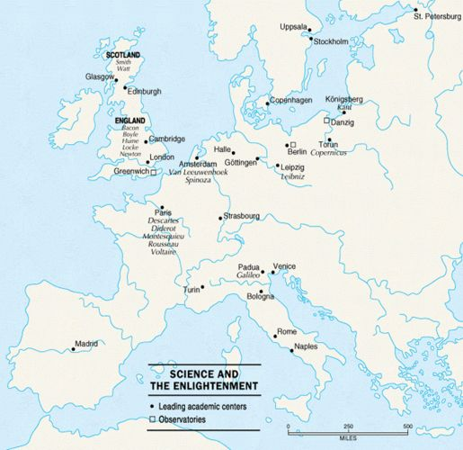
Results of the Scientific Revolution
It resulted in the spread of new ideas throughout Europe
= cultural diffusion
It challenged the traditional authority (power) of the Catholic Church since European scientists proved that many Church teachings were incorrect.
Scientific Revolution
Enlightenment

Slide 7
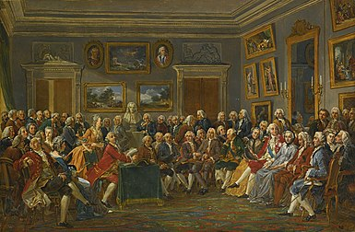
The Enlightenment (1700s)
The Enlightenment was the period in European history when reason (logic) was used to understand and improve society. In fact, the Enlightenment is often called “The Age of Reason.”

Slide 8
Key Ideas of The Enlightenment
Enlightenment philosophers believed that society could be improved by using reason (logic) and natural law (universal rules that are always true).
Enlightenment philosophers believed that governments receive their authority (power) from the people (NOT from God).
Think voting and democracy!!
The Scientific Revolution
and the Enlightenment
the spread of new ideas and the use of reason

Slide 9
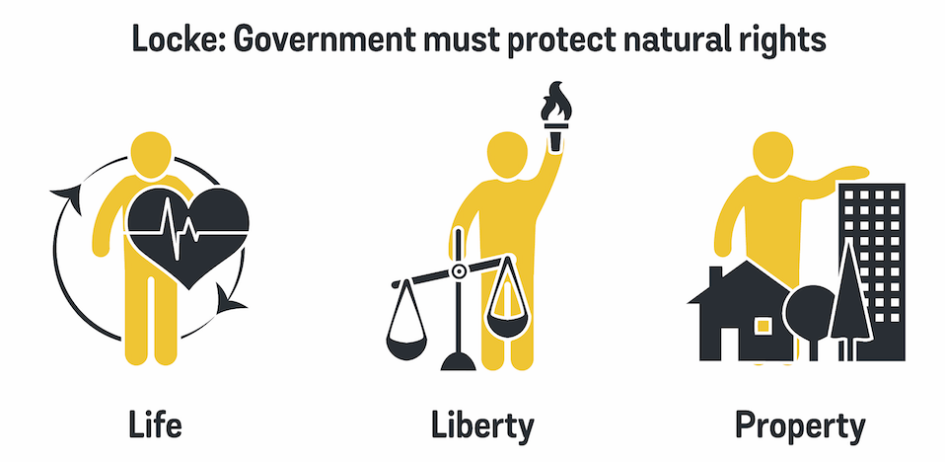
Key People of The Enlightenment
John Locke
All people have natural rights = life, liberty and property
People have the right to overthrow corrupt governments
Montesquieu
Gov’t should be divided into 3 branches = separation of powers
Each branch has power over the other = checks and balances
Power of gov’t should be LIMITED

Slide 10
Key People of The Enlightenment
Voltaire
People should have freedom of speech
People should have freedom of religion
Rousseau
Gov’t and people need a social contract = an agreement in which all people agree to work for the common good of society

Slide 11
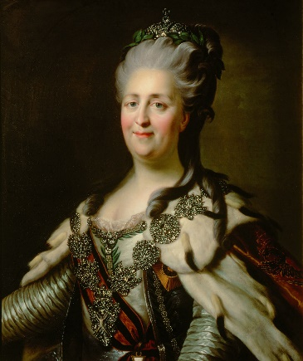
Results of The Enlightenment
Enlightened Despots
European kings and queens who believed in Enlightenment ideas and ruled using Enlightenment principles (ideas)
They were still monarchs but did things to help their people instead of only helping themselves
Enlightenment
POLITICAL REVOLUTIONS in France, Latin America, and the United States

