Slide 1
Early world history
Belief systems

Slide 2
Brief Overview
New York Social Studies Framework Connection
Key Social Studies Terms to Look for:
9.2 BELIEF SYSTEMS: RISE AND IMPACT: The emergence and spread of belief systems influenced and shaped the development of cultures, as well as their traditions and identities. Important similarities and differences between these belief systems are found in their core beliefs, ethical codes, practices, and social relationships. (Standards: 2, 3; Themes: ID, SOC)
Polytheism
Monotheism
Hinduism
Legalism
Confucianism
Buddhism
Judaism
Christianity
Islam

Slide 3
Polytheistic- religions that believe in many gods

Slide 4
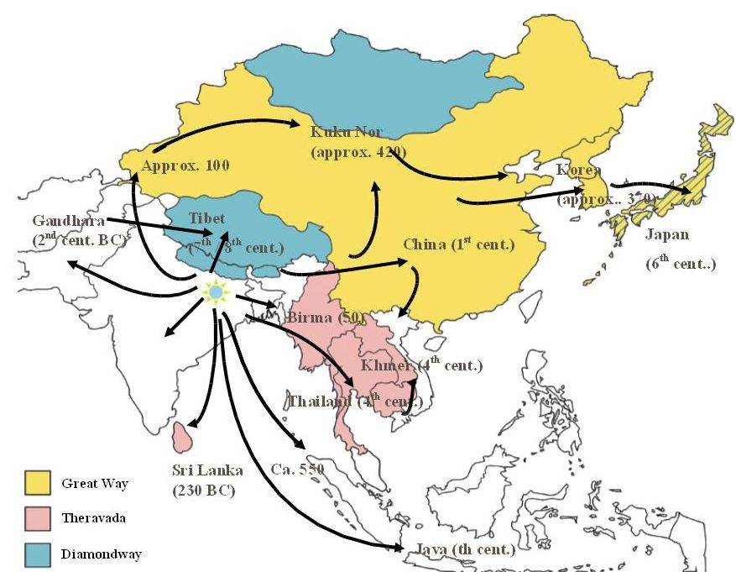

Slide 7
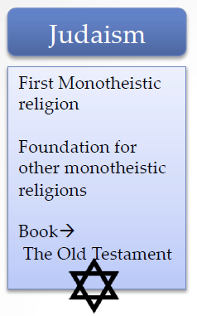
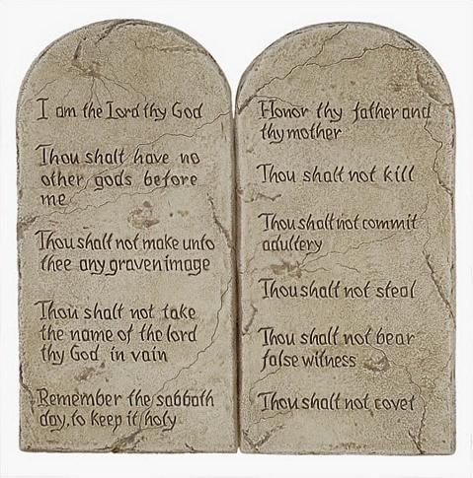
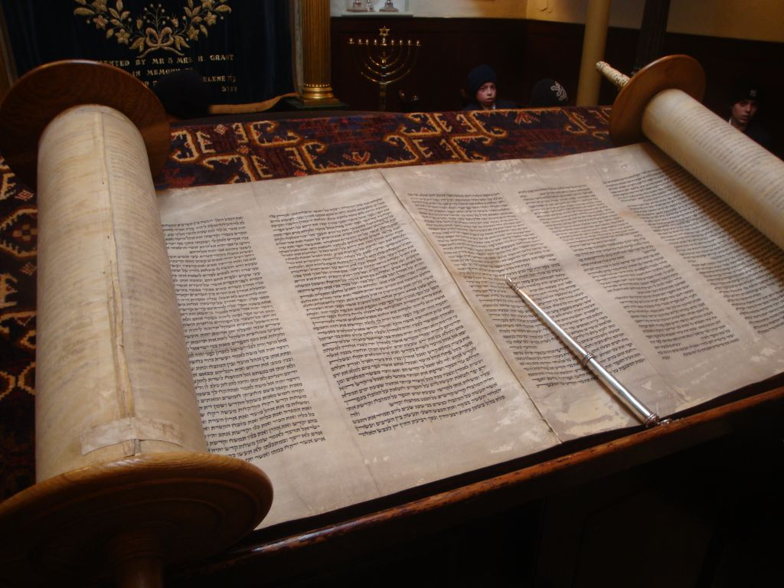
Ten Commandments

Slide 8
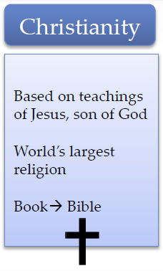
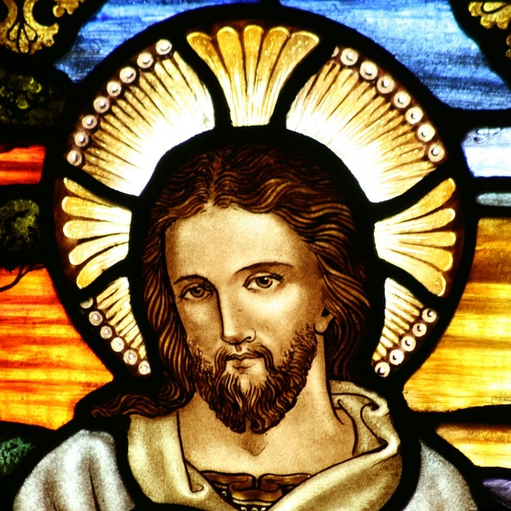

Slide 9
