Slide 1
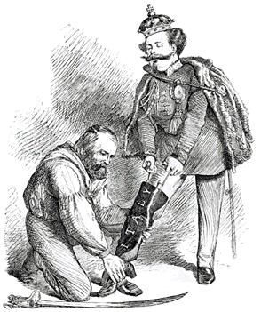
Regents global history and geography
Nationalism

Slide 2
Brief Overview
New York Social Studies Framework Connection
Key Social Studies Terms to Look for:
10.2: ENLIGHTENMENT, REVOLUTION, AND NATIONALISM: The Enlightenment called into question traditional beliefs and inspired widespread political, economic, and social change. This intellectual movement was used to challenge political authorities in Europe and colonial rule in the Americas. These ideals inspired political and social movements.
(Standards: 2, 3, 5; Themes: MOV, TCC, GEO, SOC, GOV, CIV)
Nationalism
Realpolitik
Kaiser

Slide 3
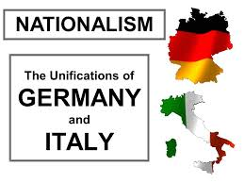
Introduction to Nationalism
Nationalism is a feeling of love, loyalty, and devotion to one’s country. Someone who feels this love, loyalty, and devotion is known as a nationalist
Nationalism usually develops in areas where people share a common language, culture, and history
Led to a number of revolutions in Europe in the 1800’s

Slide 4
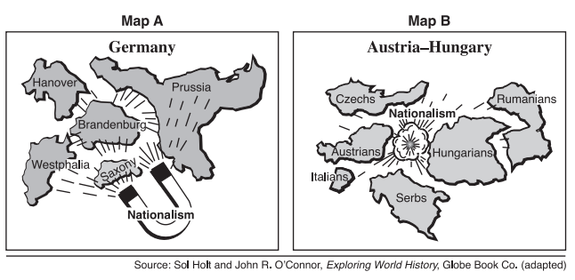
Nationalism
Nationalism can lead to unification or breaking up of governments
Unification ex.: Italy and Germany (people have common culture)
Break Up ex.: Austrian and Ottoman Empires (one ethnic group controlled many others)

Slide 5
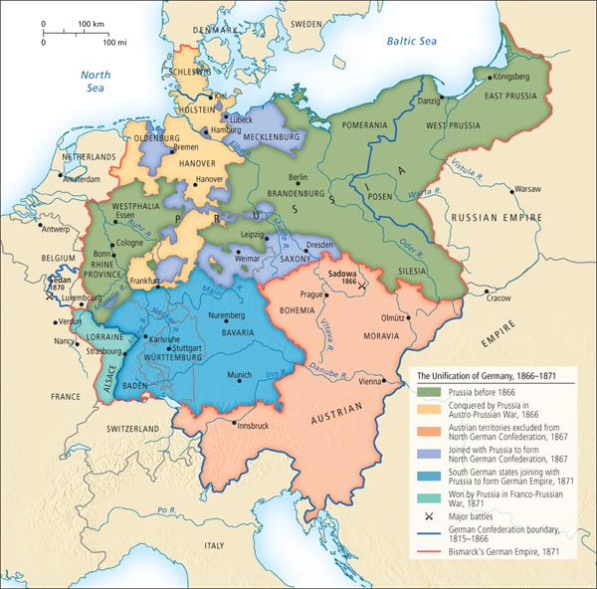
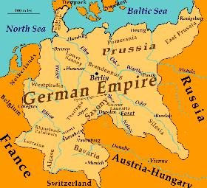
Unification of Germany (1870-1871)
Since the 800’s German speaking people lived in small states
During Napoleon’s conquest feelings of nationalism rose in Germans
Germany successfully combined its separate states to form one united nation in 1871 due to the efforts Otto von Bismarck
FROM SEPARATE STATES TO ONE EMPIRE

Slide 6
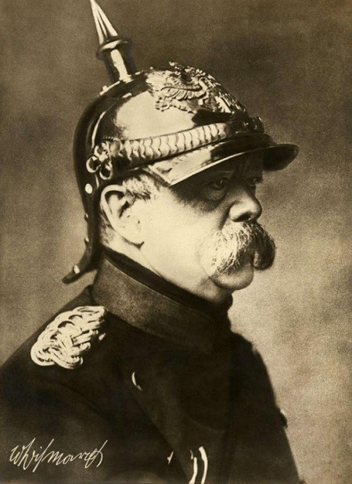
Unification of Germany (1870-1871)
Otto von Bismarck
Chancellor of Prussia
Believed in Realpolitik
He used a “blood and iron” policy (3 wars) to unify German lands- believe war was the only way to unite Germany
Danish War
Austro- Prussian War
Franco-Prussian War
1871- German states united under the Prussian king, Wilhelm I and he called himself the kaiser

Slide 7
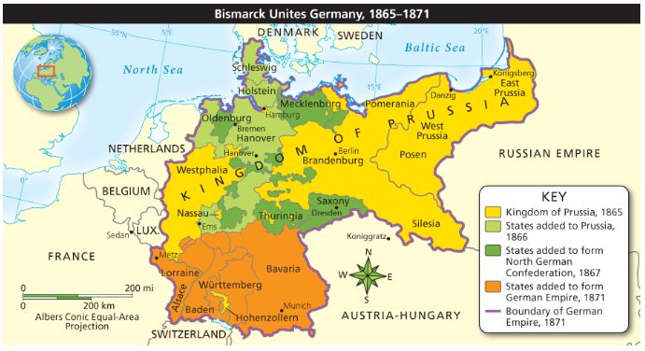

Slide 8
Unification of Italy (1870-1871)
Italy had been divided into small kingdoms since the fall of the Roman Empire
Italy successfully combined its separate states to form one united nation in 1870
FROM SEPARATE STATES TO ONE EMPIRE

Slide 9
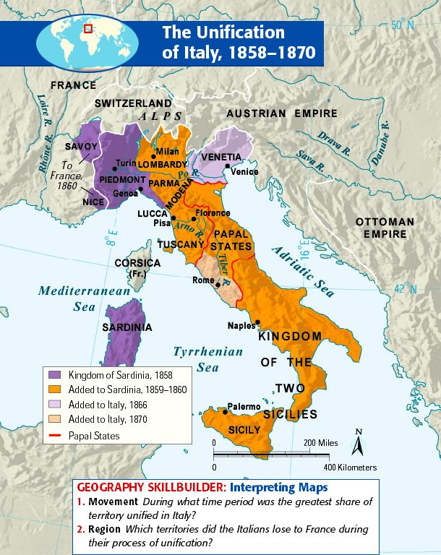
Unification of Italy (1870-1871)
Key People
Giuseppe Garibaldi- the “Sword”
Soldier who led his “Red Shirt” forces to win control of southern Italy and helped unite it with the north
Count Camillo Cavour- the “Brain”
Believed in Realpolitik
Used diplomacy and war to unite states of Tuscany, Parma, and Modena
Giuseppe Mazzini- the “Soul”
Writing and speeches provided inspiration to the nationalist movement

Slide 10
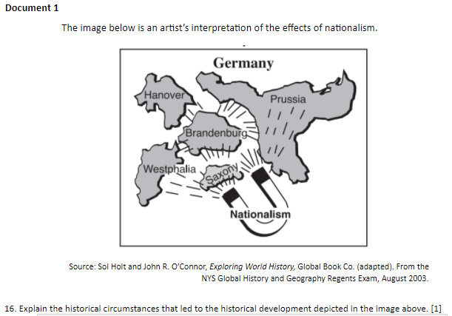
CRQ Question #1
Historical Circumstances=
What happened?
What was going on in history at this time?

Slide 11
Geographic context- refers to where the historical development or event occurs and why it happened there.
Giuseppe (Joseph) Mazzini, “An Essay On the Duties of Man: Addressed to Workingmen,” 1858
…Then may each one of you, fortified by the power and affection of many millions, all speaking the same language, gifted with the same tendencies, and educated by the same historical tradition, hope even by your own single efforts to be able to benefit all humanity. Oh my brothers, love your country! Our country is home, the house that God has given us, placing therein a numerous family that loves us, and whom we love; a family with whom we sympathize more readily and whom we understand more quickly than we do others; and which, from its being centered round a given spot, and from the homogeneous nature of its elements is adapted to a special branch of activity… Country is not only a mere zone of territory. The true country is the idea to which it gives birth; it is the thought of love, the sense of communion [that] unites in one all the sons of that territory.
1. In Mazzini’s “An Essay On the Duties of Man: Addressed to Workingmen,” what was the geographic context, such as the status of boundaries, for Mazzini’s ideas?

