Slide 1
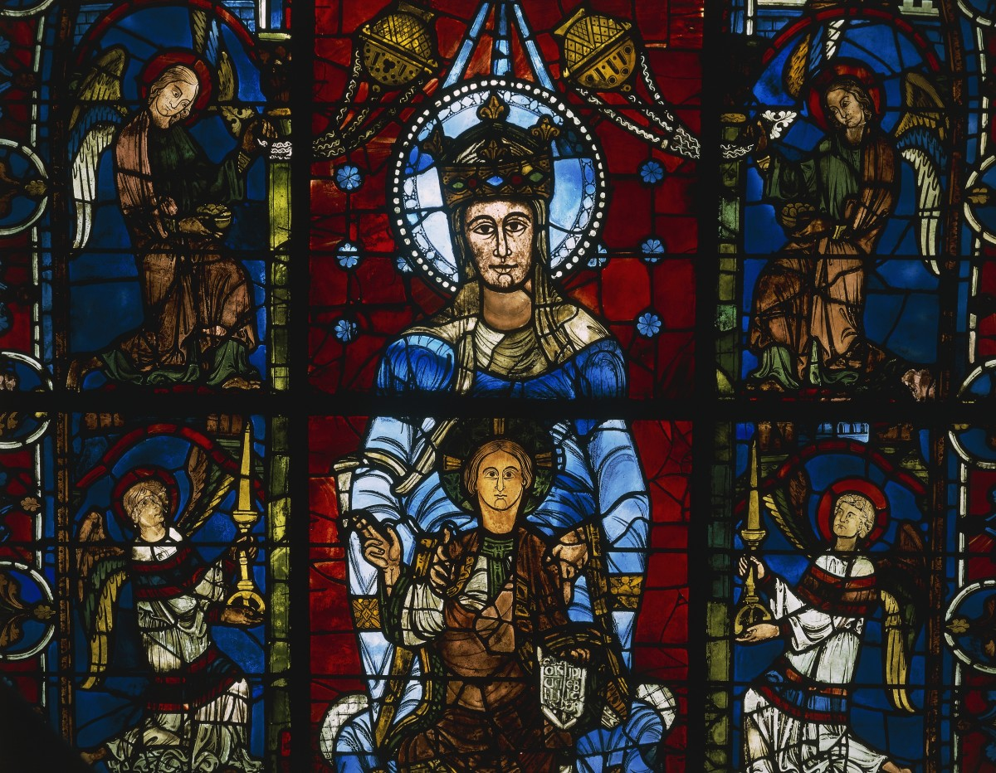
Early world history
Medieval Europe and byzantine Empire

Slide 2
Brief Overview
New York Social Studies Framework Connection
Key Social Studies Terms to Look for:
9.5 POLITICAL POWERS AND ACHIEVEMENTS: New power arrangements emerged across Eurasia. Political states and empires employed a variety of techniques for expanding and maintaining control. Periods of relative stability allowed for significant cultural, technological, and scientific innovations.
(Standards: 2, 3, 4, 5; Themes ID, MOV, GOV, CIV, TECH)
Eastern Orthodox
Justinian Code
Cultural diffusion
Cyrillic alphabet
Feudalism
Manorialism

Slide 3
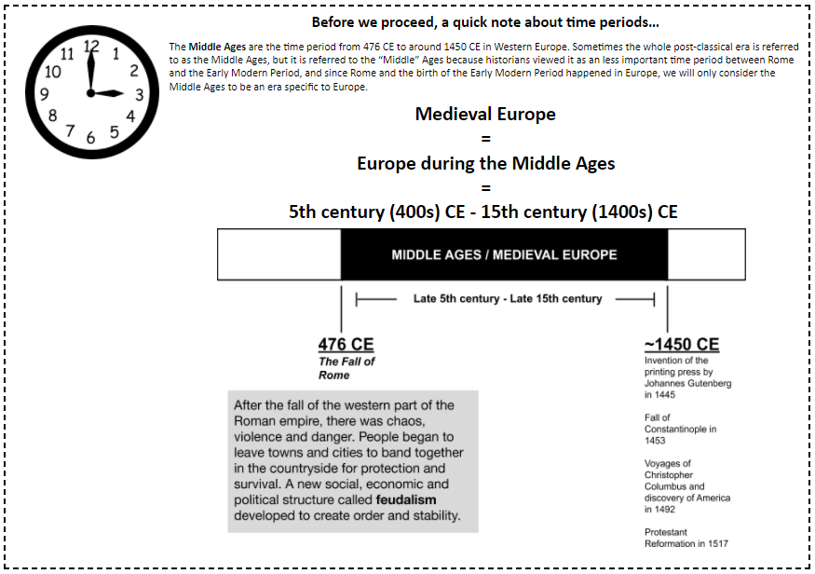

Slide 4
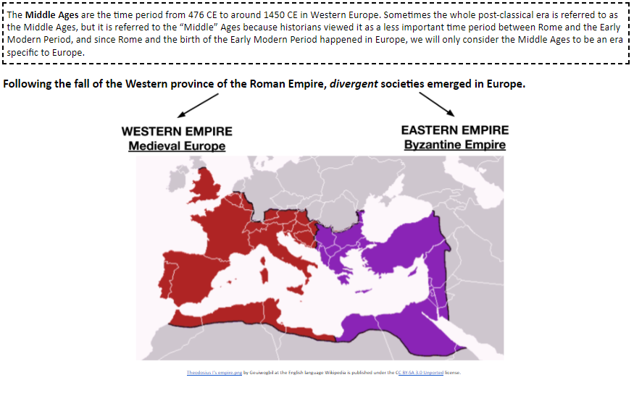

Slide 7
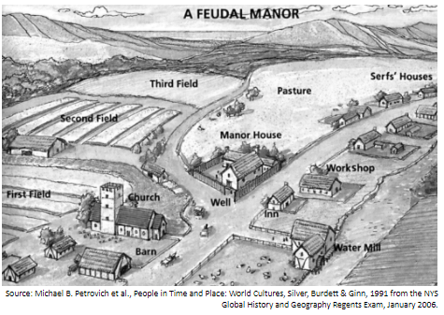

Slide 9
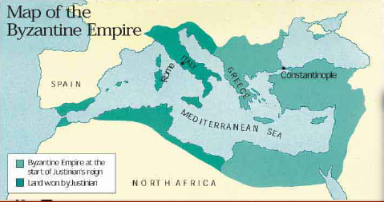

Slide 10
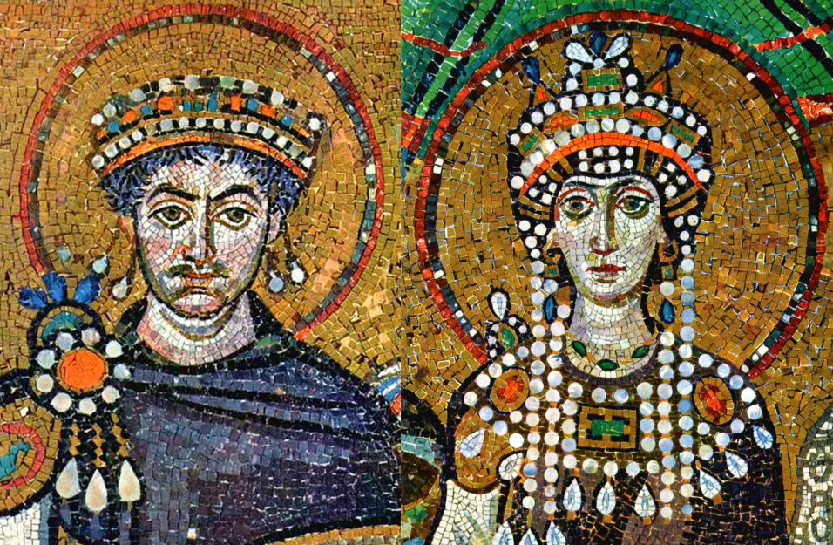
Reform of Roman law
Collected, revised, and organized all laws of ancient Rome
Code served the Byzantine empire for 900 years

