Slide 1
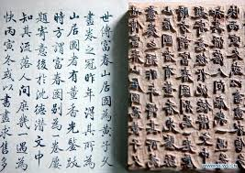
Early world history
Tang and song china

Slide 2
Brief Overview
New York Social Studies Framework Connection
Key Social Studies Terms to Look for:
9.5 POLITICAL POWERS AND ACHIEVEMENTS: New power arrangements emerged across Eurasia. Political states and empires employed a variety of techniques for expanding and maintaining control. Periods of relative stability allowed for significant cultural, technological, and scientific innovations. (Standards: 2, 3, 4, 5; Themes ID, MOV, GOV, CIV, TECH)
Silk Road
Civil service exam
Cultural diffusion

Slide 3
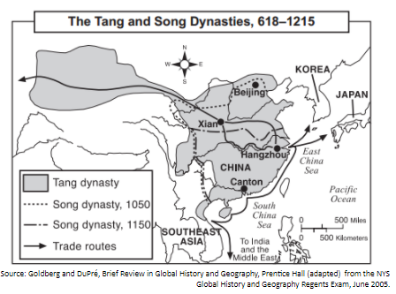

Slide 7
