Slide 1
Early world history
Golden age of islam

Slide 2
Brief Overview
New York Social Studies Framework Connection
Key Social Studies Terms to Look for:
9.5 POLITICAL POWERS AND ACHIEVEMENTS: New power arrangements emerged across Eurasia. Political states and empires employed a variety of techniques for expanding and maintaining control. Periods of relative stability allowed for significant cultural, technological, and scientific innovations. (Standards: 2, 3, 4, 5; Themes ID, MOV, GOV, CIV, TECH)
Five Pillars
Quran
Sunni
Shi’a

Slide 4
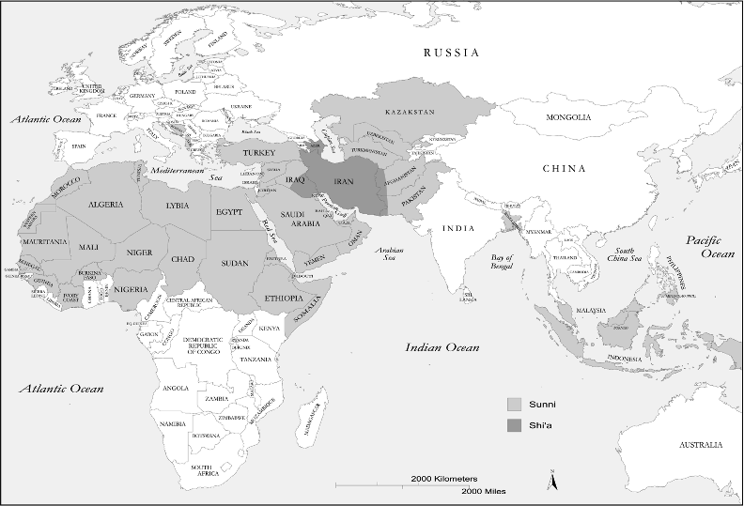

Slide 5
The Umayyads (661–750)
Notes:
Mu’awiya claimed control over the Muslim empire as caliph in 661, ushering in the Umayyad Dynasty and moving the capital of the empire from Medina to Damascus, Syria.
With the center of the empire shifted to the Levant (the region on the eastern coast of the Mediterranean Sea that includes present-day Lebanon, Syria, Jordon, Israel/Palestine, and Egypt), incursions to the west via the Mediterranean Sea were much easier to accomplish. The empire thus formally expanded to North Africa and Spain, and Arabic was declared the state language in all the conquered areas.
The Umayyads launched a new wave of invasions east to the Indus River, bringing Central Asia into the Islamic fold. With its expansion, the Muslim empire revived trade along the Silk Road, stimulating a transcontinental trading system that stretched from the Far East to Europe.
Mu’awiya was succeeded as caliph by his son, the first time the position was passed through the bloodline. The caliphate under the Umayyads began to resemble an empire or kingdom ruled by hereditary emperors like those heading the Byzantine and Persian empires.

Slide 6
The Abbasids (750–1258)
Notes:
The Abbasids claimed legitimacy as the descendants of Muhammad’s uncle, Abbas ibn Abd al-Muttalib. The Abbasids commanded initial endorsement by the Shi’a, upholding their belief that the leader of the umma must be a relative of Muhammad (though the Abbasids renounced their Shi’a beliefs soon after coming to power, infuriating their Shi’a supporters). They also appealed to the disenfranchised non-Arab Muslims in the empire and to Muslims who objected to the Umayyads’ extravagant, imperial ways and authoritarian rule.
When the Umayyad dynasty was overthrown in 750 following a series of revolts, the new caliph attempted to destroy the entire Umayyad clan. Many of the Umayyads were massacred during a banquet, while others were chased down.
A single Umayyad prince escaped death by fleeing to North Africa and then to al-Andalus, where he established the Umayyad Emirate of Cordoba in 756. (See slide 41.)

