Slide 1
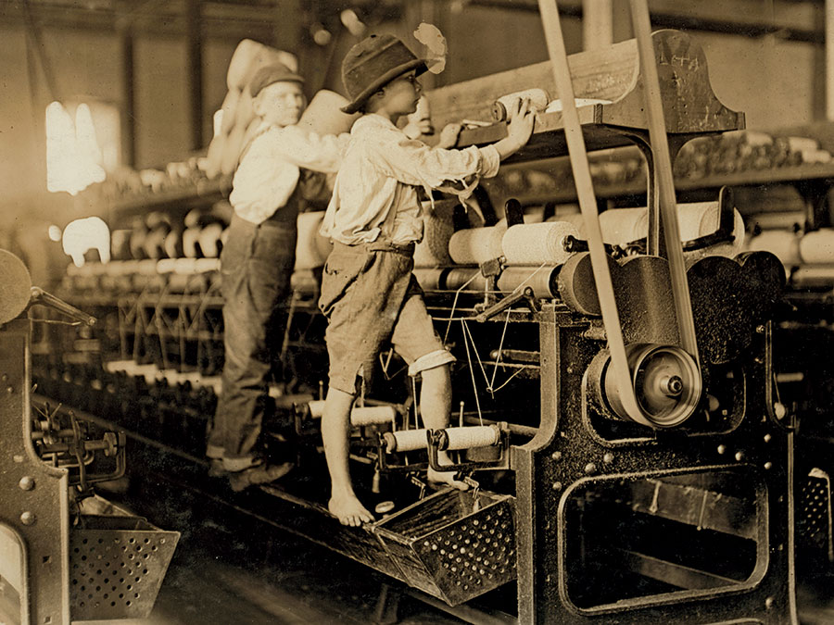
Regents global history and geography
Industrial revolution

Slide 2
Brief Overview
New York Social Studies Framework Connection
Key Social Studies Terms to Look for:
10.3 CAUSES AND EFFECTS OF THE INDUSTRIAL REVOLUTION: Innovations in agriculture, production, and transportation led to the Industrial Revolution, which originated in Western Europe and spread over time to Japan and other regions. This led to major population shifts and transformed economic and social systems.
(Standard: 2, 3, 4; Themes: MOV, TCC, GEO, SOC, ECO, TECH)
Industrialization
urbanization
Laissez faire
Capitalism
Socialism
Proletariat
Bourgeoisie
Labor unions

Slide 3
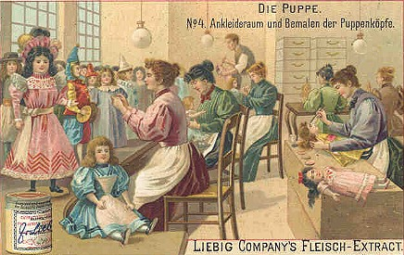
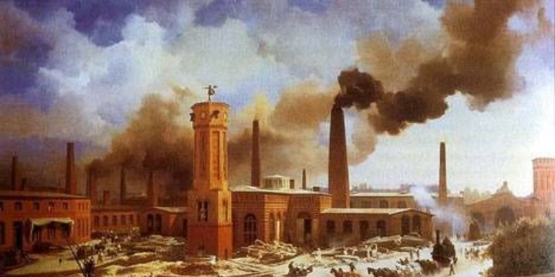
The Industrial Revolution (1700s-1800s)
The Industrial Revolution was the change from producing goods by hand to producing goods with machines in factories.
WORKING BY HAND TO WORKING BY MACHINES

Slide 4
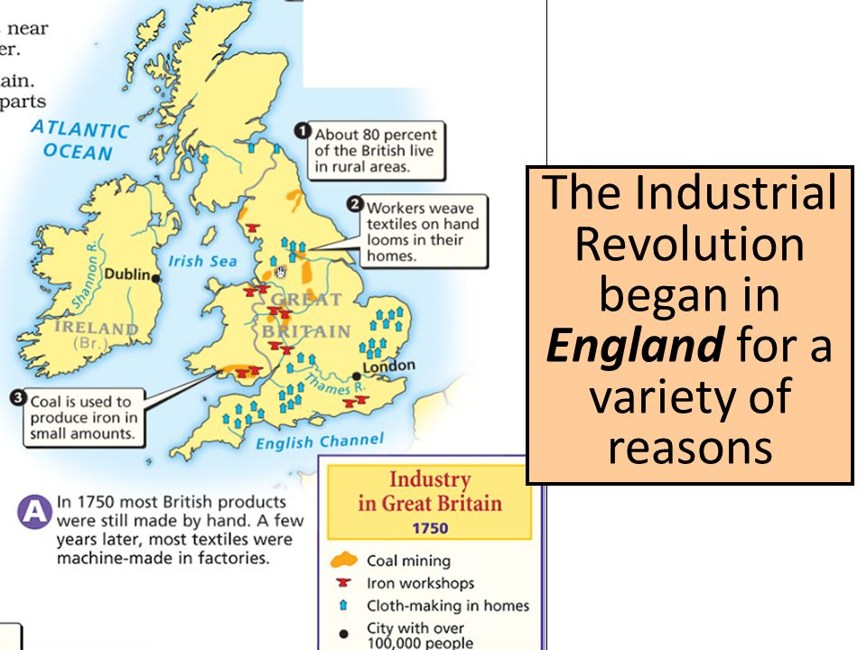
The Industrial Revolution (1700s-1800s)
KEY CAUSES
Natural Resources
Coal
Natural Transportation
Rivers
Good geography
Capital for investment
Population growth
Energy and technology

Slide 5
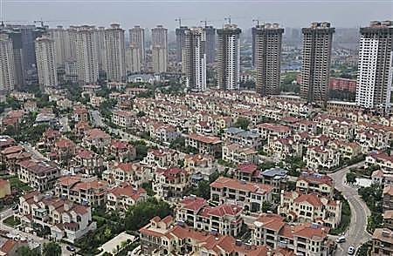
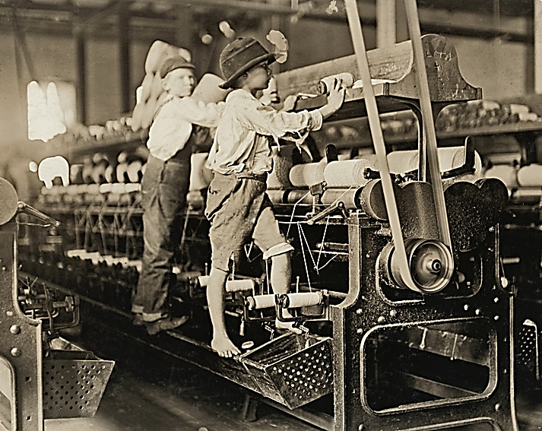
The Industrial Revolution (1700s-1800s)
KEY EFFECTS (RESULTS)
Industrialization- Machines were used to produce goods in factories
Urbanization- The growth of cities. People came to urban (city) areas to get jobs in factories. Many cities had severe pollution from the smoke that came out of factories.
Bad working conditions- Workers in factories worked in dangerous conditions for long hours and low pay. Young children were frequently hired and abused in these factories
Formation of Labor Unions- Workers formed labor unions (organizations of workers) that fought to improve the pay and working conditions of workers
Legislation- Governments eventually passed laws to set minimum wage and end child labor.

Slide 6
The Industrial Revolution (1700s-1800s)
Laissez Faire Capitalism (Market Economy)
This was the economic system that was used during the Industrial Revolution (and that is still used in most of the world today).
MAIN IDEAS
Businesses and factories should be owned by individuals (NOT the government)
Business decisions should be made by Individuals (the government should NOT interfere)
Prices should be set by individuals (NOT the government) based on supply and demand
LAISSEZ-FAIRE = CAPITALISM = FREE CHOICE

Slide 7
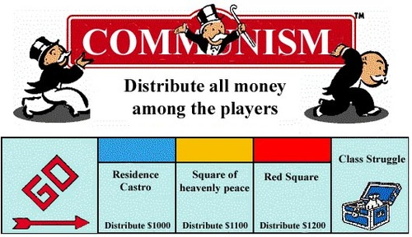
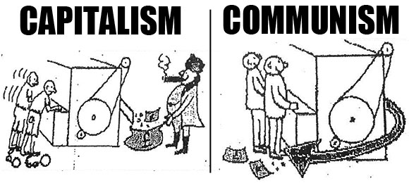
The Industrial Revolution (1700s-1800s)
Socialism
Karl Marx and Friedrich Engels
They argued that it allowed greedy factory owners to exploit (take advantage) of poor factory workers
COMMUNIST MANIFESTO
All of history has been about class struggles (Rich vs poor)
Wealthy and greedy factory owners were taking advantage of the poor factory workers to earn money
The Proletariat/worker should rise up, overthrow the bourgeoisie/rich in a violent revolution, and eliminate laissez faire capitalism
The Proletariat could then create a new kind of society where work and wealth was shared equally be everyone

Slide 8
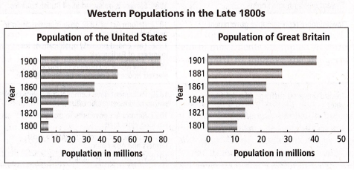
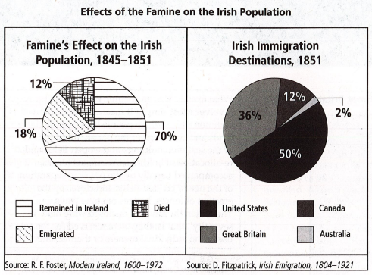
The Industrial Revolution (1700s-1800s)
Global Impact of Industrialization
Population Explosion
Movement Toward a
Global Economy
Global Migrations
- Irish Potato Famine

Slide 9
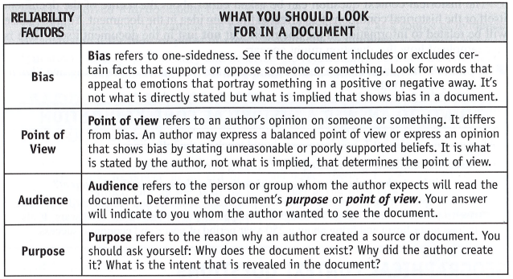
CRQs
Question 2- will include a document and ask about the SOURCE that created it
Identify the bias, point of view, audience, or purpose

Slide 10
The following is the testimony of eighteen year old Ann Eggley from an 1843 report entitled The Physical and Moral Condition of the Children and Young Persons employed in Mines and Manufactures that was ordered by the British government and created by a group of investigators called the Commissioners for Inquiring into the Employment and Condition of Children in Mines and Manufactories.
We go at four in the morning, and sometimes at half-past four. We begin to work as soon as we get down. We get out after four, sometimes at five, in the evening. We work the whole time except an hour for dinner, and sometimes we haven't time to eat….The work is far too hard for me; the sweat runs off me all over sometimes. I am very tired at night. Sometimes when we get home at night we have not power to wash us, and then we go to bed. Sometimes we fall asleep in the chair. Father said last night it was both a shame and disgrace for girls to work as we do, but there was nought else for us to do... I have been 11 years in the pit. ...I never went to a day-school. I went a little to a Sunday-school, but I soon gave it over. I thought it too bad to be confined both Sundays and weekdays. I walk about and get the fresh air on Sundays. I have not learnt to read. I don't know my letters. I have never learnt nought...
Source: The Physical and Moral Condition of the Children and Young Persons employed in Mines and Manufactures, 1843 http://spartacus-educational.com/CoalIndustry.htm is in the public domain.
1. Using document 2, explain the author’s purpose for writing about the lives of workers in mines and factories in Great Britain in the 1800s.

