Slide 1
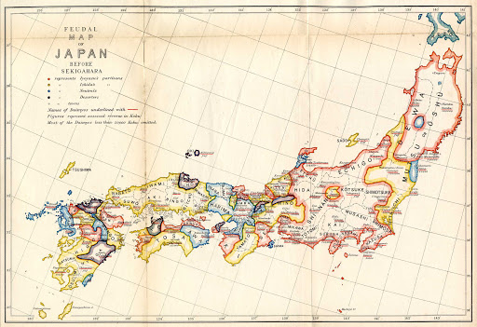
Early world history
Feudal japan

Slide 2
Brief Overview
New York Social Studies Framework Connection
Key Social Studies Terms to Look for:
9.5 POLITICAL POWERS AND ACHIEVEMENTS: New power arrangements emerged across Eurasia. Political states and empires employed a variety of techniques for expanding and maintaining control. Periods of relative stability allowed for significant cultural, technological, and scientific innovations.
(Standards: 2, 3, 4, 5; Themes ID, MOV, GOV, CIV, TECH)
Feudalism
Shogun
Daimyo
Samurai
Bushido
Cultural diffusion

Slide 3
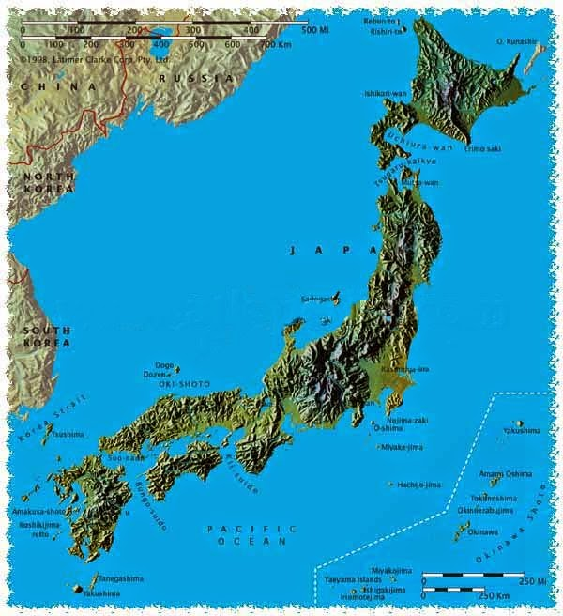
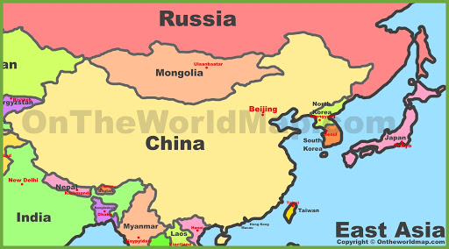

Slide 5
Feudalism in Japan
Competition for power led to establishment of feudal system
Decentralized gov’t
Shogun distributed land to daimyo, who granted land to samurai in exchange for military service

