Slide 1
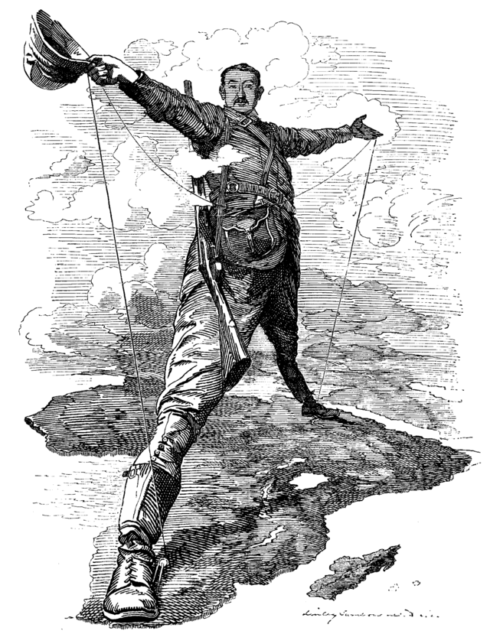
Regents global history and geography
Imperialism

Slide 2
Brief Overview
New York Social Studies Framework Connection
Key Social Studies Terms to Look for:
10.4 IMPERIALISM: Western European interactions with Africa and Asia shifted from limited regional contacts along the coast to greater influence and connections throughout these regions. Competing industrialized states sought to control and transport raw materials and create new markets across the world. (Standards: 2, 3, 4; Themes: MOV, TCC, GEO, GOV, EXCH)
Imperialism
“White Man’s Burden”
Sphere of influence
Sepoy Mutiny
Scramble for Africa
Berlin Conference
Boxer Rebellion
Modernization
Westernization

Slide 3
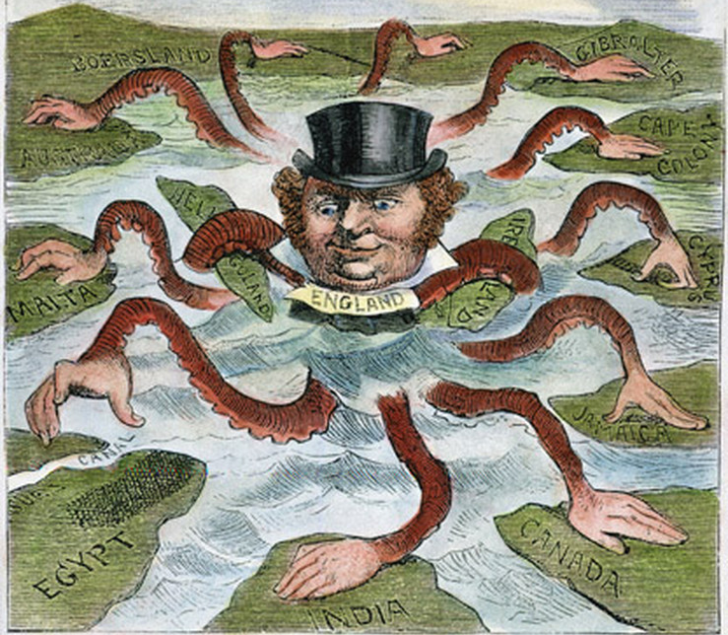
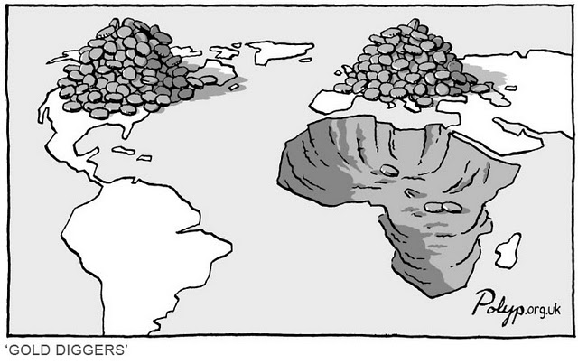
Introduction to Imperialism
Imperialism is when a strong country conquers and takes over a weaker country. The area that is taken over is known as a colony.
During the 19th century (1800s), many European nations (also called Western nations) such as Great Britain, France, Germany, and Italy took over lands throughout Africa and Asia

Slide 4
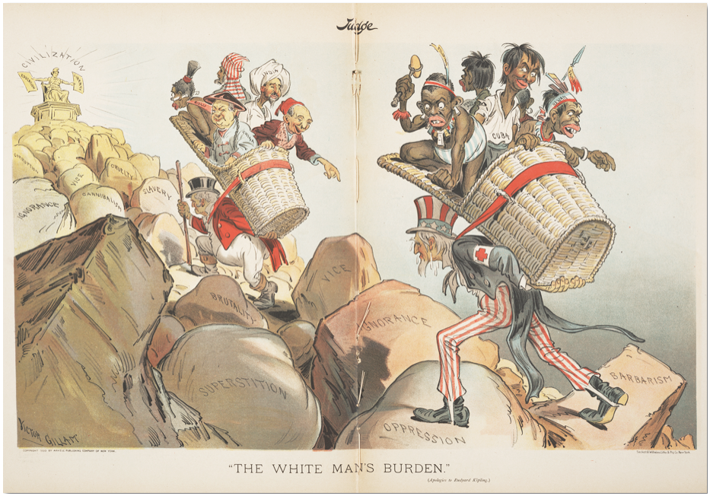
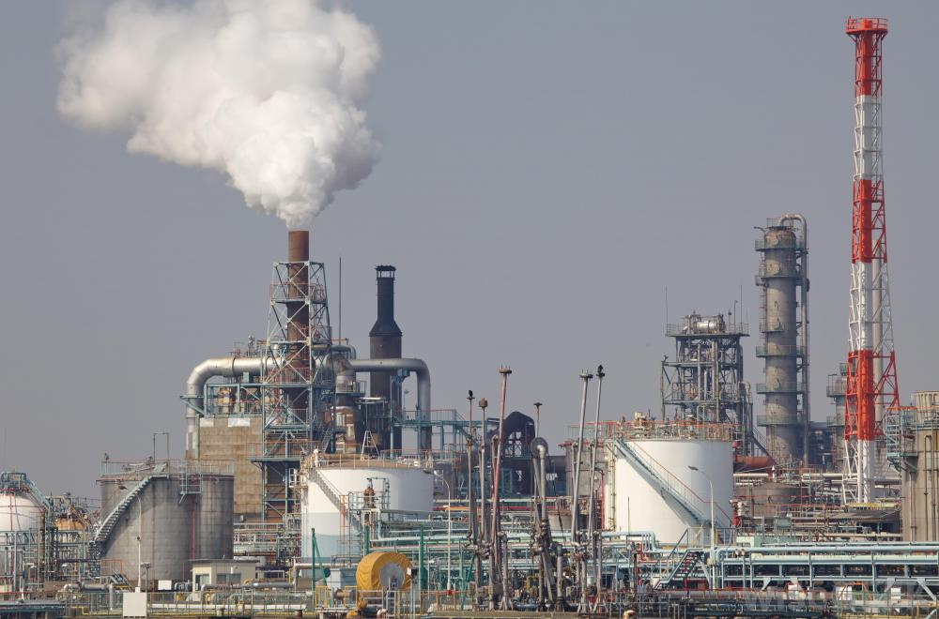
Introduction to Imperialism
KEY CAUSES (REASONS)
Europeans wanted raw materials/natural resources (like coal, tin, iron) in order to make goods in their factories
“White Man’s Burden”
white imperialists believed it was their responsibility to conquer others and “help” them
Social Darwinism
The idea that strong countries should conquer weak ones because they’re stronger
FACTORIES NEED NATURAL RESOURCES IN ORDER TO MAKE THINGS TO SELL

Slide 5
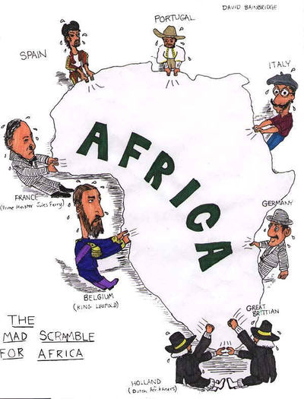
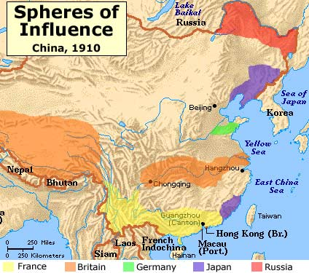
Imperialism in India, China, and Africa (1800s-1914)
KEY EFFECTS (RESULTS)
“Scramble for Africa”
Over 90% of Africa was taken over by European countries that scrambled (raced) to take over the continent
Berlin Conference- European powers divided Africa
China
After the British began smuggling opium (an addictive drug) into China, the Chinese fought back in the famous Opium War
China was carved up into spheres of influence (areas where trade was controlled by different European nations)
India
India was taken over by Great Britain (England) and ruled for almost 200 years

Slide 6
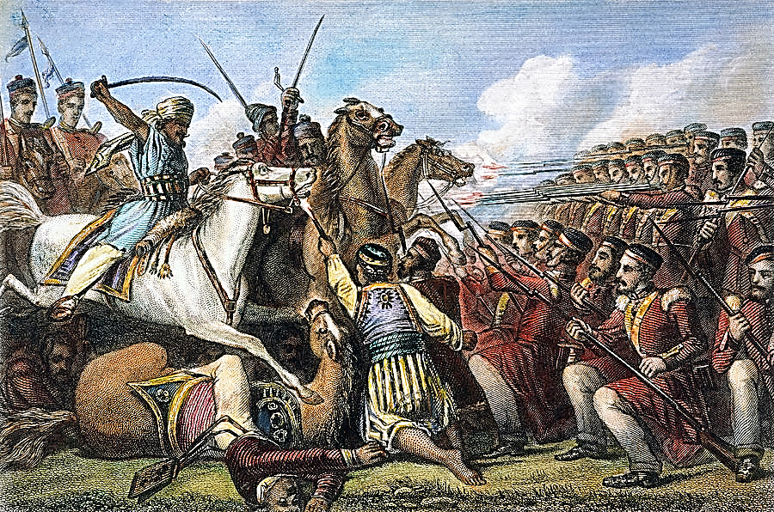
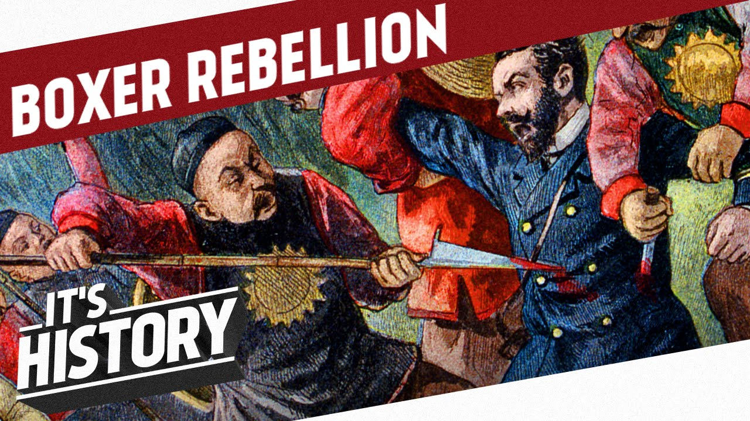
Imperialism in India, China, and Africa (1800s-1914)
RESPONSES TO IMPERIALISM
Sepoy Mutiny
Indian soldiers rebelled against the British because they were forced to follow rules against their religious beliefs
Boxer Rebellion
Boxers were a group who tried to expel foreigners from China but rebellion was crushed by soldiers from nations with interests in China

Slide 7
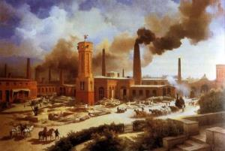
Industrialization in Japan
MEIJI RESTORATION (1868-1912)
Modernization
Japan industrialized (built factories, machines, roads, communications)
Westernization
Japan adopted the customs and techniques of Western countries (i.e.- Europe and the United States). Japan changed its government, military, education system, and technology to make it more like those of Europe and the United States

Slide 8
Sir John A.R. Marriott (1859-1945) was a British politician and historian.
. . . British brains, British enterprise, and British capital have, in a material sense, transformed the face of India. Means of communication have been developed: innumerable bridges, over 40,000 miles of railway, 70,000 miles of metalled roads, testify to the skill and industry of British engineers. Irrigation works on a stupendous [huge] scale have brought 30,000,000 acres under cultivation, and thus greatly added to the agricultural wealth of a country which still lives mainly by agriculture. But, on the other hand, the process of industrialization has already begun. The mills of Bombay have become dangerous competitors to Lancashire, and the Indian jute [rope] industry is threatening the prosperity of Dundee. Thanks to improved sanitation (much resented by the more ignorant beneficiaries [Indians]), to a higher standard of living, to irrigation, to canalization, to the development of transport, and to carefully thought-out schemes for relief work, famines, which by their regular recurrence formerly presented a perennial [continuing] problem to humane administrators, have now virtually disappeared. To have conquered the menace of famine in the face of greater longevity, of diminished death-rate, and the suppression of war, is a remarkable achievement for which India is wholly indebted to British administration. . . .
Source: Sir John A. R. Marriott, The English in India, Oxford University Press, 1932 from the NYS Global History and Geography Regents Exam, June 2004.
Question: Using document 2, identify Sir John A.R. Marriott’s point of view concerning British imperialism in India.

