Slide 1
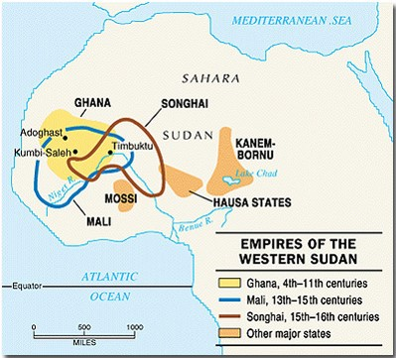
Early world history
African civilizations

Slide 2
Brief Overview
New York Social Studies Framework Connection
Key Social Studies Terms to Look for:
9.4 RISE OF TRANSREGIONAL TRADE NETWORKS: During the classical and postclassical eras, transregional trade networks emerged and/or expanded. These networks of exchange influenced the economic and political development of states and empires. (Standards: 2, 3, 4; Themes: ID, MOV, GEO, ECO, TECH, EXCH)
9.8 AFRICA AND THE AMERICAS PRE-1600: The environment, trade networks, and belief systems influenced the development of complex societies and civilizations in Africa and the Americas ca. 1325–1600. (Standards: 2, 3, 4, 5; Themes: ID, MOV, GEO, GOV, EXCH)
Bantu
Animism
Trans-Sahara trade

Slide 3
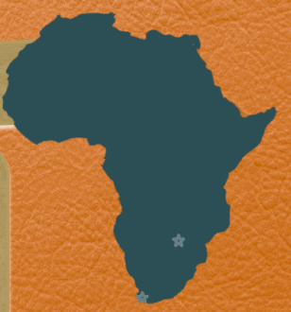

Slide 4
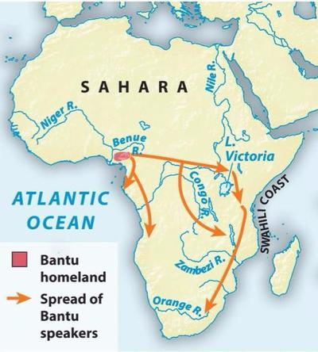
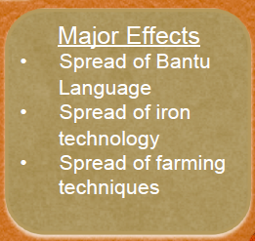

Slide 5
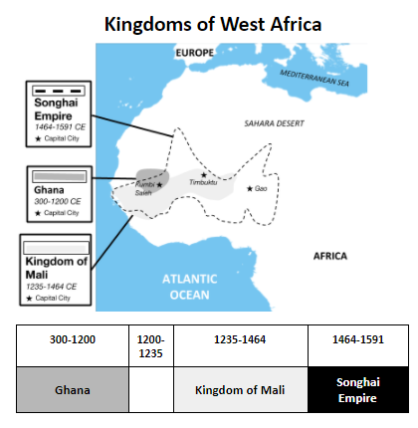
The West African Trading Empires of Ghana (800-1050 CE), Mali (1235-1464 CE), and Songhai (1464-1591 CE) were powerful and wealthy states that controlled the gold and salt trade in West Africa. Their cities were located at the intersections of trade routes.

Slide 6
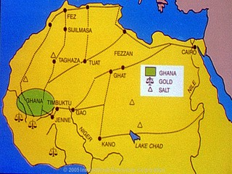
African trading kingdoms
Towns became part of important trade network
GOLD and SALT were most traded products
People needed salt in their bodies to prevent dehydration
Sahara had plenty of salt
People of the savanna traded gold for salt
Why salt?

Slide 7
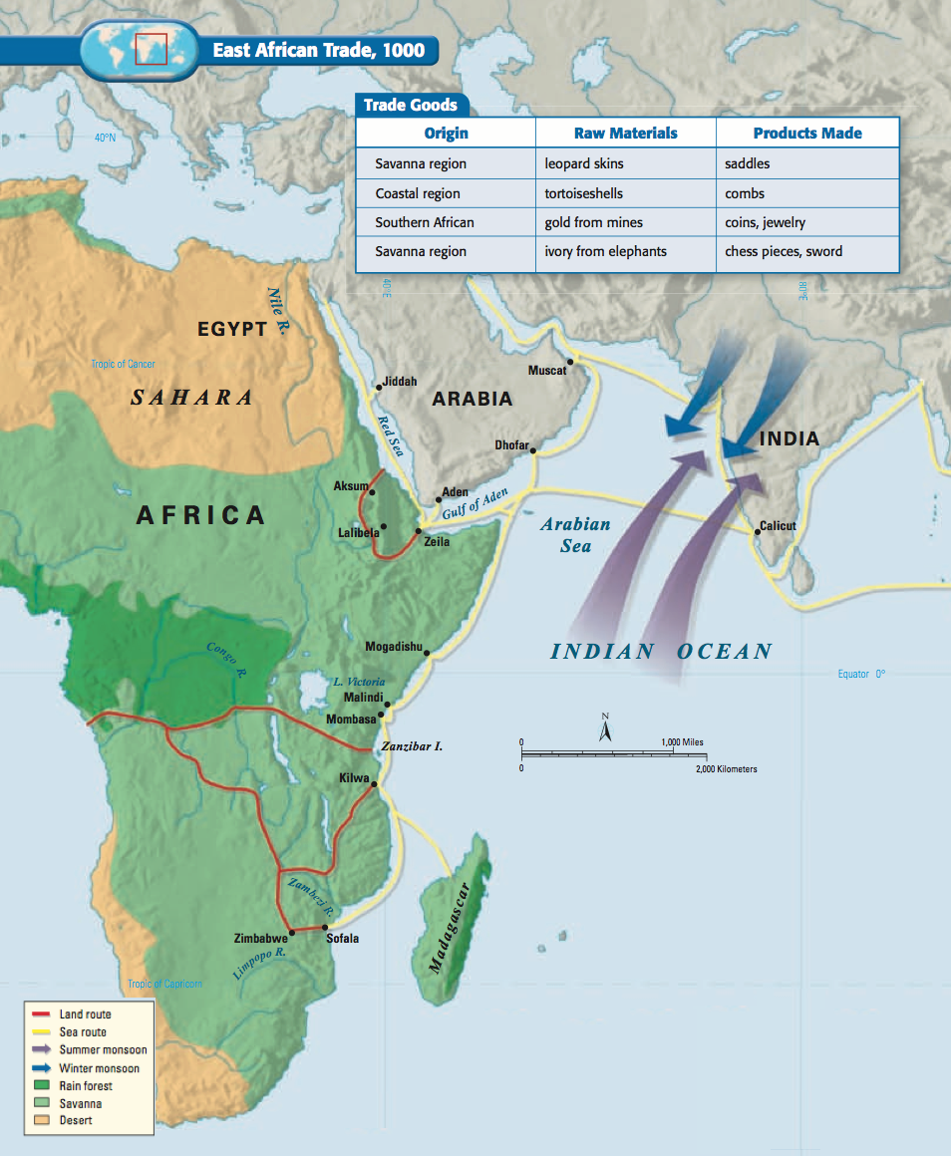
African trading kingdoms
African rulers created powerful kingdoms by gaining control of trade routes
West Africa
Ghana
Mali
Songhai
East Africa
Aksum (Axum)
Swahili City-States

Slide 8
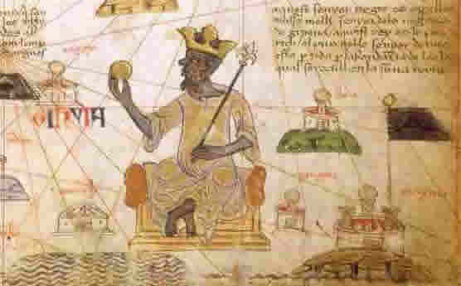
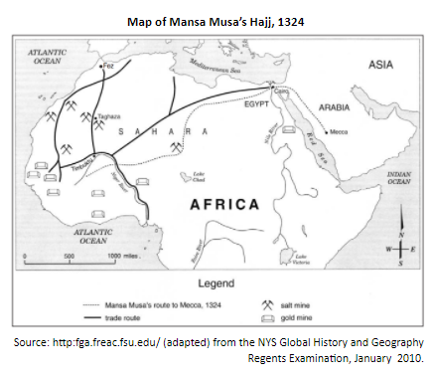
Mansa musa
Leader of Mali from 1312-1332
Skilled military leader
100,000 man army protected Mali
Expanded empire to twice the size of Ghana
Influenced spread of Islam in West Africa
Considered golden age of Mali under his rule

Slide 9
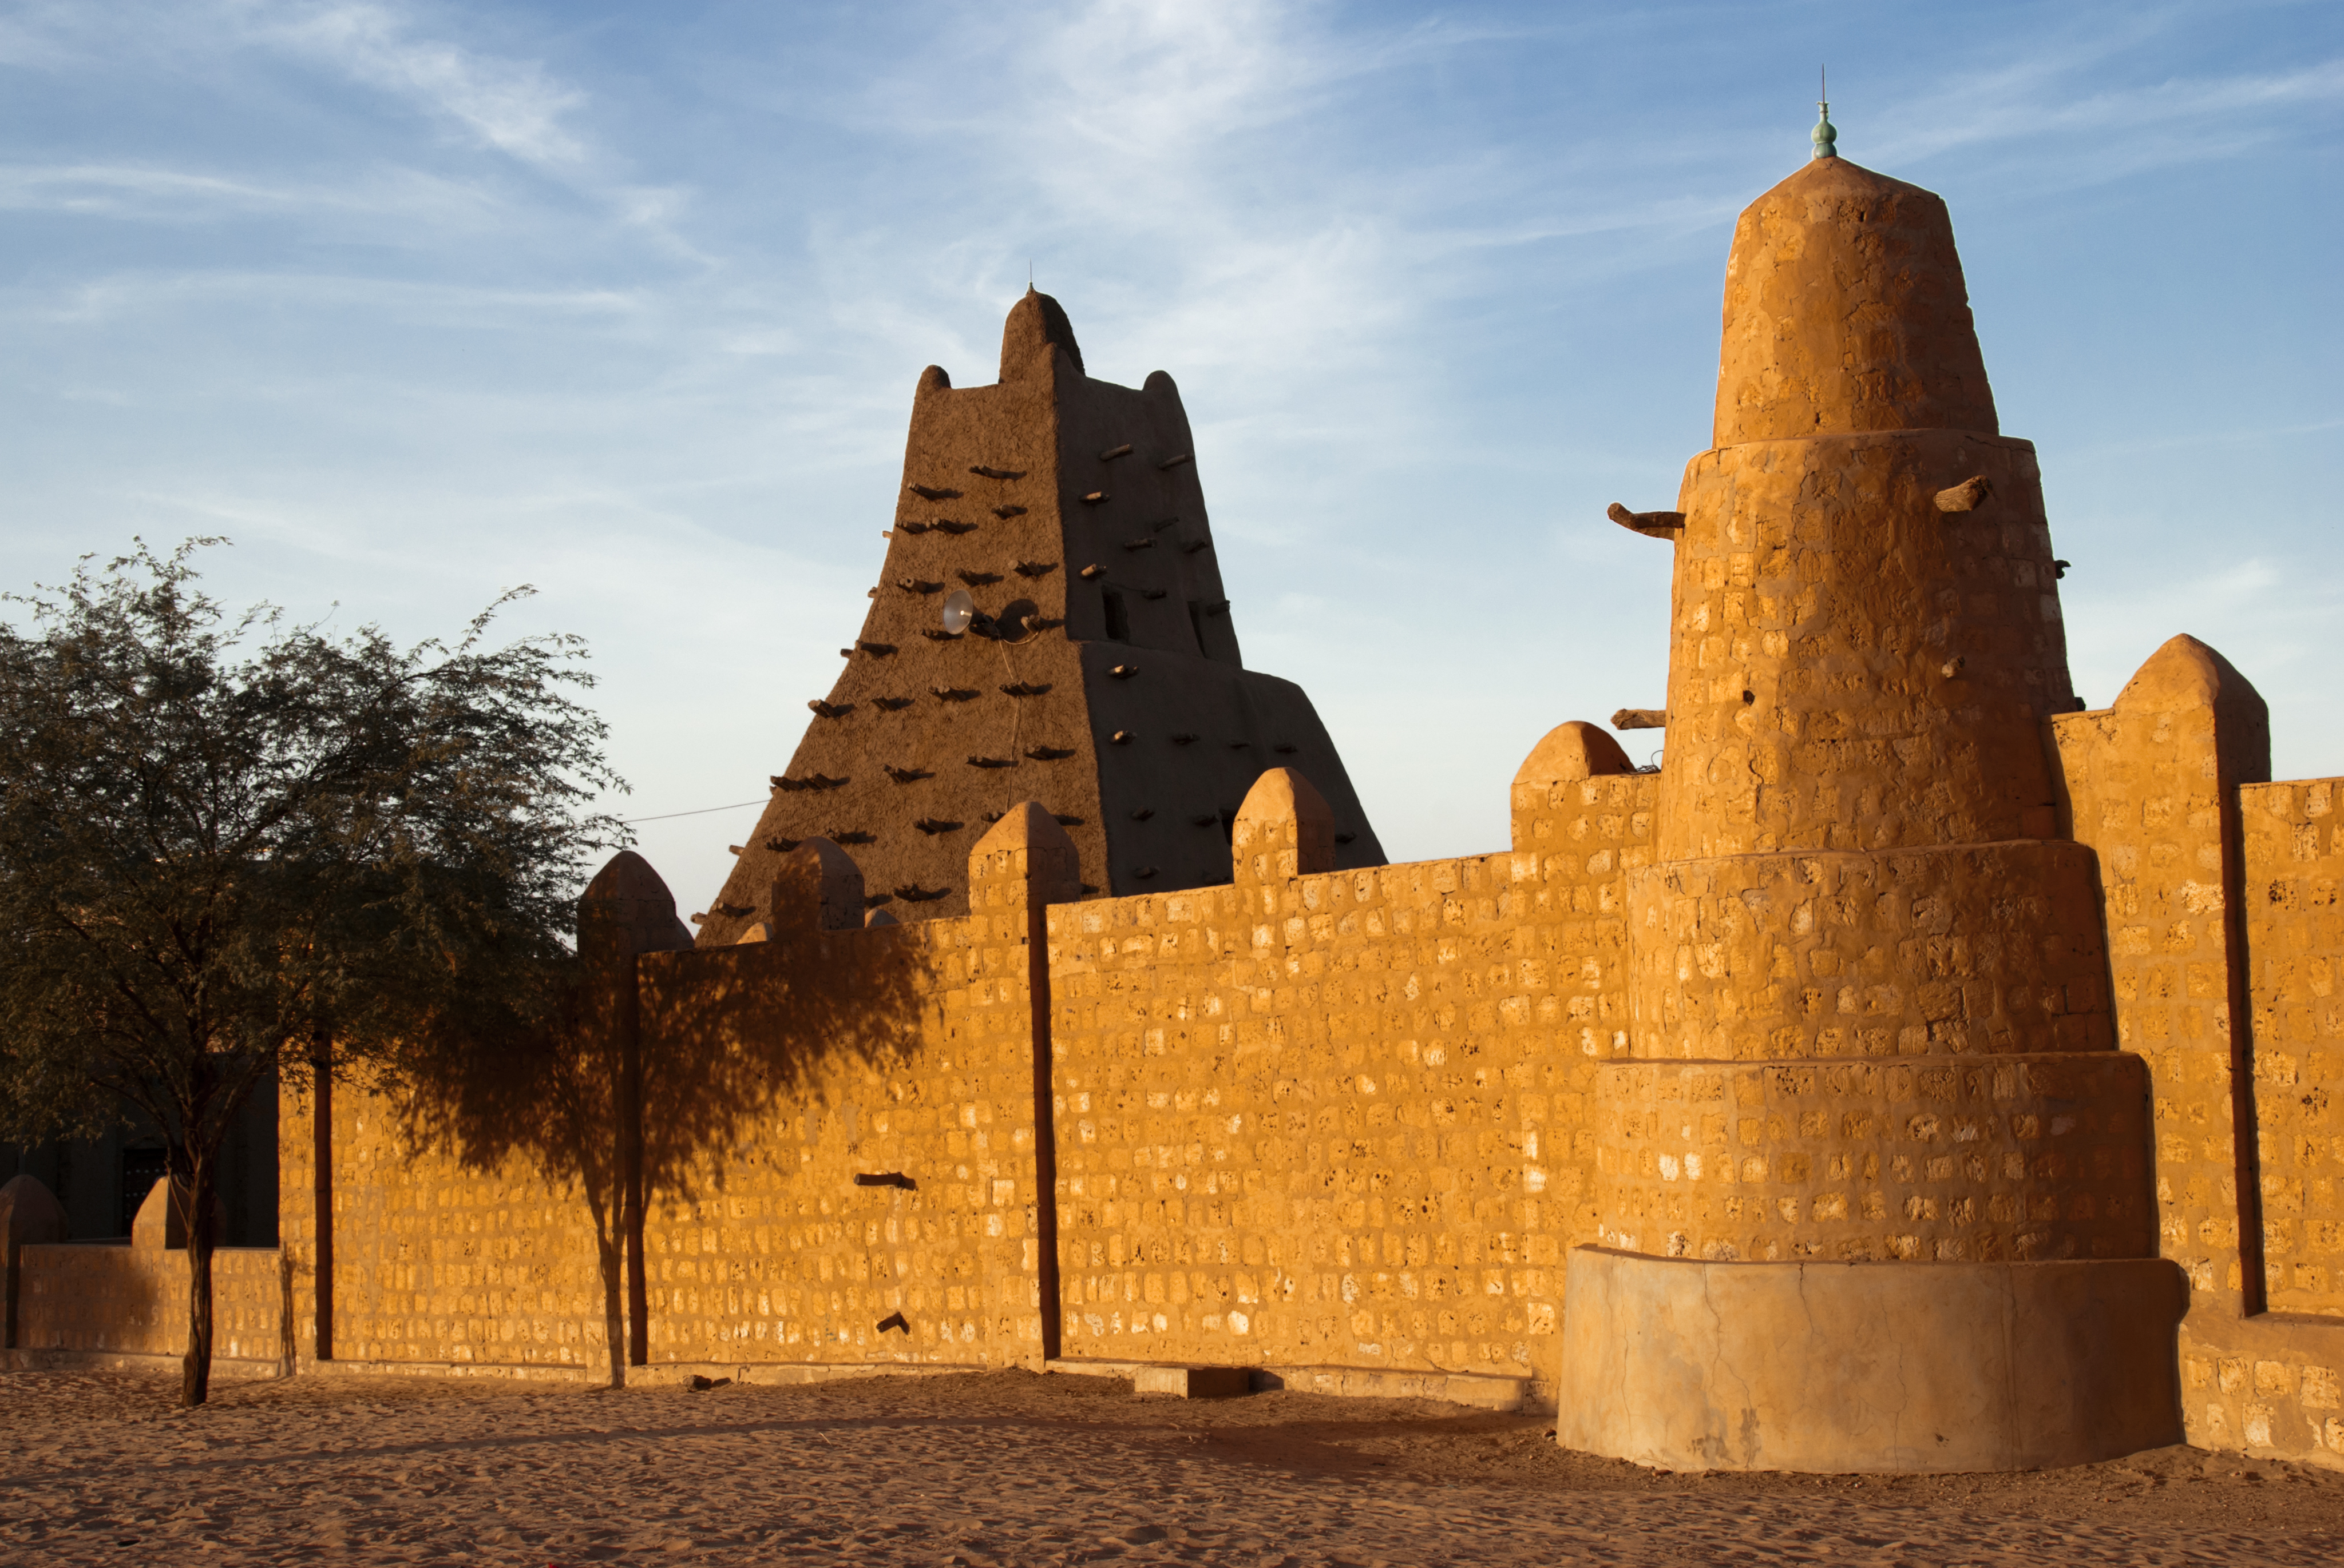
Timbuktu
Mansa Musa ordered building of mosques
Attracted Muslim doctors, religious leaders, and scholars
Muslims attended outstanding mosques and universities
Prosperous through trade of gold and salt
By 1400 it became one of the most important trading cities

