Slide 1
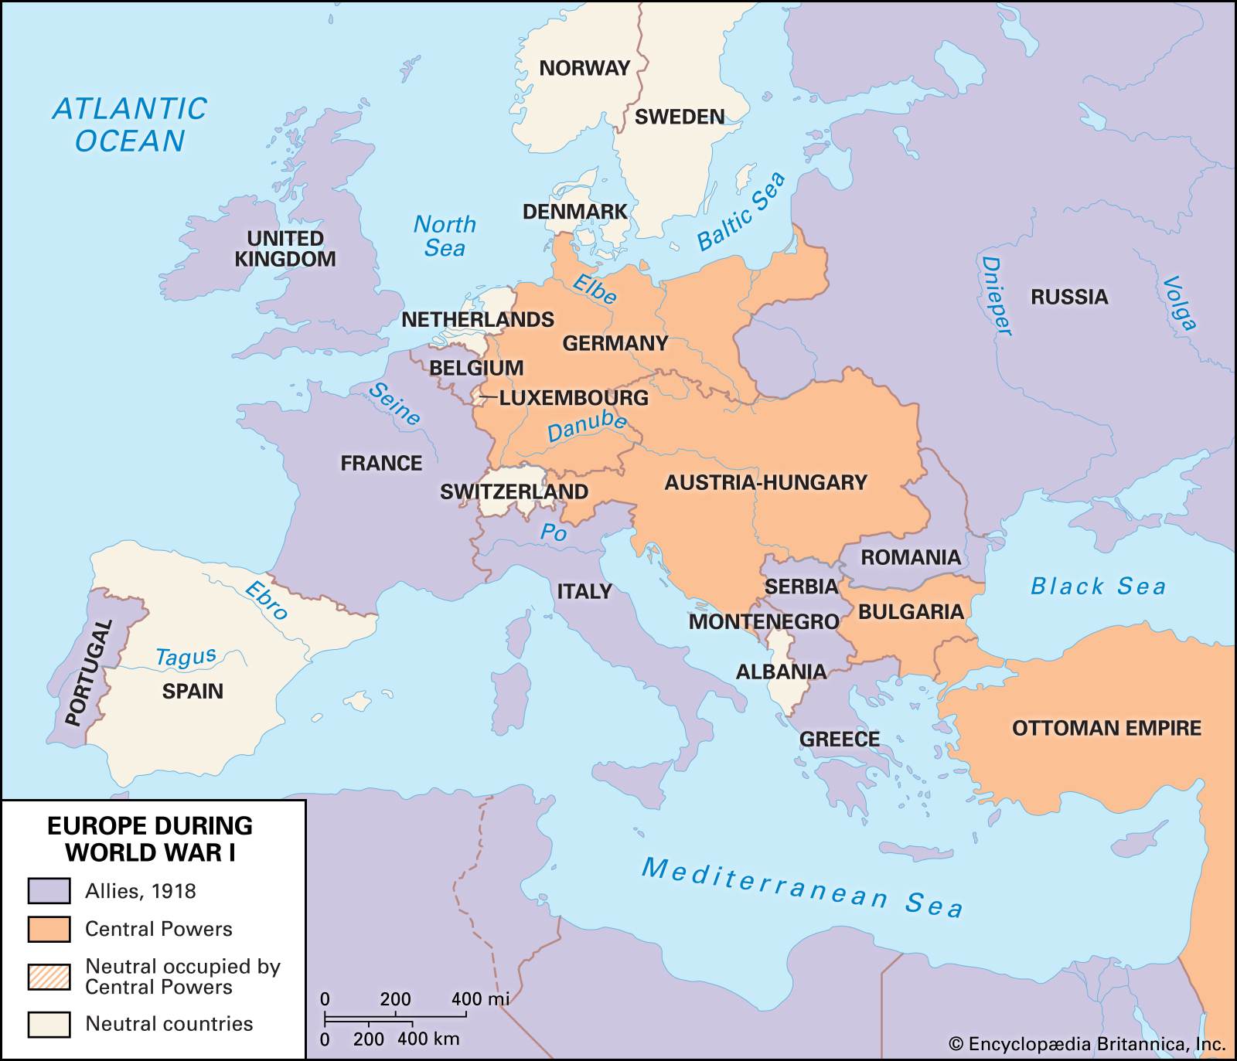
Regents global history and geography
World war i

Slide 2
Brief Overview
New York Social Studies Framework Connection
Key Social Studies Terms to Look for:
10.5 UNRESOLVED GLOBAL CONFLICT (1914–1945): World War I and World War II led to geopolitical changes, human and environmental devastation, and attempts to bring stability and peace.
(Standards: 2, 3, 4, 5; Themes: TCC, GEO, GOV, CIV, TECH, EXCH)
Militarism
Nationalism
Alliances
Imperialism
Trench warfare
Reparations
Self-determination
Treaty of Versailles
League of Nations

Slide 3
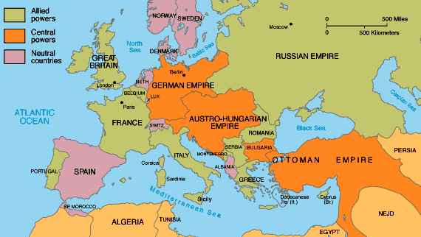
World War I (1914-1918)
World War I was a global military conflict that was fought mainly in Europe

Slide 4
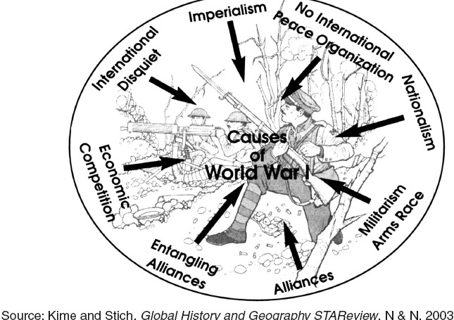
World War I (1914-1918)
KEY CAUSES (REASONS)
Militarism- Countries in Europe (especially Germany and Britain) built up their armies and their supply of weapons in the late 1800s.
Alliances- Countries in Europe divided themselves into two military alliances
Imperialism- Countries in Europe competed with each other to take over lands in Africa, Asia, and the Balkans (Southeastern Europe). This competition increased tension.
Nationalism- Ethnic groups in the Balkans (Southeastern Europe) wanted to gain independence (self-government) from Austria-Hungary and they were willing to fight for it.

Slide 5
Opposing Sides
World War I (1914-1918)
Central Powers
Germany
Austria-Hungary
Ottoman Empire
Allied Powers
Britain
France
Russia
Italy (first remained neutral but joined later)
United States (joined in 1917)

Slide 6
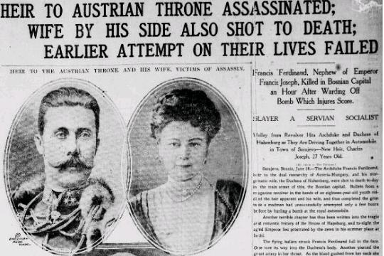
World War I (1914-1918)
KEY CAUSES (REASONS)
The “Spark”
Assassination of Archduke Franz Ferdinand of Austria-Hungary by a Serbian nationalist
Austria-Hungary declared war on Serbia
Allies mobilize for war

Slide 7
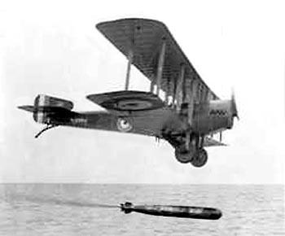
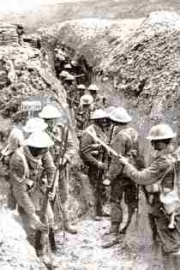
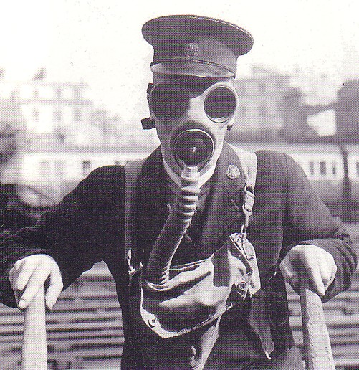
An Industrialized War
World War I (1914-1918)
New technology changed the methods of warfare greatly
Automatic machine gun
Tank
Submarine (U-boats)
Airplane
Poison gas
Gas mask
Trench warfare

Slide 8
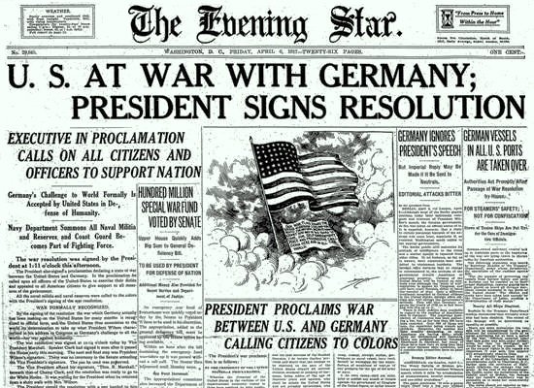
Major Turning Points of the War
World War I (1914-1918)
Entry of the United States
Tried to remain neutral, sent supplies to Allies
1917- Germany started unrestricted submarine warfare, meaning it attacked any ships in the Atlantic
Began attacking American ships
Russian Withdrawal
Russian Revolution began in 1917, they had to concentrate on problems at home

Slide 9
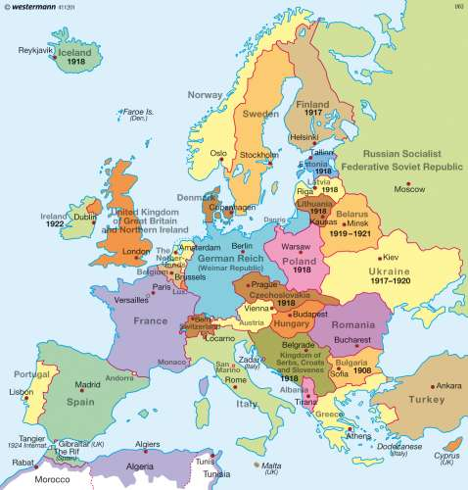
World War I (1914-1918)
After WWI, there were many more nations which were carved out of the Ottoman Empire and Austria-Hungary
KEY EFFECTS (RESULTS)
In order to provide the people of Eastern Europe with self-determination (the right of ethnic groups to create their own governments), Austria-Hungary and the Ottoman Empire were broken apart and much of the land was used to create new nations

Slide 10
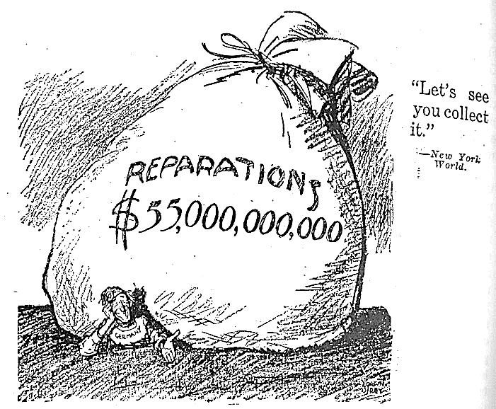
World War I (1914-1918)
Treaty of Versailles- This was the Treaty that ended World War I. NOTE: The key thing to remember is that the treaty severely punished Germany in a number of ways:
Germany was forced to accept blame (guilt) for causing World War I.
Germany was forced to pay 30 billion dollars in war reparations (money for damages caused during the war)
Germany had to reduce (decrease) the size of its military
Germany was forced to give up some of its lands

Slide 11
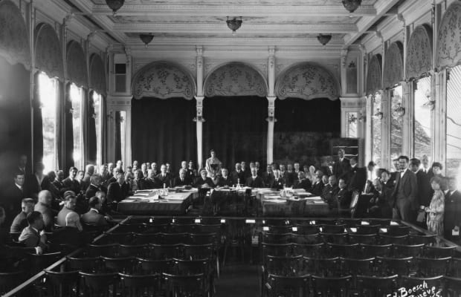
World War I (1914-1918)
KEY EFFECTS (RESULTS)
More than 8.5 million people died
Economic losses
Many nations were dissatisfied with the results of the war
The League of Nations was formed
U.S. did not join, weakening the League

