Slide 1
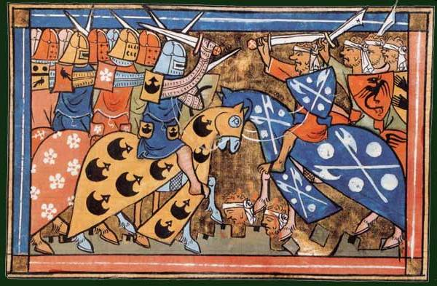
Early world history
The crusades and the black death

Slide 2
Brief Overview
New York Social Studies Framework Connection
Key Social Studies Terms to Look for:
9.6 SOCIAL AND CULTURAL GROWTH AND CONFLICT: During the postclassical era, the growth of transregional empires and the use of trade networks influenced religions and spread disease. These cross-cultural interactions also led to conflict and affected demographic development.
(Standards: 2, 3, 4; Themes: TCC, GEO, GOV, ECO, EXCH)
Crusade
Bubonic Plague (Black Death)

Slide 3
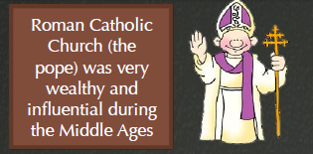

Slide 4
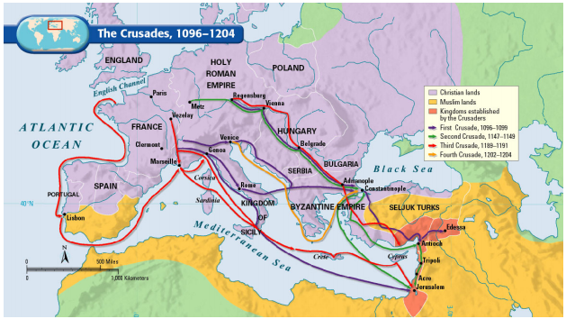

Slide 7
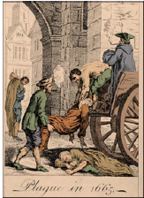

Slide 8
