Slide 1
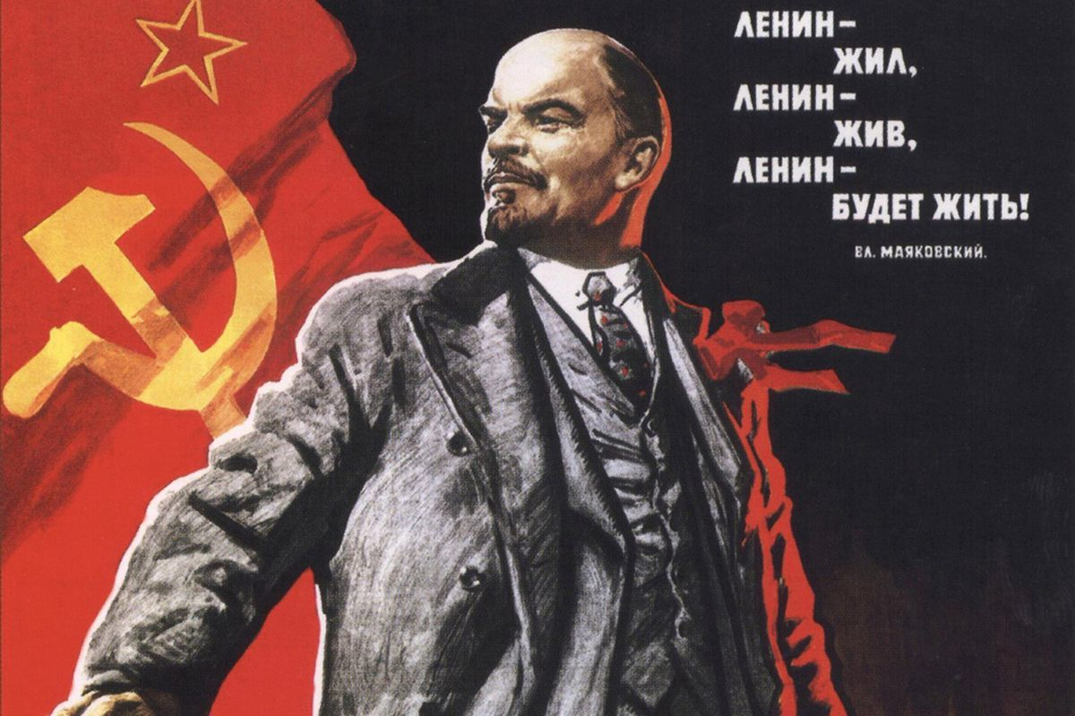
Regents global history and geography
Russian revolution

Slide 2
Brief Overview
New York Social Studies Framework Connection
Key Social Studies Terms to Look for:
10.5 UNRESOLVED GLOBAL CONFLICT (1914–1945): World War I and World War II led to geopolitical changes, human and environmental devastation, and attempts to bring stability and peace.
(Standards: 2, 3, 4, 5; Themes: TCC, GEO, GOV, CIV, TECH, EXCH)
Revolution
Soviet
Bolshevik
New Economic Policy

Slide 3
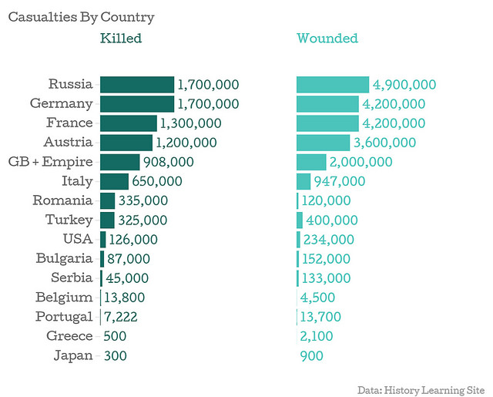
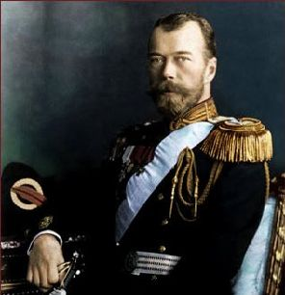
BOLSHEVIK REVOLUTION
KEY CAUSES
Like all political (government) revolutions, the Russian Revolution took place because the people of Russia were unhappy with their government. People were unhappy for several reasons
World War I- Russia suffered many casualties (injuries and death) in the war. World War I also created food shortages at home (people were starving)
Czar Nicholas II- He was the ruler of Russia at the time. People thought that he abused his power by denying (taking away) the rights of the people

Slide 4
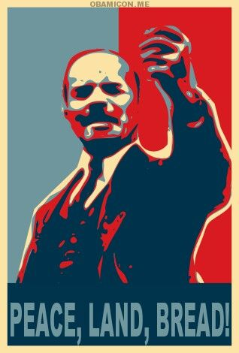
BOLSHEVIK REVOLUTION
BOLSHEVIKS
This was the radical (extreme) socialist group that was leading the Russian Revolution
The leader of the Bolsheviks was a man named Vladimir Lenin
Lenin and the Bolsheviks gained the support of the Russian people by promising to provide them with “Peace, Land, and Bread.”
This slogan meant that they would take Russia out of WWI, give land to peasants, and feed everyone

Slide 5
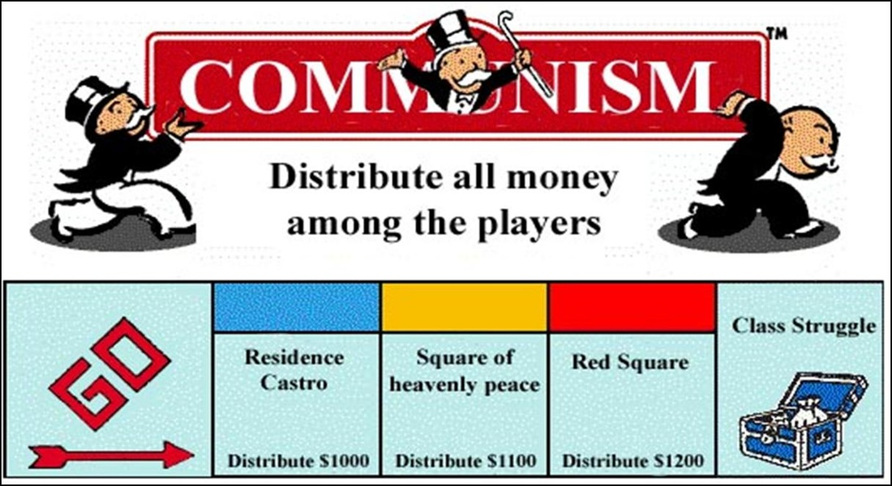
BOLSHEVIK REVOLUTION
KEY EFFECTS
Civil War between Lenin’s “Reds” and “Whites”- those loyal to Czar Nicholas
Czar Nicholas II was executed
Lenin and the Bolsheviks (Communists) came to power in Russia
Russia became a Communist nation

Slide 6
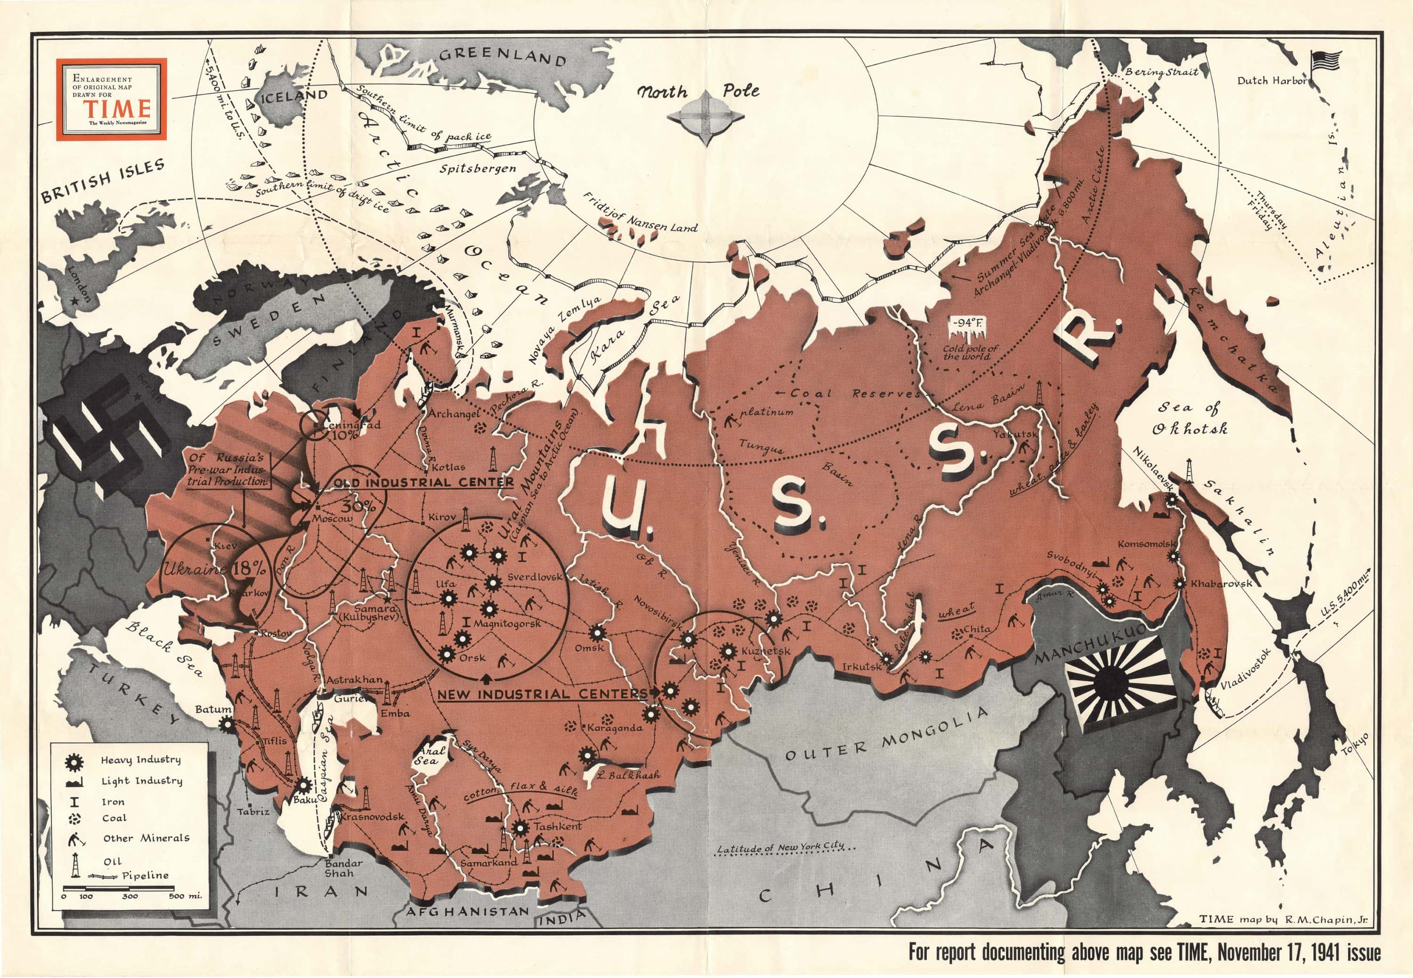
LENIN’S GOVERNMENT
BOLSHEVIK REVOLUTION
One Party Government
Communist Party was only legal party
New Economic Policy (NEP)
Part capitalist and socialist
Government owned large industry, banks and foreign trade
Peasants owned their farms and small industries were privately owned
The Soviet Union
Lenin and the Communists has gained control of much of the old Russian Empire
Created Union of Soviet Socialist Republics, also called the Soviet Union
Russia controlled the other states in the Soviet Union

