Slide 1
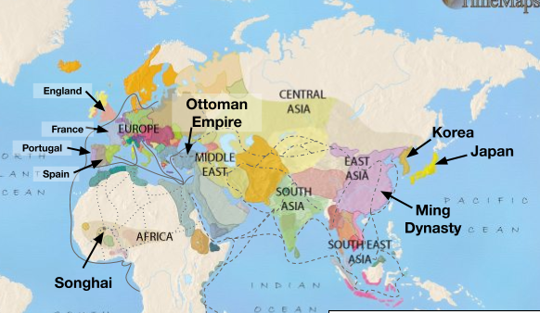
Early world history
The Ottoman and Ming Pre-1600

Slide 2
Brief Overview
New York Social Studies Framework Connection
Key Social Studies Terms to Look for:
9.7 THE OTTOMAN EMPIRE AND THE MING DYNASTY PRE-1600: Islam, Neo-Confucianism, and Christianity each influenced the development of regions and shaped key centers of power in the world between 1368 and 1683. The Ottoman Empire and the Ming Dynasty were two powerful states, each with a view of itself and its place in the world.
(Standards: 2, 3, 4, 5; Themes: ID, MOV, GEO, SOC, GOV, EXCH)
Sultan
Janissaries
Civil service exams

Slide 3
The ottomans
The Ottomans were a Muslim Turkish-speaking nomadic people who migrated from Central Asia in northwestern Asia Minor. They quickly conquered other societies and expanded their empire.

Slide 4
The ottomans
1326: A leader named Osman and his Turkish warriors (Ottomans) took over areas of Asia Minor and the Balkan Peninsula in Eastern Europe near the Byzantine Empire.

Slide 5
The ottomans
1453: Under the leader, Mehmet II, the Ottomans continued to expand and they captured the capital of the Byzantine Empire, Constantinople.
Constantinople was renamed Istanbul and became the new capital of the Ottoman Empire.
Hagia Sophia, a church, was turned into a mosque.
After a 54 day siege and using a 27-foot cannon hauled by oxen and an advanced army with muskets [guns], Constantinople fell to the Ottomans.

Slide 6
The ottomans
Accomplishments:
Took on bold military campaigns that increased the amount of territory controlled by the Ottomans
Increased naval strength which allowed them to conquer parts of North Africa
Oversaw achievements of Ottoman civilization in the fields of law, literature, art, and architecture
Built strong fortresses to defend his territories
Adorned and modernized the cities of the Islamic world (including Mecca, Damascus, and Baghdad) with mosques, bridges, aqueducts, and other public works
Suleiman the Magnificent
1520-1566: The Ottoman Empire had a golden age under the sultan named Suleiman.
The Ottomans called Suleiman “The Lawgiver” and Europeans called him “The Magnificent.”
Suleiman also developed laws and enforced the Islamic law of sharia.

Slide 7
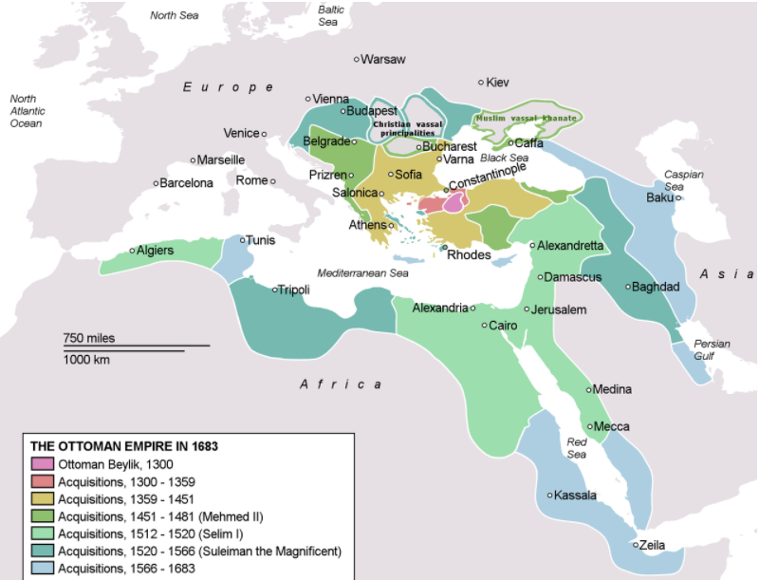
The Ottomans
Janissaries
Elite force of the Ottoman army

Slide 8
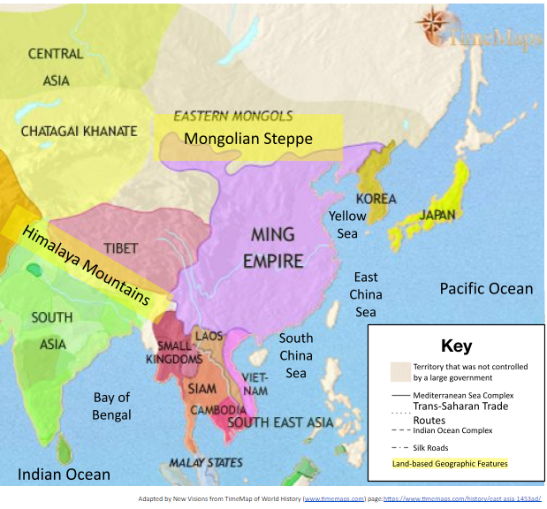

Slide 9
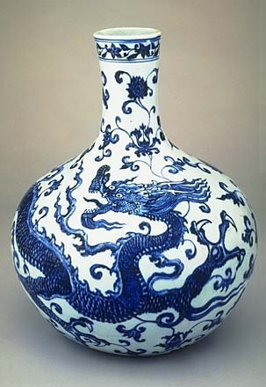
Ming china
Chinese pushed out Mongols and founded new dynasty in 1368
Restored civil service system
Encouraged Confucian learning
Economic prosperity
Restricted foreign trade
Cultural diffusion- Korea, Japan, Southeast Asia

Slide 10
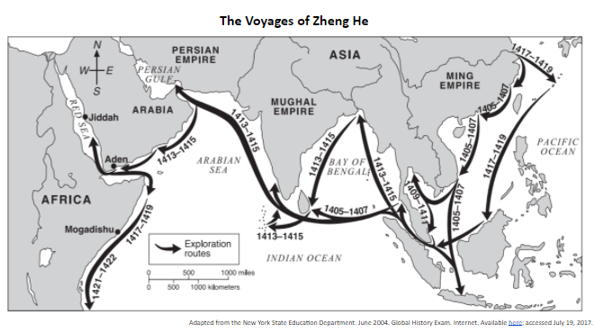
Ming china
Voyages of Zheng He
Ming rulers sent explorers out
Zheng He- most famous admiral
Sent to promote trade and collect tribute from lesser powers
Explored East Africa and Southeast Asia
Showed power of Chinese

