Slide 1
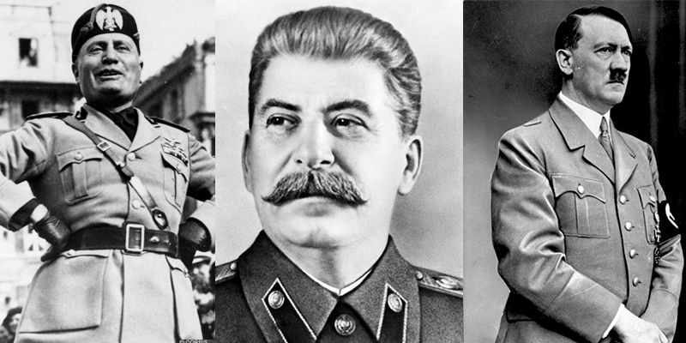
Regents global history and geography
Between the wars

Slide 2
Brief Overview
New York Social Studies Framework Connection
Key Social Studies Terms to Look for:
10.5 UNRESOLVED GLOBAL CONFLICT (1914–1945): World War I and World War II led to geopolitical changes, human and environmental devastation, and attempts to bring stability and peace. (Standards: 2, 3, 4, 5; Themes: TCC, GEO, GOV, CIV, TECH, EXCH)
10.5d Nationalism and ideology played a significant role in shaping the period between the world wars.
Totalitarian
Command economy
Five-year plan
Collective
Zionism
Civil disobedience
Fascism
Guomindang
Long March

Slide 3
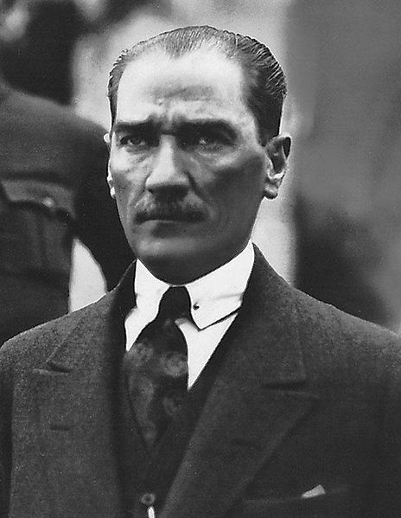
Nationalism Between World Wars (1919-1939)
TURKEY
After WWI, Ottoman Empire fell apart
Kemal Ataturk came to power
He is considered a nationalist because he made many changes in order to strengthen Turkey
Westernization- Imitated the customs and traditions of European countries (for example, people in Turkey were required to dress like Western Europeans)
Democracy- Gave people a voice in government (even women were given the right to vote).
Eliminated many Muslim traditions and customs to create a secular, or non-religious, nation

Slide 4
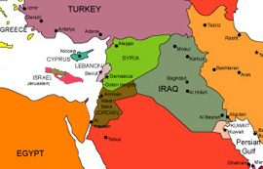
Nationalism Between World Wars (1919-1939)
ZIONISM
Zionism is the name for the nationalist movement of Jews
Goal was to create a Jewish homeland after World War I
Jews wanted an area called Palestine
Palestinians (those living in Palestine) and Jews constantly fought and still fight today

Slide 5
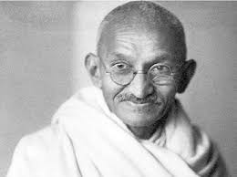
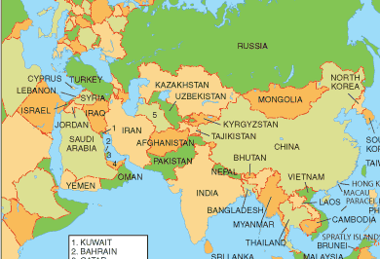
Nationalism Between World Wars (1919-1939)
INDIA
By 1919, India had been a British colony for 200 years
Mohandas Gandhi
Nationalist leader of India
Used non-violent techniques called civil disobedience or passive resistance
Salt March- event where Gandhi protested British taxes on salt by leading a peaceful march to the sea to make his own salt
Boycott- Gandhi encouraged the people of India to boycott (stop buying) British products (like clothing) that were sold in India

Slide 6
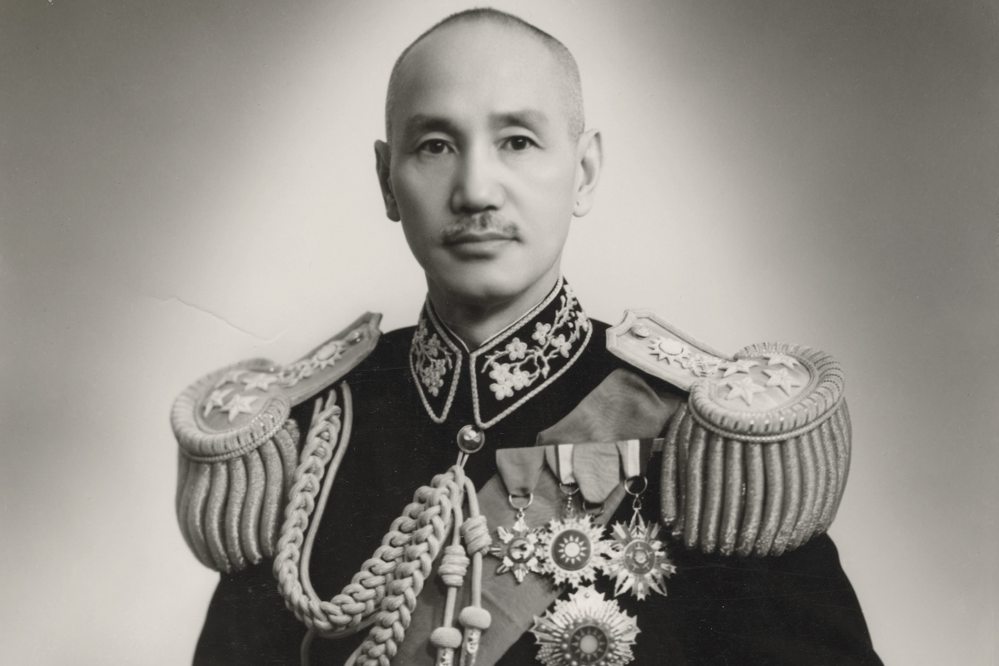
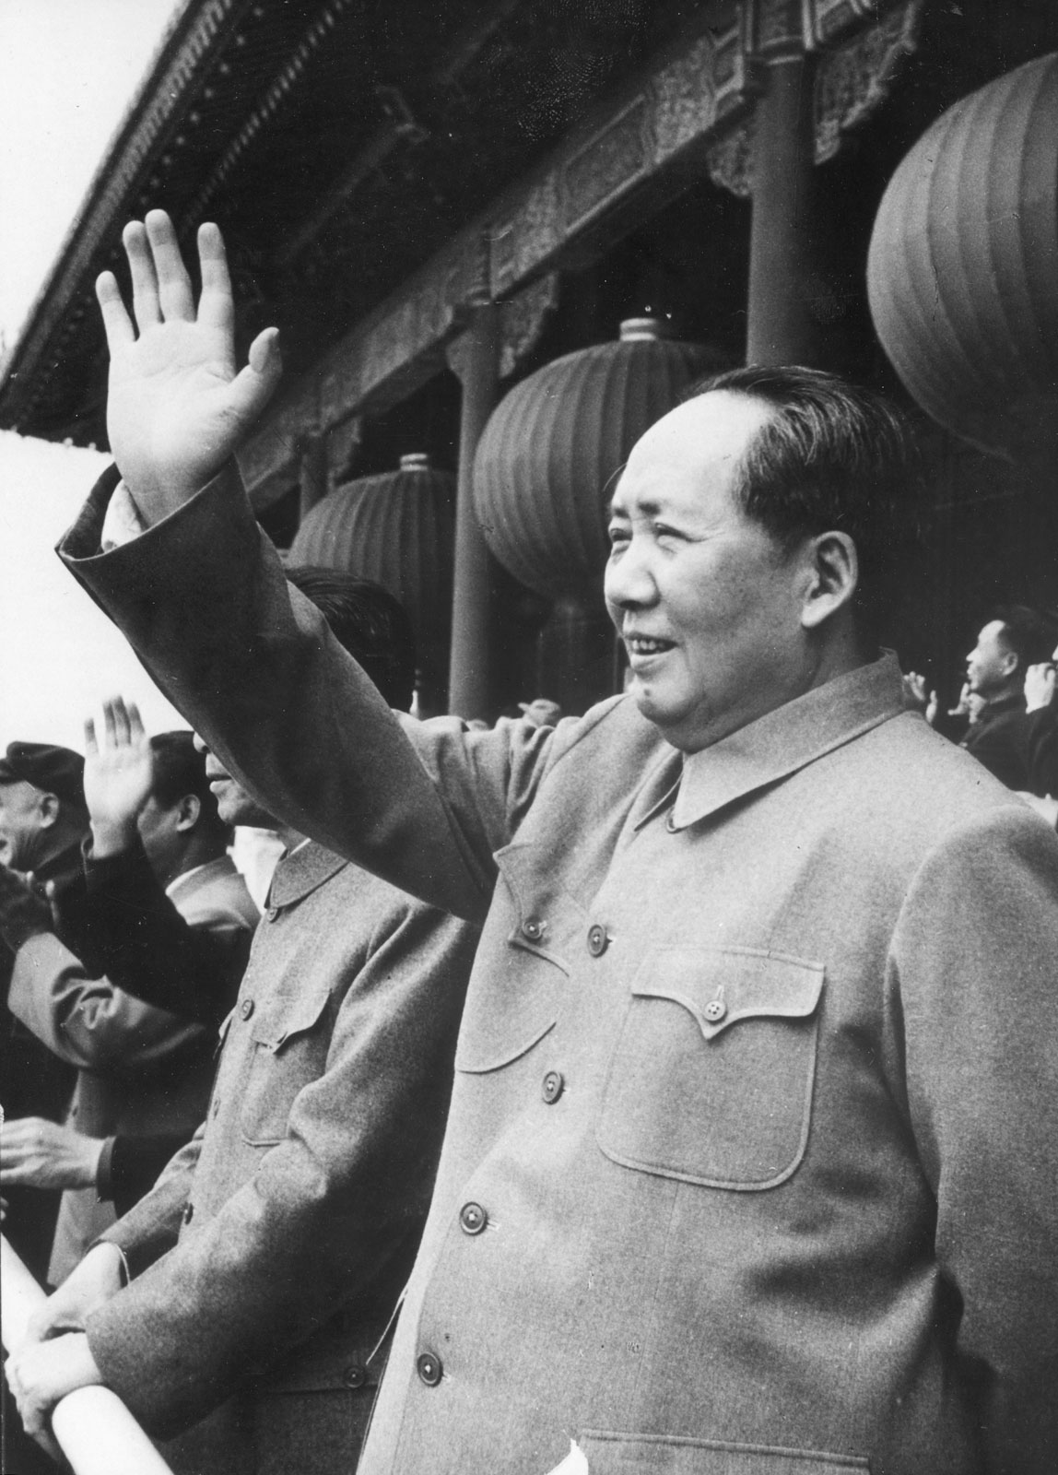
Nationalism Between World Wars (1919-1939)
CHINA
Civil War
Guomindang (Nationalist Party)
Led by Sun Yixian
Wanted to set up a republic based on the “Three Principles of the People” (nationalism, democracy, and livelihood)
Jiang Jieshi took control in 1925 and was supported by middle class businessmen
Communist Party
Led by Mao Zedong
Appealed to peasants by promising to redistribute land to them and offering healthcare and schooling
Long March- Mao fled from the Guomindang and retreated to northern China
Civil war ended when Japan invaded China

Slide 7
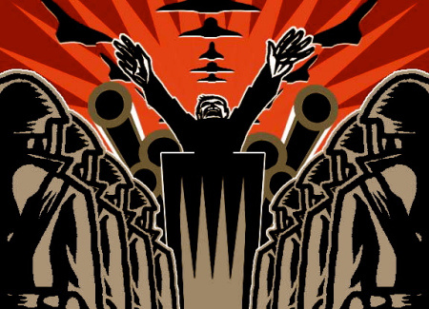
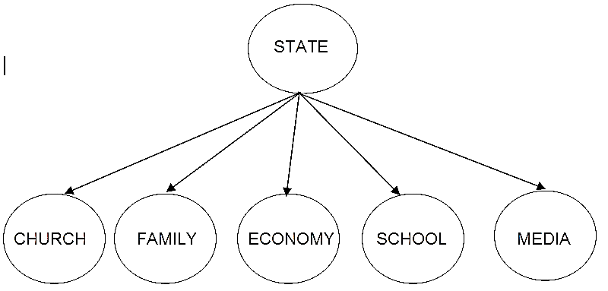
Introduction to Totalitarian Dictatorships
Totalitarian dictatorships are governments where one ruler has complete control over ALL aspects of life within a country.
They control the political, social, and economic features of a nation.

Slide 8
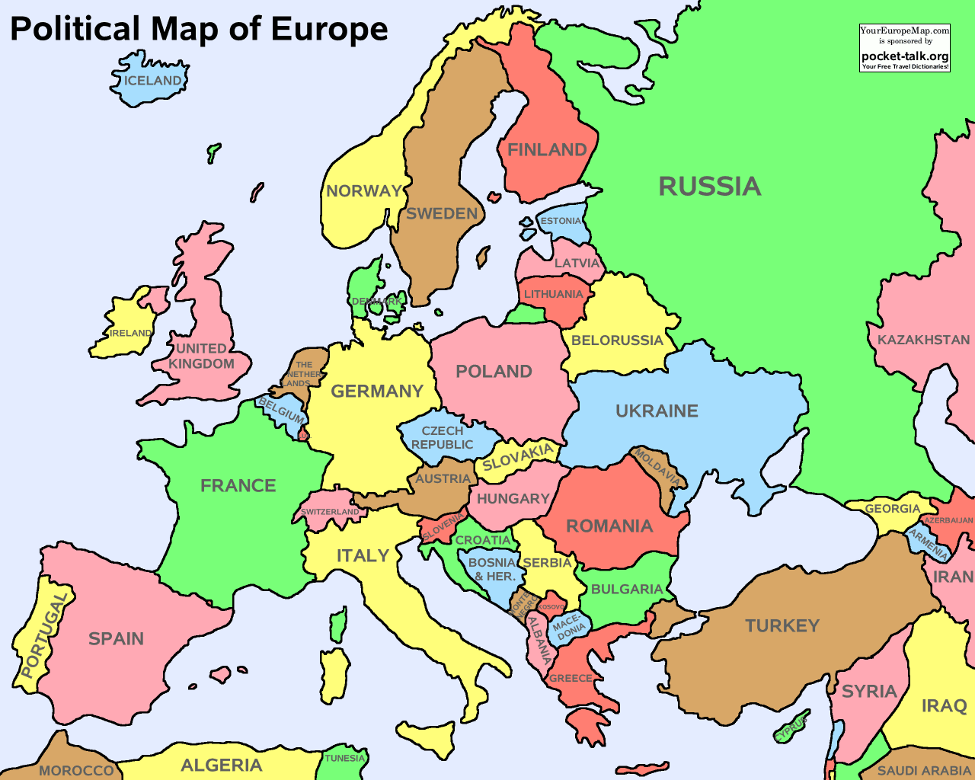
Introduction to Totalitarian Dictatorships
After World War I, totalitarian dictatorships were established in 3 countries under 3 men:
The Soviet Union = Joseph Stalin
Germany = Adolf Hitler
Italy = Benito Mussolini

Slide 9
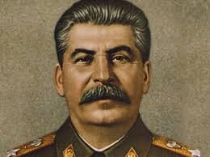
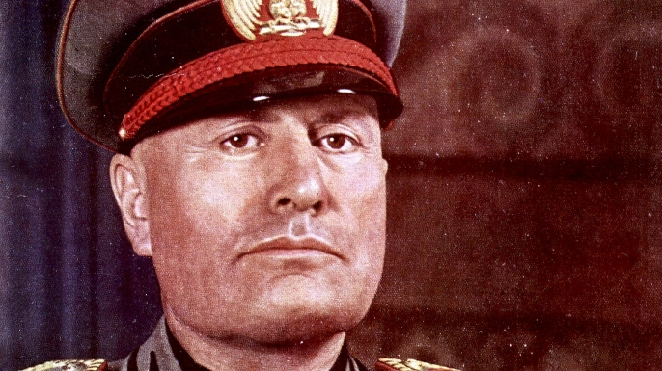
Introduction to Totalitarian Dictatorships
All 3 totalitarian dictatorships had similarities:
Censorship- They ended freedom of speech in their countries. The governments strictly controlled the media (i.e.- newspapers, radio, and television) of their nation
One political party- Only the political party of the dictators was allowed to exist
Stalin = Communists
Mussolini = Fascists
Hitler’s = Nazis
People were expected to put the needs of the state (their country) before their own needs.
They eliminated opposition (people against them) by using a secret police force
They used propaganda- Messages that were meant to influence the way people thought

Slide 10
Introduction to Totalitarian Dictatorships
NOTE: for the Regents you need to know that both Hitler and Mussolini were able to come to power because Germany and Italy were facing severe economic problems such as inflation (rising prices) and unemployment (many people had no job).
The people of Germany and Italy believed that Hitler and Mussolini could solve these problems
I CAN SOLVE YOUR PROBLEMS!
I’LL GIVE YOU JOBS AND STABILITY!
I CAN SOLVE YOUR PROBLEMS!
I’LL GIVE YOU JOBS AND STABILITY!
MUSSOLINI
HITLER

Slide 11
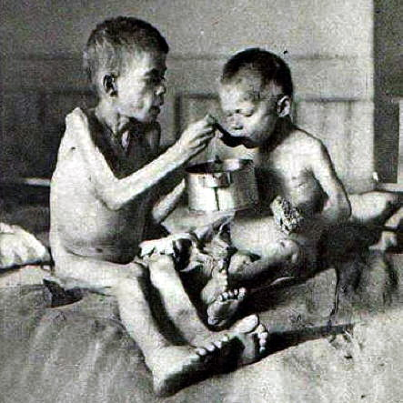
Totalitarianism under Joseph Stalin
Stalin was the Communist dictator of the Soviet Union
You should know these effects:
Command Economy = government controls everything
Five-Year Plans = increase factories
Collectivization = take control of farms
Ukrainian famine = blockaded Ukraine from food and millions died

