Slide 1
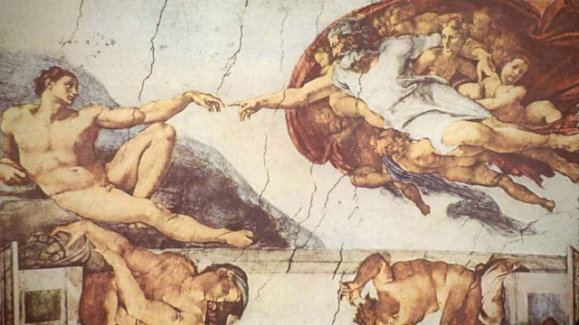
Early world history
Renaissance and Protestant Reformation

Slide 2
Brief Overview
New York Social Studies Framework Connection
Key Social Studies Terms to Look for:
9.9 TRANSFORMATION OF WESTERN EUROPE AND RUSSIA: Western Europe and Russia transformed politically, economically, and culturally ca. 1400–1750. This transformation included state building, conflicts, shifts in power and authority, and new ways of understanding their world.
(Standards: 2, 3, 5; Themes: ID, MOV, TCC, GOV, CIV, TECH, EXCH)
Renaissance
Humanism
Secular
Patron
vernacular
Protestant Reformation
95 Theses
indulgences

Slide 4
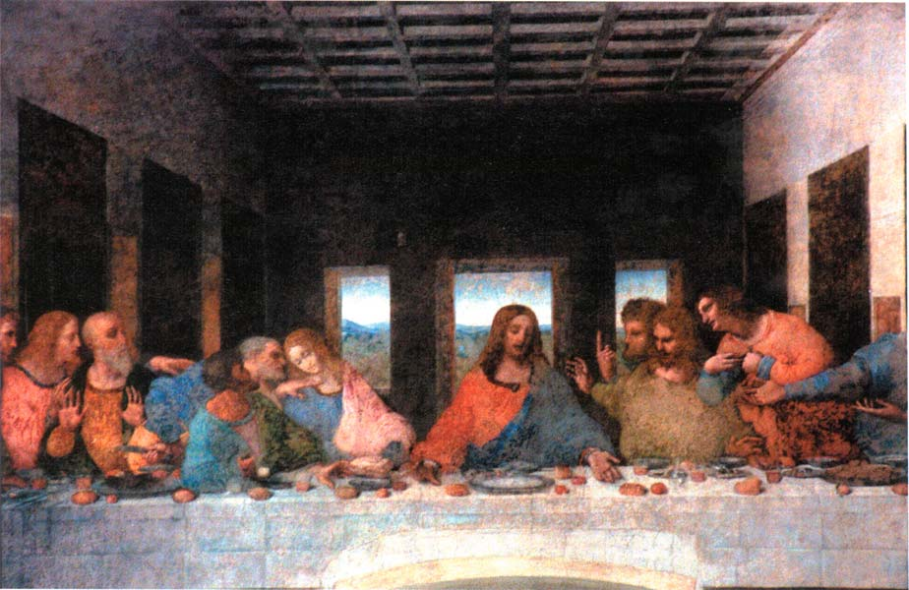
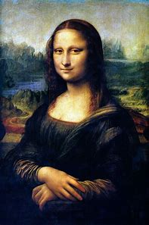
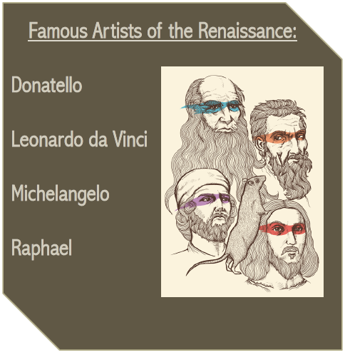
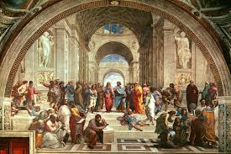
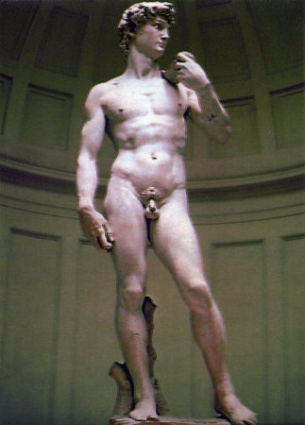
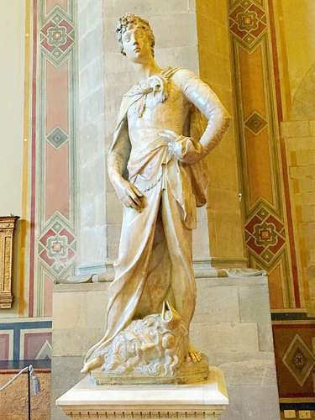

Slide 5
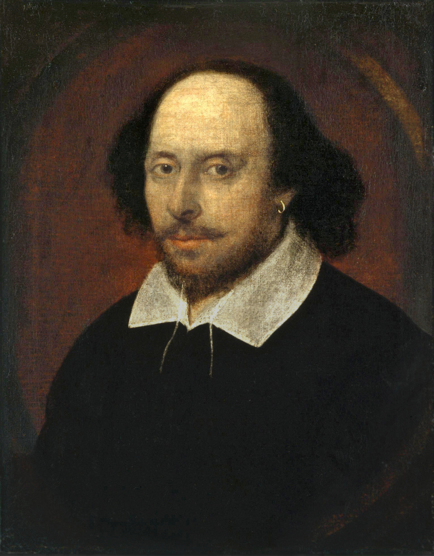
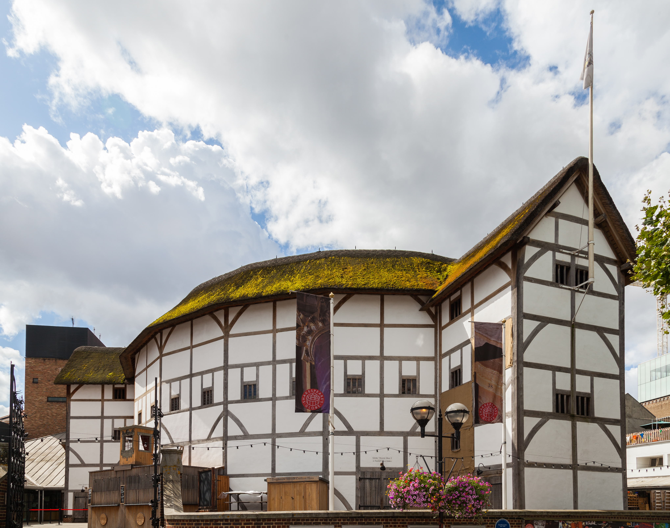
Shakespeare
Playwright of 37 well known plays
Ex. Romeo and Juliet, Hamlet, Taming of the Shrew
Timeless themes keep his plays relevant to modern times
Contributed over 1700 words to the English language
Ex. Bedroom, lonely, generous, heartsick, hurry, and sneak

Slide 6
