Slide 1
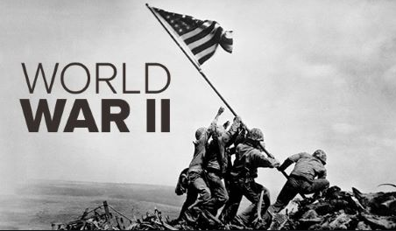
Regents global history and geography
World war ii

Slide 2
Brief Overview
New York Social Studies Framework Connection
Key Social Studies Terms to Look for:
10.5 UNRESOLVED GLOBAL CONFLICT (1914–1945): World War I and World War II led to geopolitical changes, human and environmental devastation, and attempts to bring stability and peace.
(Standards: 2, 3, 4, 5; Themes: TCC, GEO, GOV, CIV, TECH, EXCH)
Appeasement
Fascism
Munich Conference
Allied Powers
Axis Powers
D-Day
Holocaust
United Nations
Nuremberg Trials

Slide 3
Introduction to World War II (1939-1945)
World War II was the second major global conflict of the twentieth century
It was fought mainly in Europe and on the islands of the Pacific Ocean
GREAT BRITAIN
SOVIET UNION
USA
GERMANY
JAPAN
ITALY

Slide 4
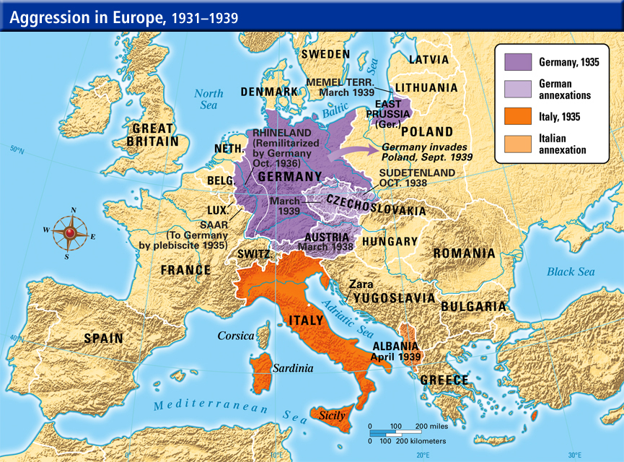
Events leading up to WWII
Japanese Aggression
Took over Korea, Manchuria for resources
Italian Aggression
Took over Ethiopia to create an empire
German Aggression
Bitter about Treaty of Versailles
Hitler built up the German military and drafted soldiers into the army.
Hitler placed soldiers in the Rhineland (an area between Germany and France).
Hitler took over the neighboring country of Austria and then Czechoslovakia

Slide 5
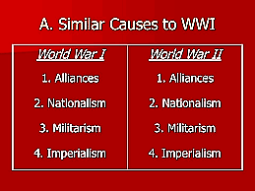
Events leading up to WWII
World War II took place mainly because very little was done early on to stop Hitler, Mussolini, or Japan
The League of Nations was an international organization created after World War I in order to prevent war
It failed to stop Hitler, Mussolini, or Japan from being aggressive
Appeasement- a policy where an aggressive nation is given what they want by other nations in order to avoid war
At the Munich Conference in Germany, Great Britain appeased Hitler by giving him control over Czechoslovakia
This led Hitler to demand even more land

Slide 6
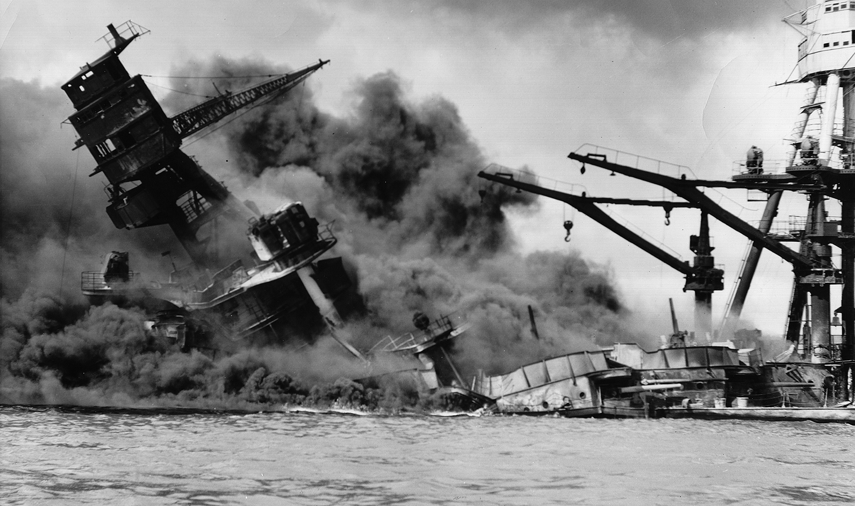
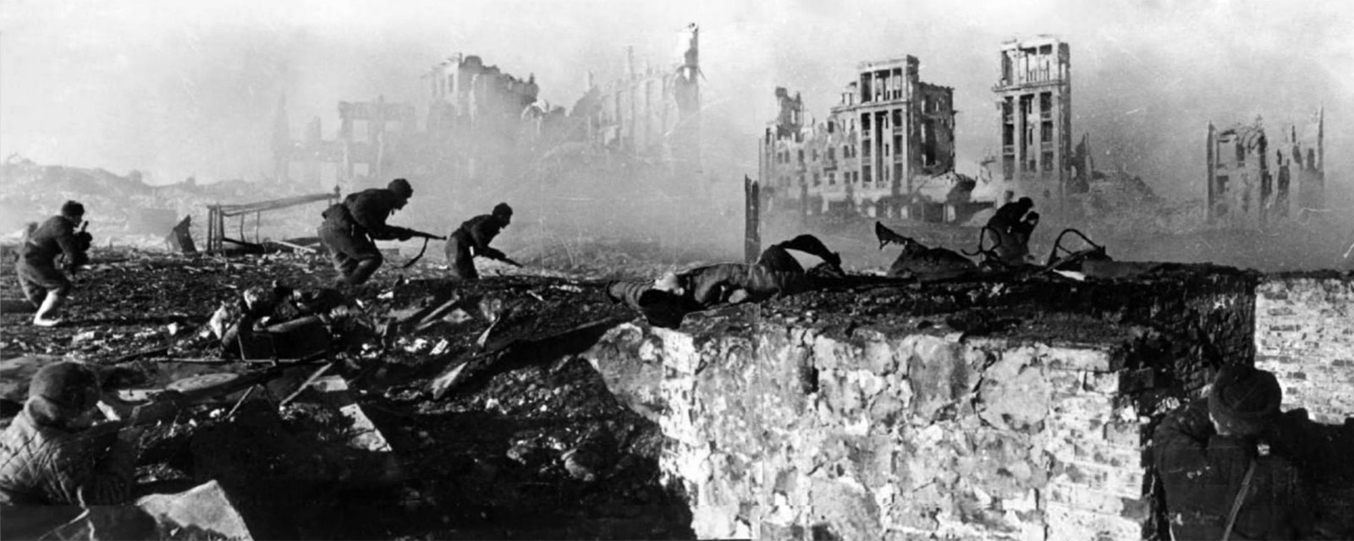
Key Events of World War II
Pearl Harbor
To stop Japanese aggression the U.S. banned the sale of war materials to Japan​
Angered by the ban, Japan launched surprise attack on Pearl Harbor- Dec. 7, 1941​ which caused the U.S. to enter the war
Battle of Stalingrad
Russian troops and a bad winter forced German troops to surrender in 1943​
Soviet troops pushed Nazis out and began advancing toward Germany

Slide 7
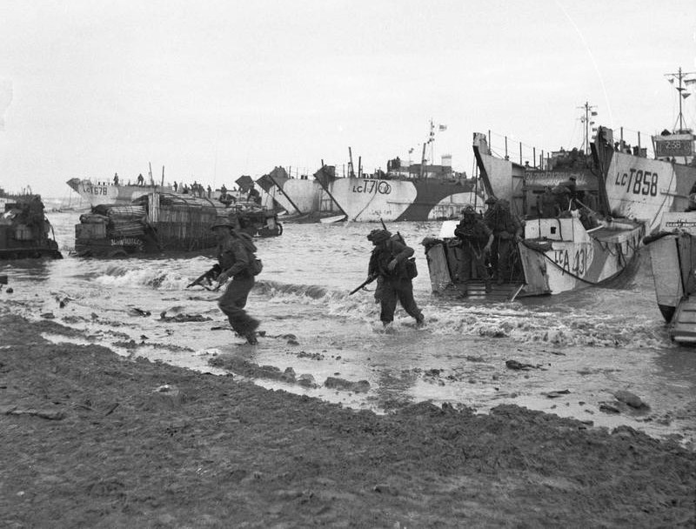
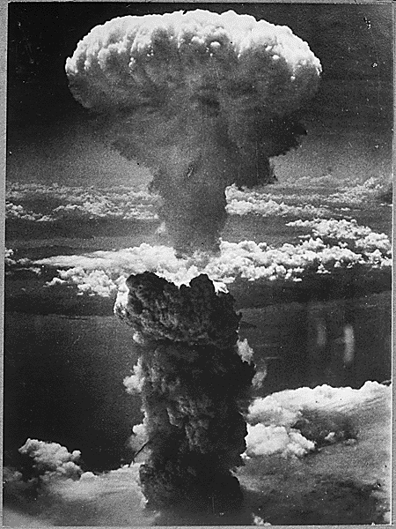
Key Events of World War II
D-Day Invasion- This was the beginning of the final Allied push against Germany
It resulted in the eventual defeat of Germany
Atomic bombing of Hiroshima and Nagasaki- This was the final event of World War II
The U.S. dropped two atomic bombs on Japan
Japan surrendered soon after.
The Holocaust
Hitler and the Nazis tried to kill all Jews in Europe
6 million Jews and 6 million non-Jews were killed during this event
Example of genocide (human rights violation)

Slide 8
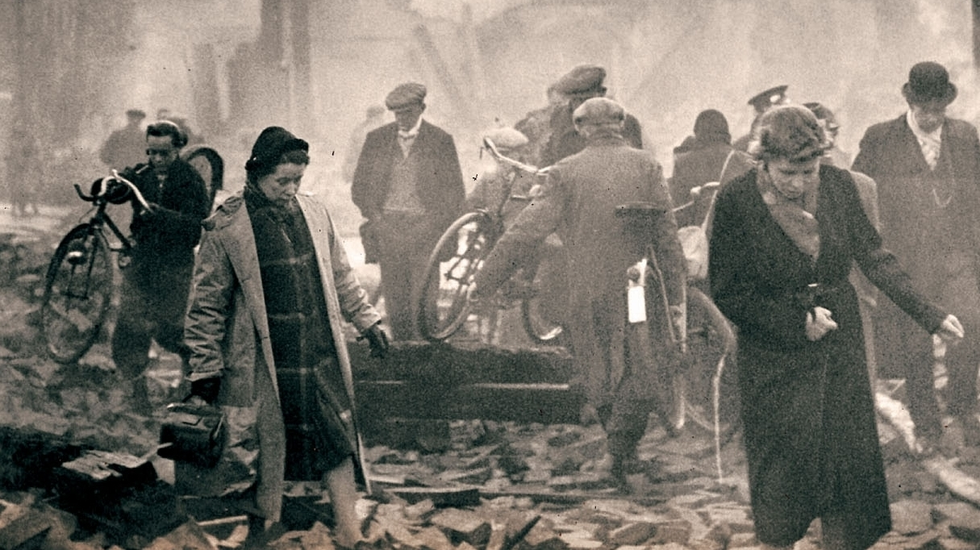
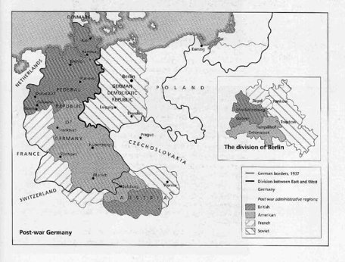
Effects (Results) of World War II
Human and Economic Losses
As many as 75 million people died
Many part of Europe and Asia were destroyed by the war
Occupied Nations
Germany was divided up among the Allies to Britain, France, U.S., and USSR​
France, Britain, and U.S. united their sections to create a democratic W. Germany​
E. Germany was controlled by Soviets and became Communist
U.S. occupied Japan

Slide 9
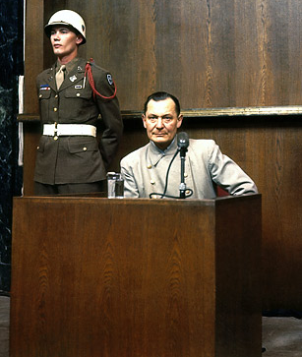
Effects (Results) of World War II
Formation of the United Nations
The United Nations is the organization that was created after World War II in order to solve international problems (like poverty and disease) and prevent future wars.
Nuremberg Trials
This is the court case where the surviving Nazis who helped Hitler carry out the Holocaust were put on trial
19 Nazi leaders were executed or sentenced to imprisonment as a result of “crimes against humanity” (i.e.- genocide)

