Slide 1
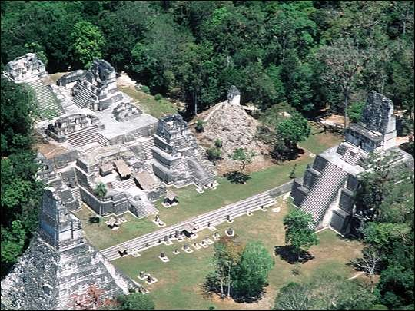
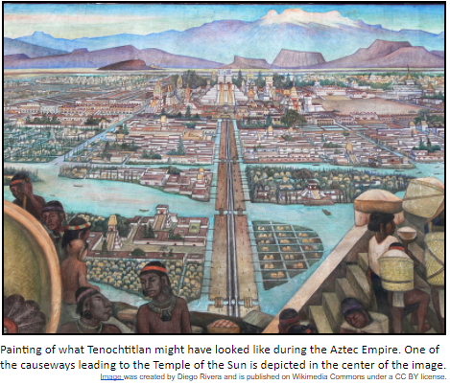
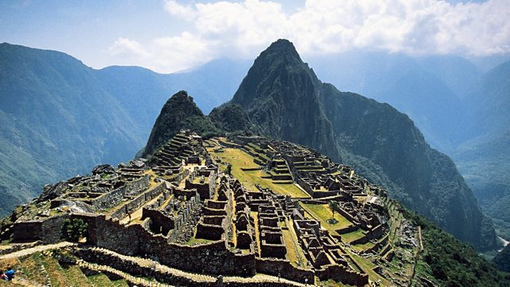
Early world history
Maya, Aztec, and inca

Slide 2
Brief Overview
New York Social Studies Framework Connection
Key Social Studies Terms to Look for:
9.8 AFRICA AND THE AMERICAS PRE-1600: The environment, trade networks, and belief systems influenced the development of complex societies and civilizations in Africa and the Americas ca. 1325–1600.
(Standards: 2, 3, 4, 5; Themes: ID, MOV, GEO, GOV, EXCH)
Chinampas
Terrace Farming

Slide 3
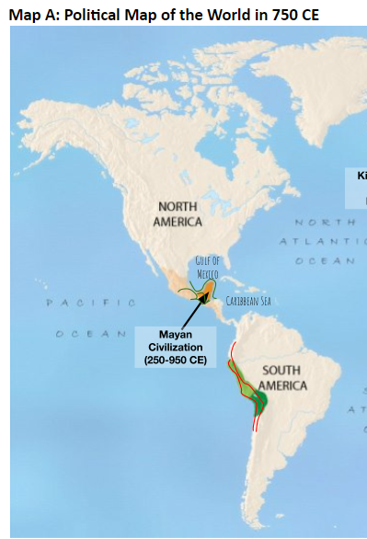
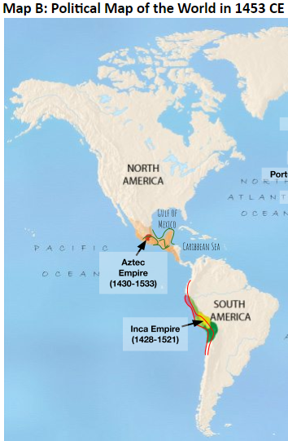

Slide 4
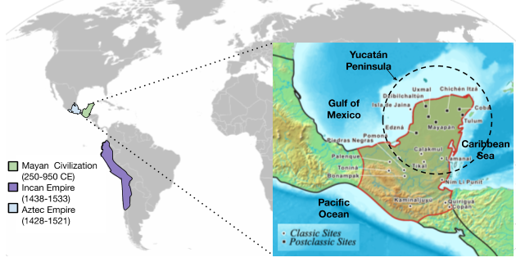
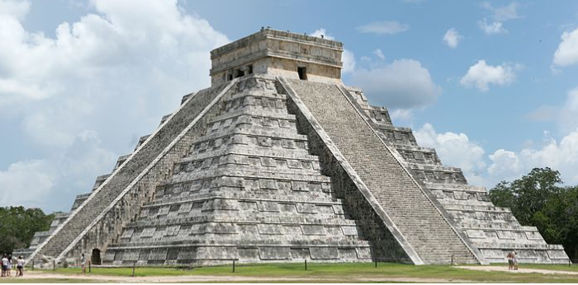

Slide 5
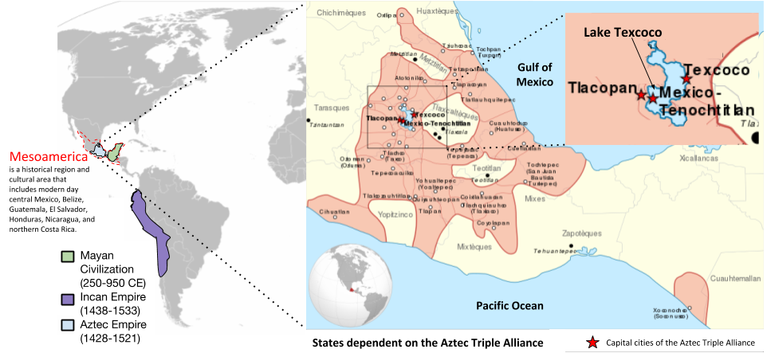

Slide 6
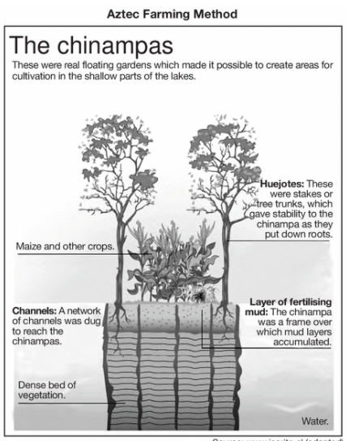
Tenochtitlan

Slide 7
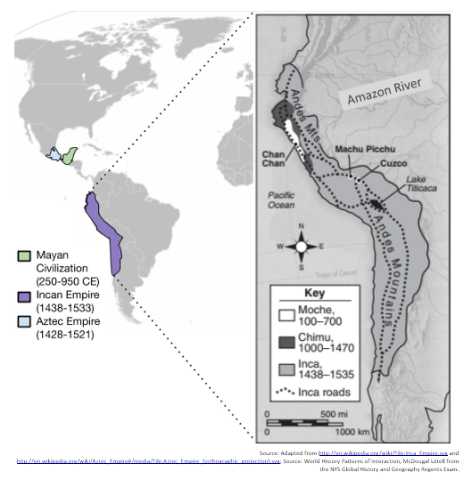

Slide 8
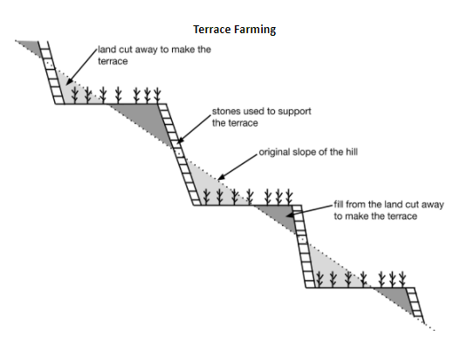
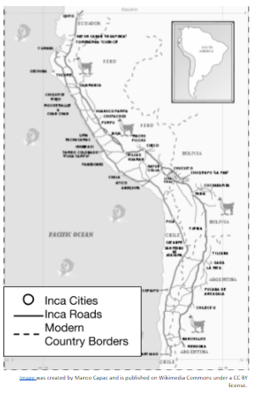
Inca Achievements

