Slide 1
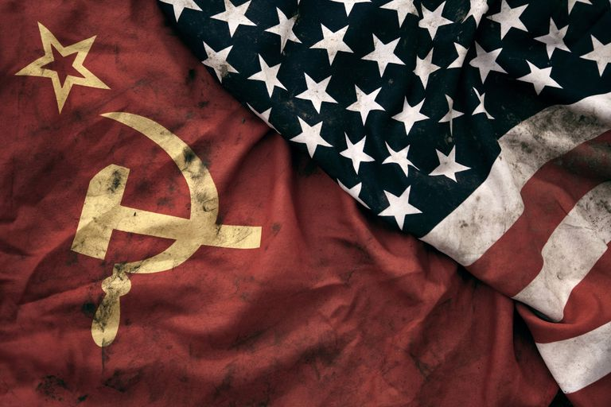
Regents global history and geography
The cold war

Slide 2
Brief Overview
New York Social Studies Framework Connection
Key Social Studies Terms to Look for:
10.6 UNRESOLVED GLOBAL CONFLICT (1945–1991: THE COLD WAR): The second half of the 20th century was shaped by the Cold War, a legacy of World War II. The United States and the Soviet Union emerged as global superpowers engaged in ideological, political, economic, and military competition.
(Standards: 2, 3, 4, 5; Themes: TCC, GOV, ECO, TECH, EXCH)
Iron curtain
Superpower
Satellite
Truman Doctrine
Containment
Marshall Plan
NATO
Warsaw Pact

Slide 3
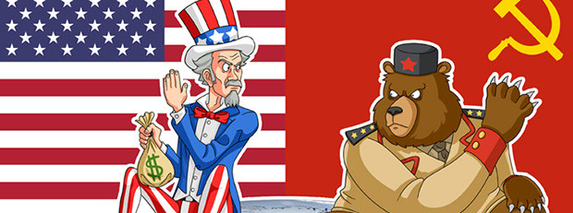
The Cold War (1945-1991)
The Cold War lasted nearly 50 years and was a continued state of tension and hostility between the United States (a democratic nation) and the Soviet Union (a communist nation) after World War II.
It is called a “cold” war because the United States and the Soviet Union never had an armed battle between the superpowers

Slide 4
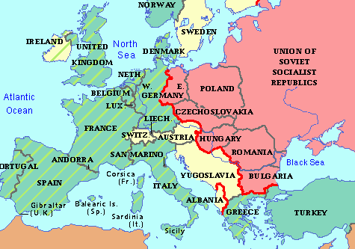
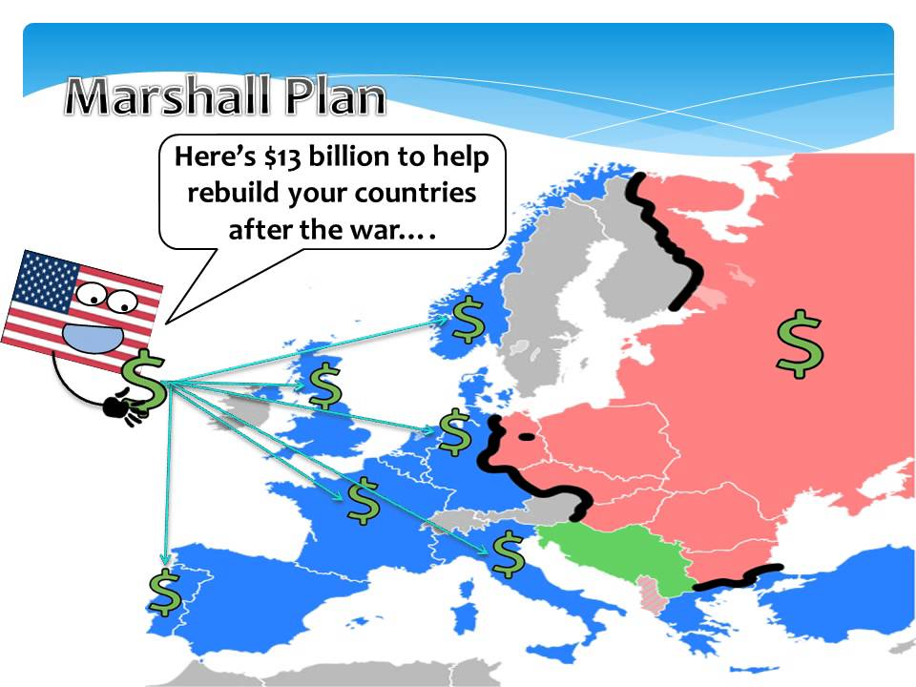
The Cold War (1945-1991)
KEY EVENTS
Soviet Union turned Eastern European nations into satellite nations
Iron Curtain- imaginary line dividing Europe
Containment- limiting communism to areas already under Soviet control
Truman Doctrine- economic and military program designed to help other nations resist Soviet aggression
Marshall Plan- economic aid package designed to strengthen democratic governments that had been destroyed by WWII

Slide 5
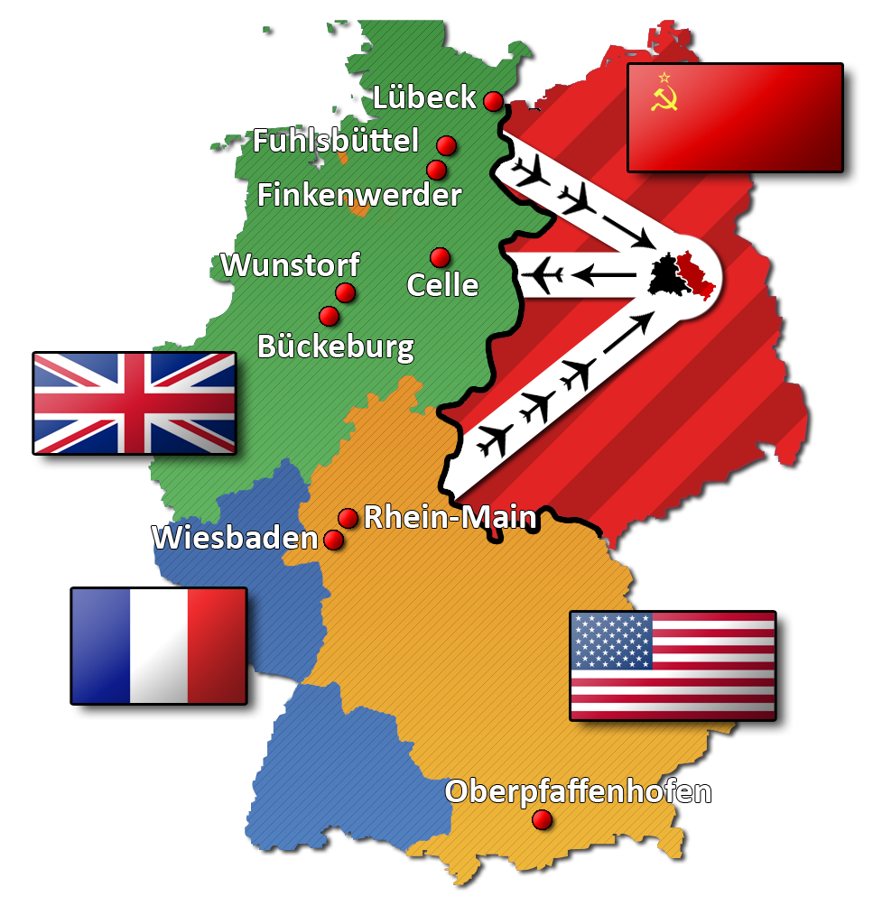
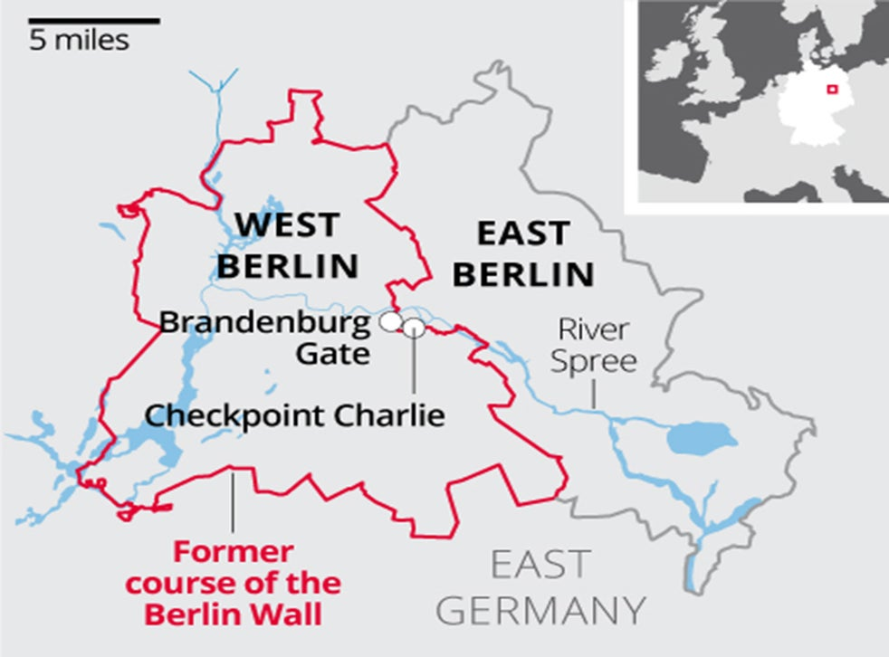
The Cold War (1945-1991)
KEY EVENTS
Berlin Airlift- Stalin hoped to force the Allies out of Berlin in 1948 by closing all land routes for bringing in supplies, so for almost a year the Allies airlifted supplies into West Berlin
Berlin Wall- Berlin (capital of Germany) was divided and the West was thriving while the Soviets were punishing the East
People were escaping East Germany by moving to West Berlin
In order to stop people from leaving, the Soviets built the Berlin Wall, eventually surrounding all of West Berlin- anyone trying to escape to West Berlin was shot

Slide 6
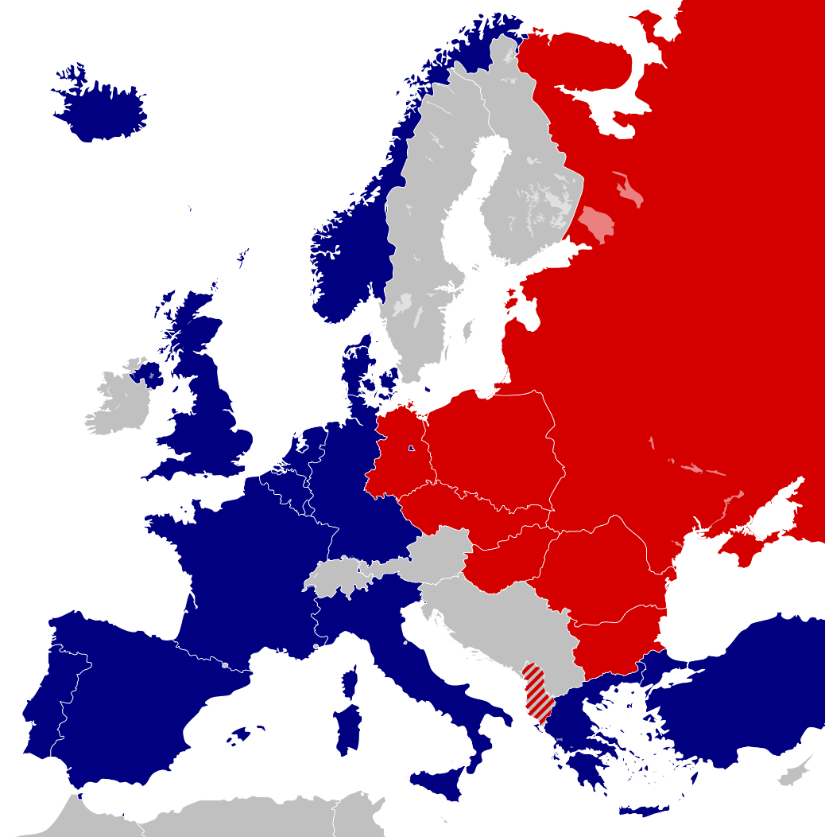
The Cold War (1945-1991)
KEY EVENTS
Military alliances
NATO (North Atlantic Treaty Organization)- military alliance between Western European countries plus the US and Canada
Warsaw Pact- Soviets responded to NATO by forming their own alliance with seven satellites in Eastern Europe
WARSAW PACT
NATO

Slide 8
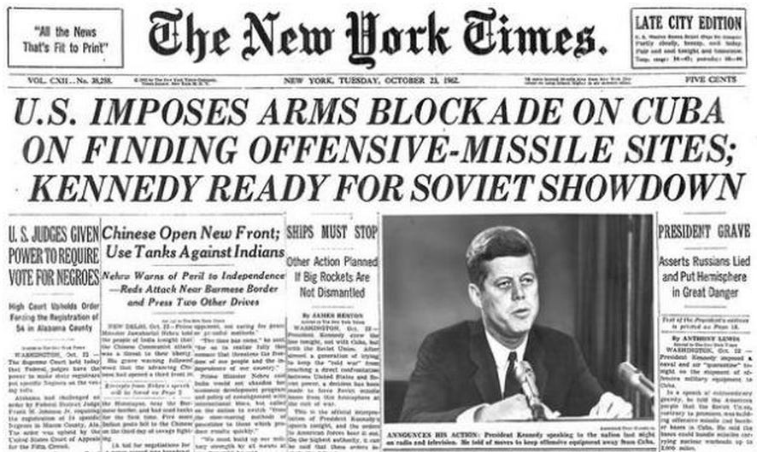
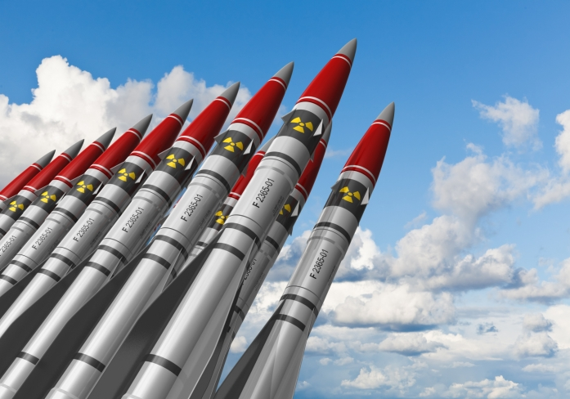
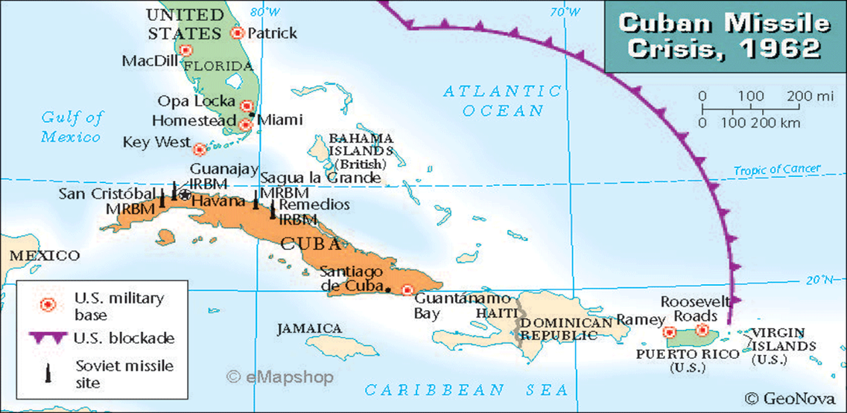
The Cold War (1945-1991)
KEY EVENTS
Cuban Missile Crisis
1961- Castro allowed Soviets to build nuclear missile sites in Cuba
1962- President Kennedy demanded removal of these missiles and ordered a naval blockade of Cuba
Khrushchev agreed to remove the missiles if US agreed they would not invade Cuba
Hungarian Revolution of 1956- When Hungary (a communist satellite controlled by the Soviet Union) tried to break away from Soviet control, the Soviet Union sent in the army and repressed (ended) the rebellion.
Arms Race

Slide 9
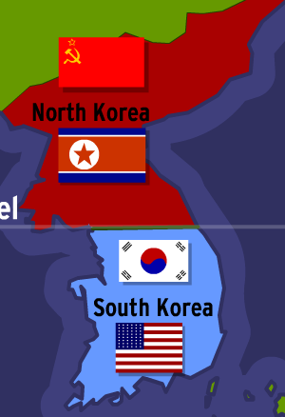
The Cold War (1945-1991)
Korean War
after WWII Korea was divided- Soviets occupied the North and US occupied the South
North Korean forces tried to unify the country under communist rule and invaded South Korea in 1950
Armistice was signed in 1953
Vietnam War
In 1954 Vietnam was temporarily divided and the northern half was ruled by a communist leader, Ho Chi Minh
American forces were sent to prevent Ho Chi Minh from uniting Vietnam under communist control
By 1975 US was unsuccessful and Vietnam was united under a communist government

