Slide 1
Regents global history and geography
Communism in china

Slide 2
Brief Overview
New York Social Studies Framework Connection
Key Social Studies Terms to Look for:
10.7 DECOLONIZATION AND NATIONALISM (1900–2000): Nationalist and decolonization movements employed a variety of methods, including nonviolent resistance and armed struggle. Tensions and conflicts often continued after independence as new challenges arose. (Standards: 2, 3, 4, 5; Themes: TCC, GEO, SOC, GOV, CIV,)
10.7d Nationalism in China influenced the removal of the imperial regime, led to numerous conflicts, and resulted in the formation of the communist People’s Republic of China.
Communism
Great Leap Forward
Cultural Revolution
Four Modernizations
One-Child Policy

Slide 3
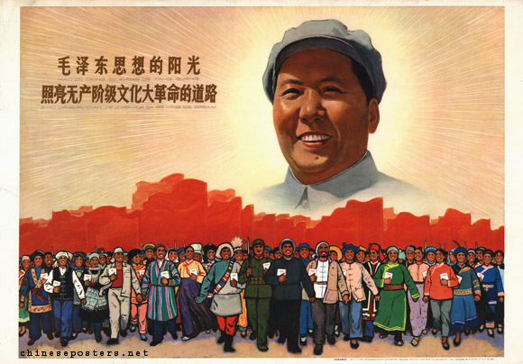
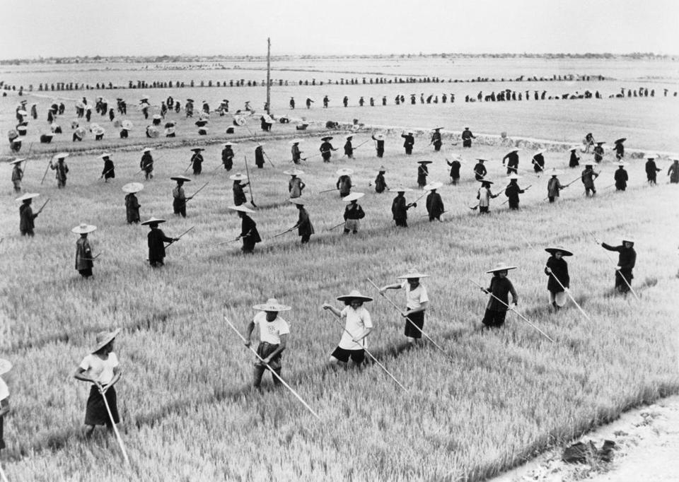
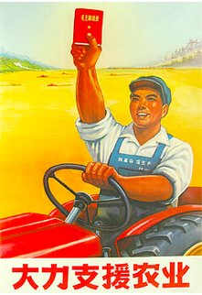
Communism in China, 1949-Present
In 1949, after 22 years of civil war China became the second country in the world (after the Soviet Union) to adopt communism
Mao Zedong
He was the first Communist dictator of China
He gained the support of peasants because he promised to provide them with their own land once the Communists were brought to power
Great Leap Forward
This was the attempt by Mao to modernize (update) the industrial (factory) and agricultural (farm) production of China
Cultural Revolution- Mao’s attempt to renew people’s loyalty to communism
Little Red Book
Closed schools and universities
Red Guards- attacked professors, government officials, factory managers, skilled workers

Slide 4
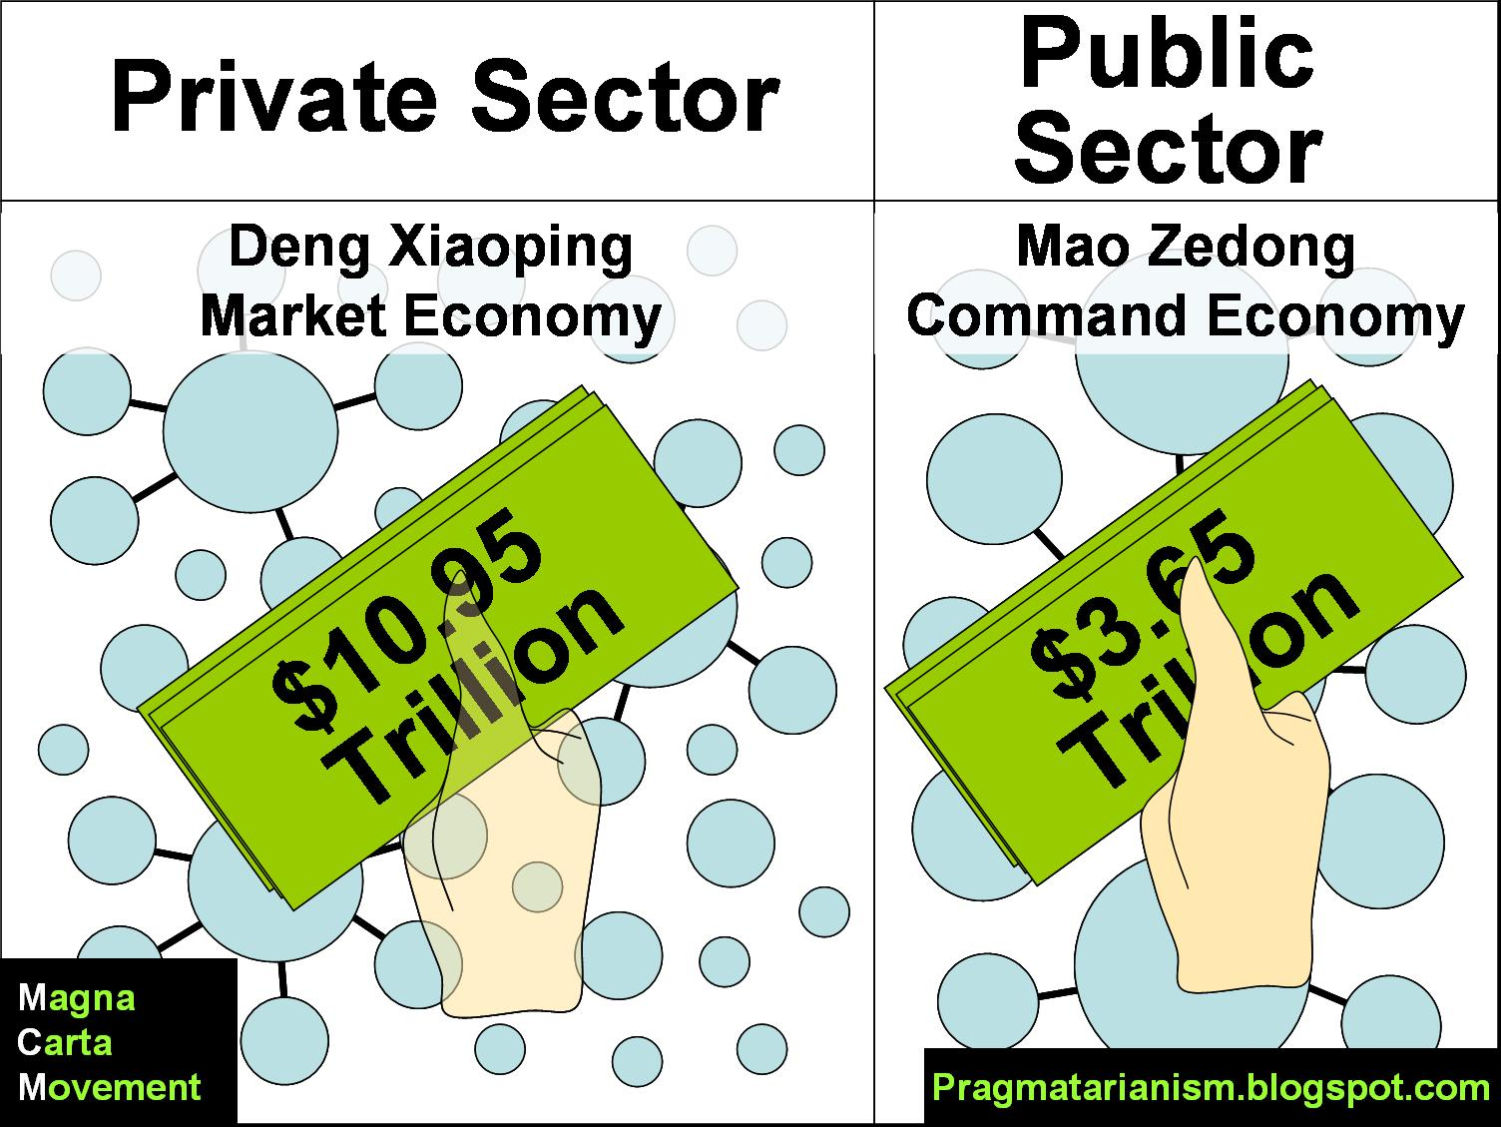
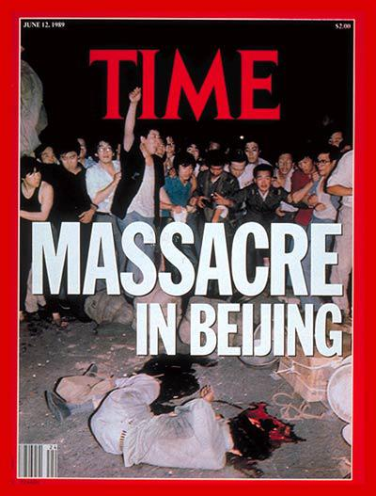
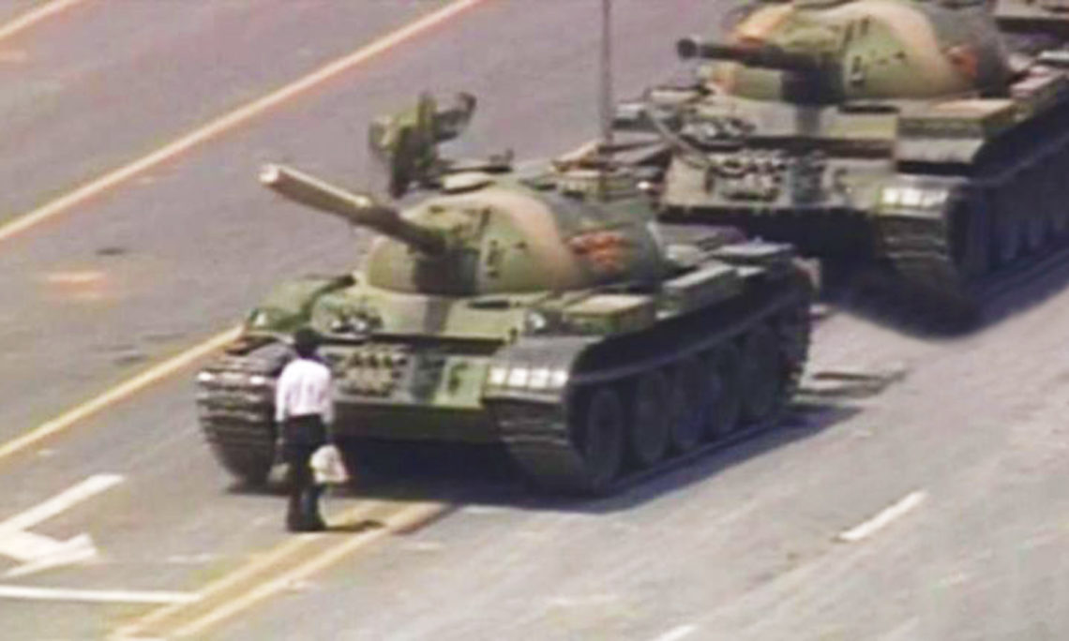
Communism in China
Deng Xiaoping
He was the ruler in China after Mao Zedong
Deng changed the economy through the Four Modernizations
Farming, Industry, Science and Technology, and Defense modernized and improved
Tiananmen Square Protests/Massacre (1989)
This was a series of protests where the Chinese peacefully demanded democratic reforms (changes)- They wanted more rights and a say in government.
Deng Xiaoping called in the army to repress (end) the protests. Hundreds of Chinese protesters were killed or arrested.
This proved that China’s government was not willing to make democratic changes

Slide 5
Communism in China
Current issues in China
China controls the Buddhist region of Tibet and the people of Tibet want independence (self-government)
China denies its people human rights (such as freedom of speech and the right to vote)
One-Child Policy- In order to prevent overpopulation (China has 1.3 billion people), in 1979 the government of China only allowed each family to have one child
Policy was expanded to two children in 2016 due to population shrinking and ageing

