Slide 1
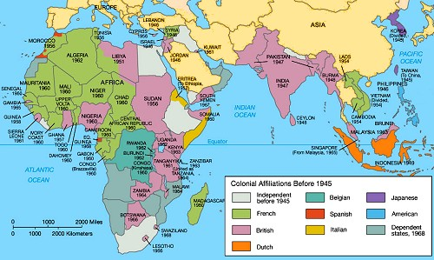
Regents global history and geography
Decolonization and nationalism

Slide 2
Brief Overview
New York Social Studies Framework Connection
Key Social Studies Terms to Look for:
10.7 DECOLONIZATION AND NATIONALISM (1900–2000): Nationalist and decolonization movements employed a variety of methods, including nonviolent resistance and armed struggle. Tensions and conflicts often continued after independence as new challenges arose. (Standards: 2, 3, 4, 5; Themes: TCC, GEO, SOC, GOV, CIV,)
Decolonization
Nonalignment
Apartheid
Genocide
Nationalism

Slide 3
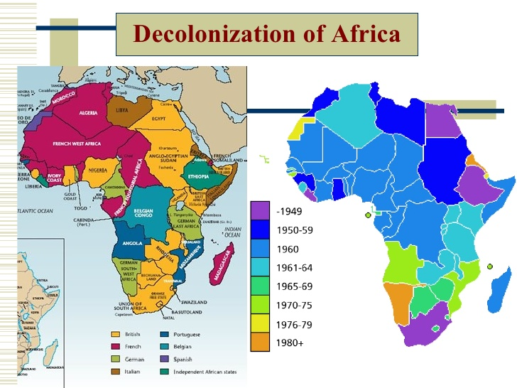
Intro to Decolonization
Decolonization is the period after World War II in which the nations of Africa and Asia finally gained independence (self-government) from the European (Western) nations that controlled them
AFRICAN NATIONS ACHIEVED INDEPENDENCE FROM EUROPEAN NATIONS

Slide 4
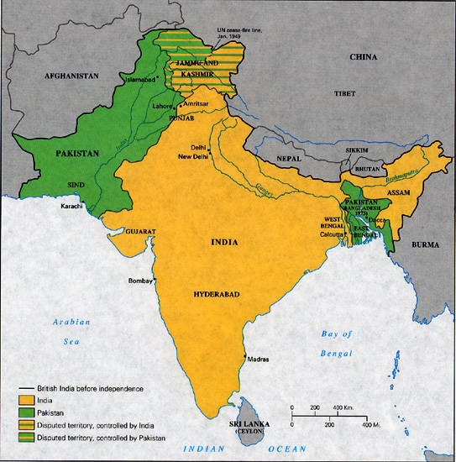
Decolonization in India (1948)
After World War II, India gained independence (self-government) from Great Britain (England) with help from Gandhi
1947- Jawaharlal Nehru became India’s first prime minister
Partition of India
after independence, conflict between Hindus and Muslims divided India
To prevent conflict between Hindus and Muslims, India was divided into 2 nations
India = Hindus
Pakistan = Muslims

Slide 5
Decolonization in India (1948)
India after Independence
India established a democratic government
India followed a policy of nonalignment (or neutrality) during the Cold War, which means that it did not take sides
USSR
USA

Slide 6
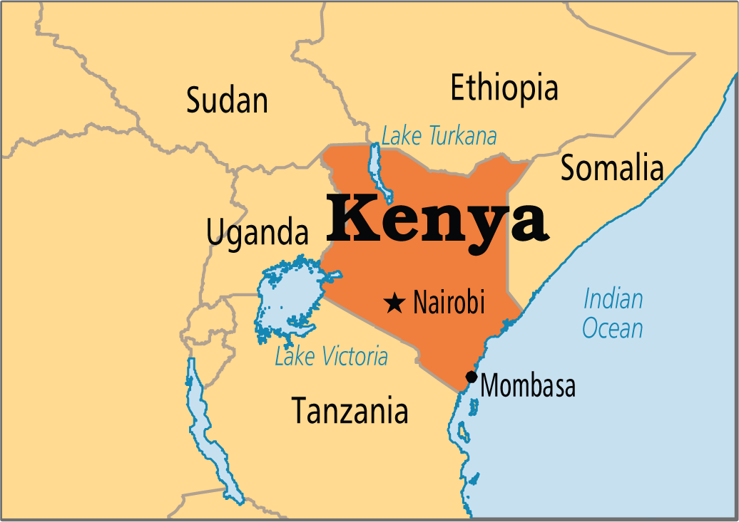
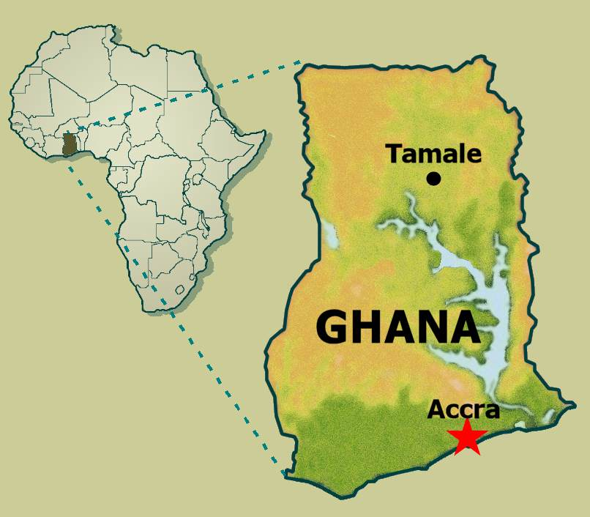
Decolonization in Africa (1945-1980)
WWII led to nationalism and a push for independence in many African colonies
Nations of Africa achieve independence from European nations
Jomo Kenyatta = independence leader of Kenya
Kwame Nkrumah = independence leader of Ghana

Slide 7
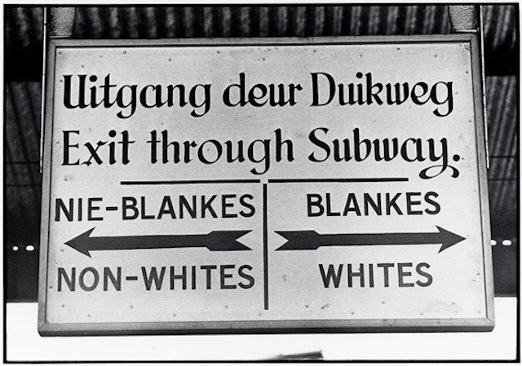
South Africa After Independence
South Africa won independence from Britain in 1910 but its white citizens held all the power
In 1948 a system of apartheid, or separation of races, was created to control the nation’s government and economy
Required blacks and other non-whites to live in certain zones, segregated public facilities and transportation and forbade interracial marriage

Slide 8
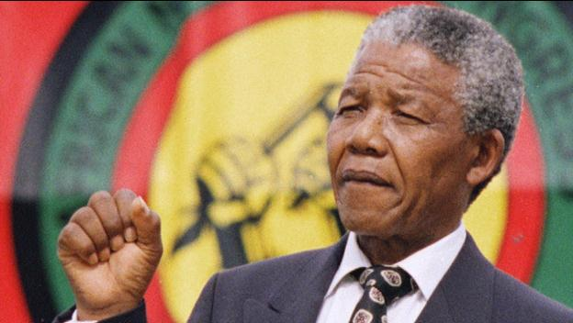
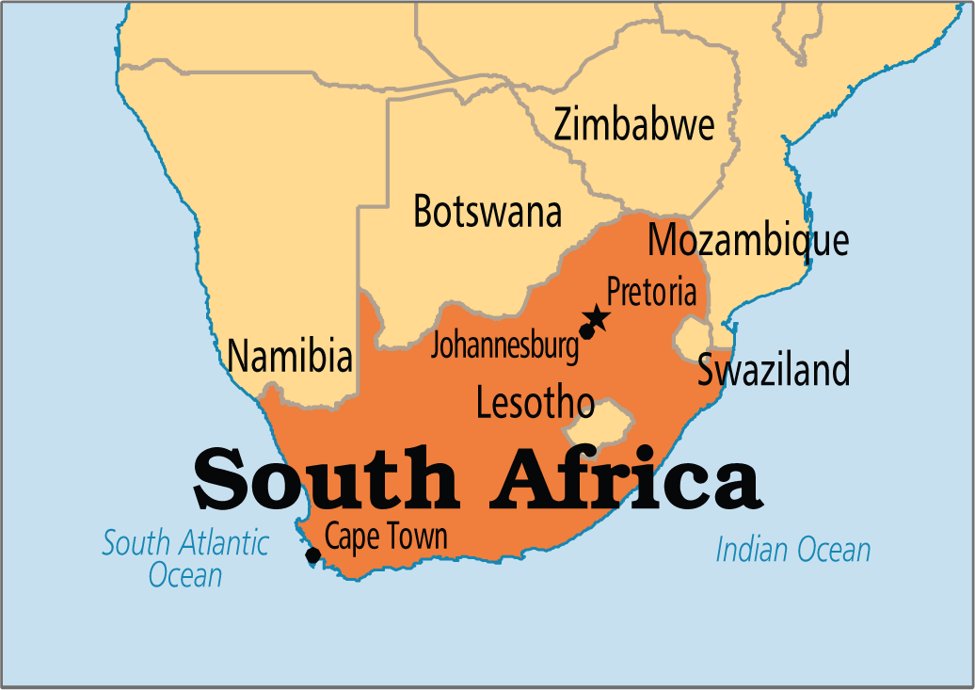
South Africa After Independence
Nelson Mandela
Nationalist leader in South Africa who was a leader in of the ANC (African National Congress)- political party that worked to oppose apartheid
Put in prison for 27 years
1990 apartheid ended and Mandela was released from prison
Became first black President of South Africa in 1994

Slide 9
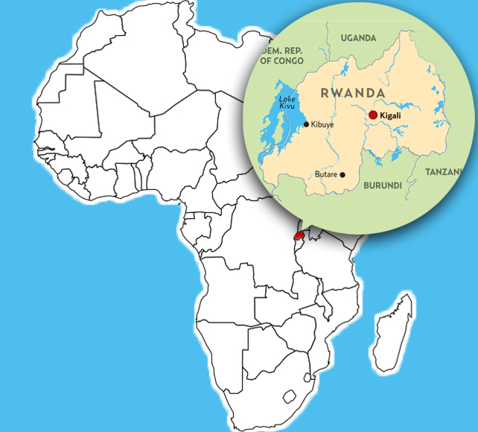
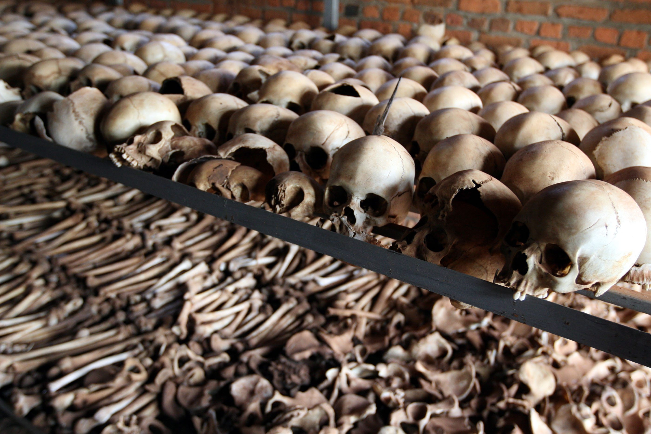
Rwanda After Independence
Ethnic conflict
Hutus and Tutsis- Tutsis had been favored by the Belgians during colonial rule
Once independence was granted the ethnic tensions intensified
1994: Hutu extremists set out to eliminate the Tutsis and nearly 800,000 people were killed in a few months in Rwanda
Example of genocide and human rights violation

Slide 10
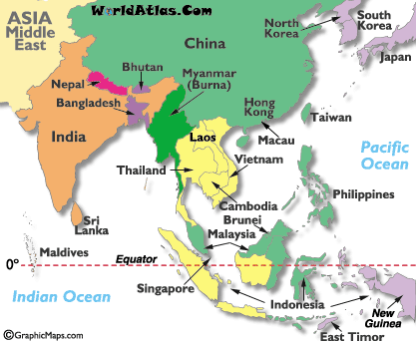
Decolonization in Southeast Asia
1953-1954, Cambodia and Vietnam gain independence from France

Slide 11
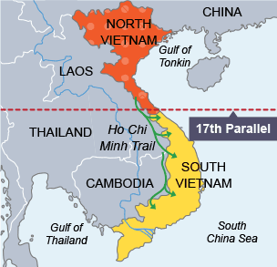
Decolonization in Vietnam
Nationalist leader- Ho Chi Minh
Communist
Vietnam War
North Vietnam vs. South Vietnam
US sends troops to South Vietnam to stop spread of communism
Vietnam becomes Communist when the south falls to the north

Slide 12
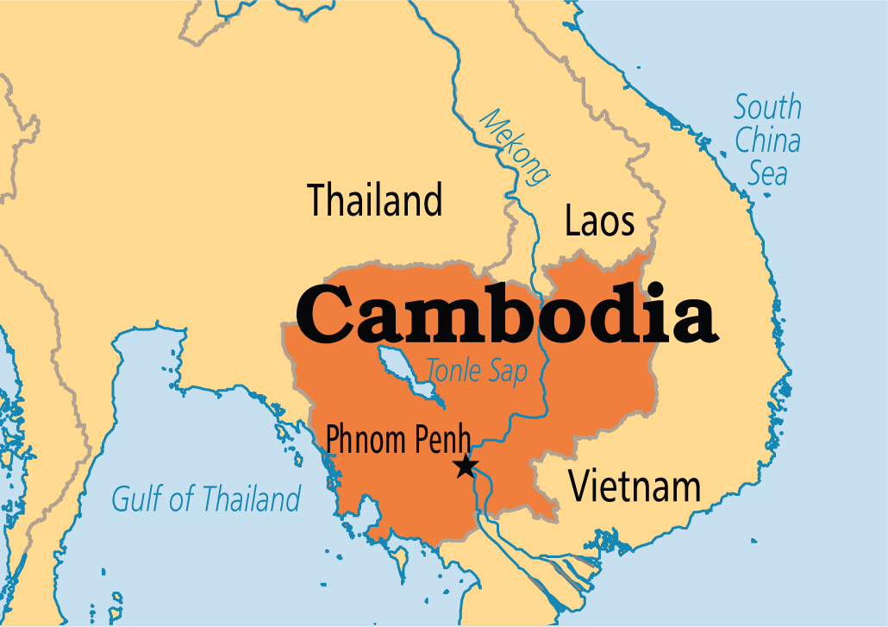
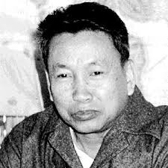
Decolonization in Cambodia
After independence, Communist Khmer Rouge come to power
Pol Pot was the leader who became a dictator
Committed genocide against his people to remove all western influence from his nation
More than 1 million people were killed

Slide 13
Nationalist Leaders of Decolonization
Mohandas Gandhi = India
Kwame Nkrumah = Ghana
Jomo Kenyatta = Kenya
Nelson Mandela = South Africa
Ho Chi Minh = Vietnam

