Slide 1
Early world history
Age of exploration

Slide 2
Brief Overview
New York Social Studies Framework Connection
Key Social Studies Terms to Look for:
9.10 INTERACTIONS AND DISRUPTIONS: Efforts to reach the Indies resulted in the encounter between the people of Western Europe, Africa, and the Americas. This encounter led to a devastating impact on populations in the Americas, the rise of the transatlantic slave trade, and the reorientation of trade networks. (Standards: 2, 3, 4; Themes: MOV, TCC, GEO, SOC, GOV, CIV, ECO, TECH, EXCH)
Compass
Astrolabe
Cartography
Triangular trade
Columbian Exchange
Middle Passage
Mercantilism
Encomienda system

Slide 4
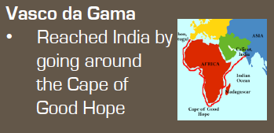

Slide 5
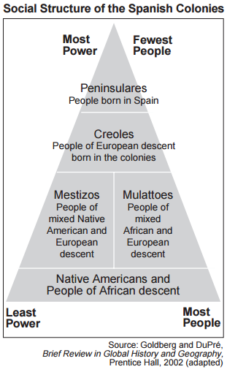
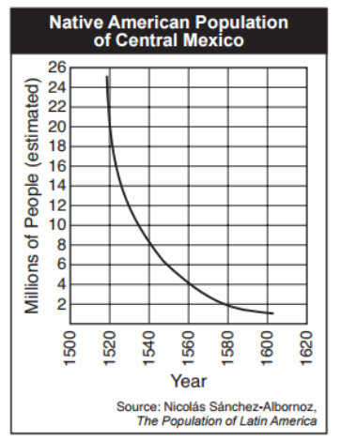
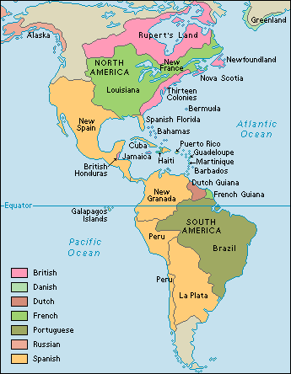

Slide 6
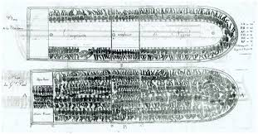
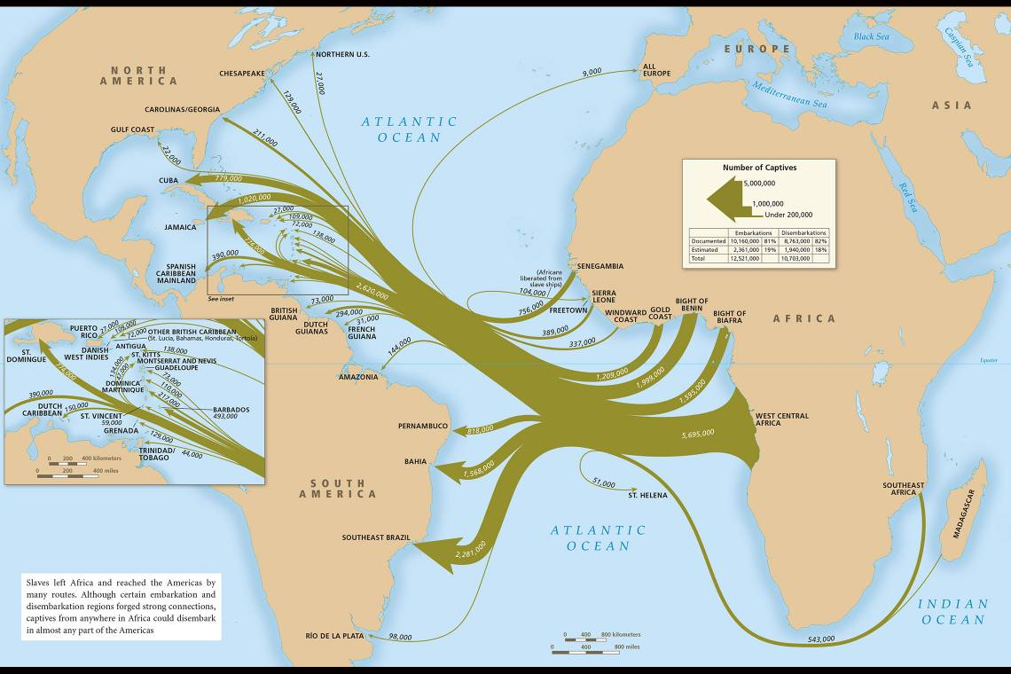

Slide 7
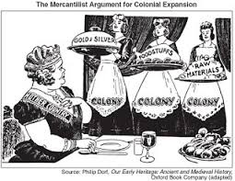
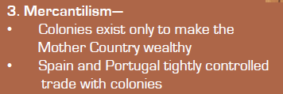
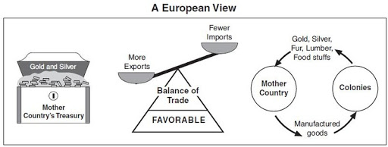

Slide 8
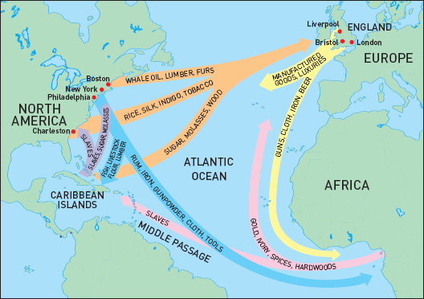

Slide 9
