Slide 1
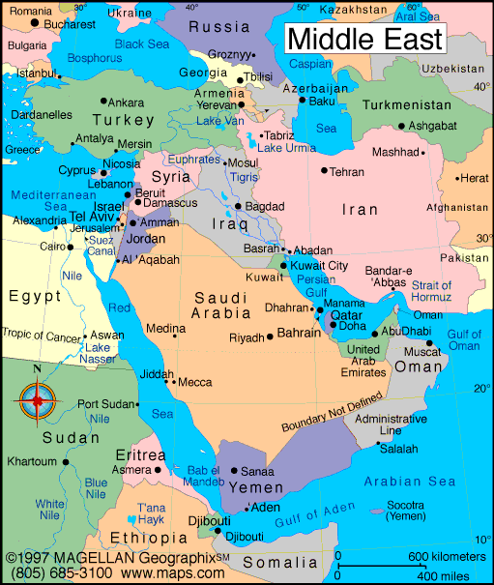
Regents global history and geography
The middle east after wwii

Slide 2
Brief Overview
New York Social Studies Framework Connection
Key Social Studies Terms to Look for:
10.7 DECOLONIZATION AND NATIONALISM (1900–2000): Nationalist and decolonization movements employed a variety of methods, including nonviolent resistance and armed struggle. Tensions and conflicts often continued after independence as new challenges arose. (Standards: 2, 3, 4, 5; Themes: TCC, GEO, SOC, GOV, CIV,)
Palestine Liberation Organization (PLO)
Camp David Accords
Islamic Fundamentalism
Theocracy

Slide 3
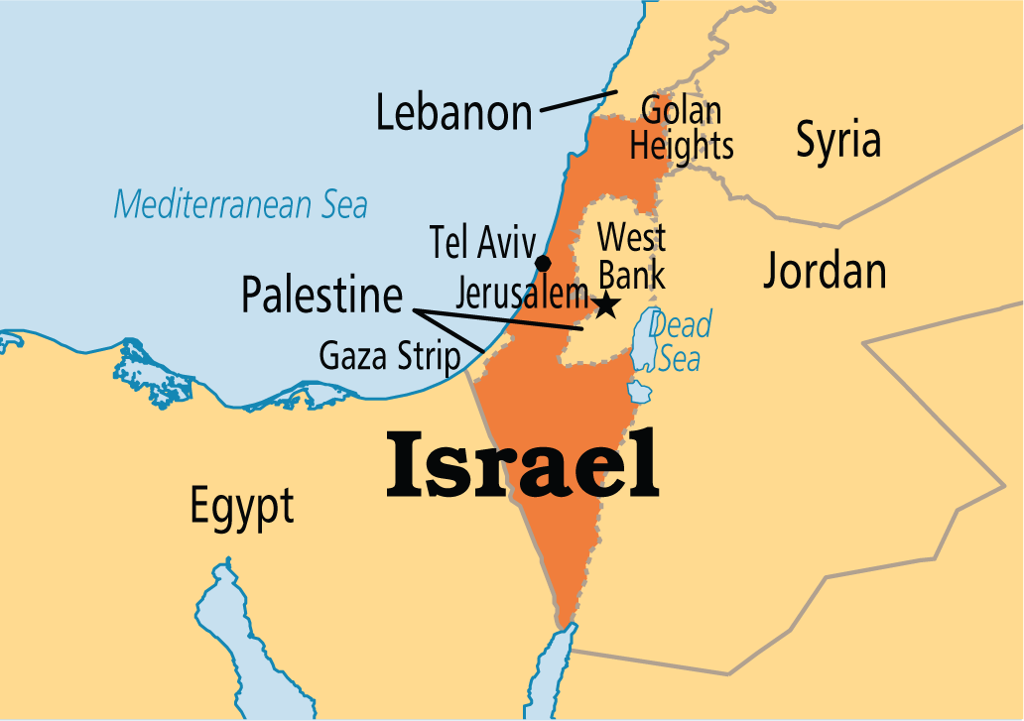
Creation of Israel
Israel created after WWII when the United Nations drew up a plan to partition Palestine into an Arab state and a Jewish state
Palestinians believe they should own the land
1948-1973: 4 major wars fought over the land
Palestine Liberation Organization (PLO)- formed to destroy Israel and win self-rule for the Palestinians
Camp David Accords- agreement brokered by U.S. President Jimmy Carter in 1978 between Egypt and Israel making peace between the two nations possible
Palestinians are still fighting for control

Slide 4
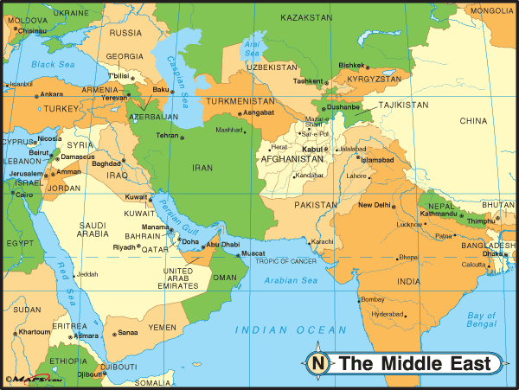
Islamic Fundamentalism
The belief that governments should create governments based on Islam
3 such governments are Iran, Afghanistan and Saudi Arabia

Slide 5
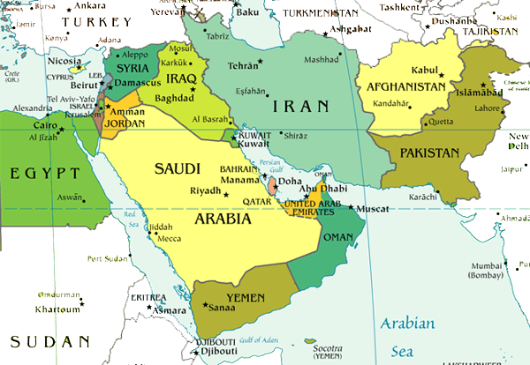
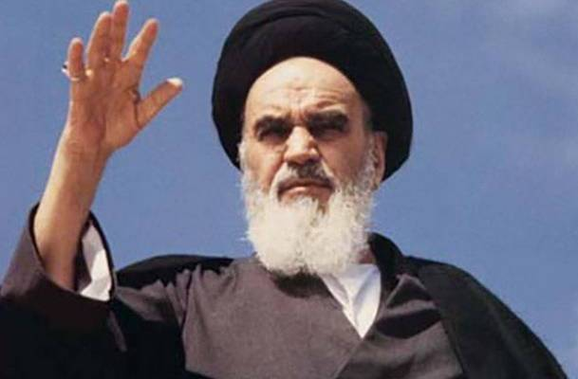
Iranian Revolution (1979)
Unpopular Shah Pahlavi (American supported dictator) overthrown
Ayatollah Khomeini takes control and creates an Islamic republic based on Islamic fundamental beliefs
Iranian government was extremely hostile to the West, especially the U.S.
Government required strict adherence to Islamic fundamental beliefs
Rights were taken from women
Iran encouraged Muslims in other countries to work to overthrow secular governments and establish Islamic republics
Iran is still a theocracy today

Slide 6
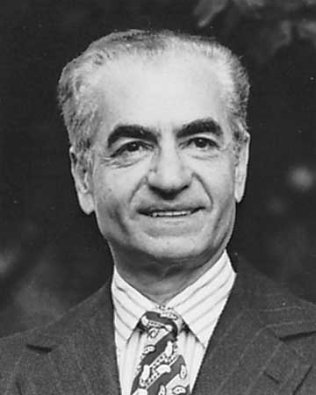
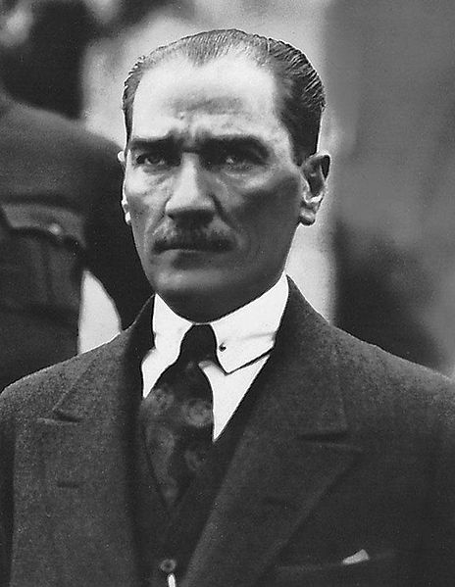
SHAH PAHLAVI OF IRAN
KEMAL ATATURK OF TURKEY
BOTH LEADERS WANTED TO WESTERNIZE AND MODERNIZE THEIR NATIONS…ATATURK WAS MORE SUCCESSFUL AS SHAH PAHLAVI WAS OVERTHROWN IN 1979

