Slide 1
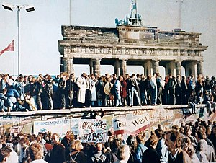
Regents global history and geography
Collapse of communism

Slide 2
Brief Overview
New York Social Studies Framework Connection
Key Social Studies Terms to Look for:
10.6 UNRESOLVED GLOBAL CONFLICT (1945–1991: THE COLD WAR): The second half of the 20th century was shaped by the Cold War, a legacy of World War II. The United States and the Soviet Union emerged as global superpowers engaged in ideological, political, economic, and military competition. (Standards: 2, 3, 4, 5; Themes: TCC, GOV, ECO, TECH, EXCH)
10.6c The end of the Cold War and the collapse of the communist bloc in Europe had a global impact.
Students will investigate the political reforms of glasnost and economic reforms of perestroika.
Students will examine the impacts of those reforms within the Soviet Union, on the Soviet communist bloc, and in the world.
Perestroika
Glasnost

Slide 3
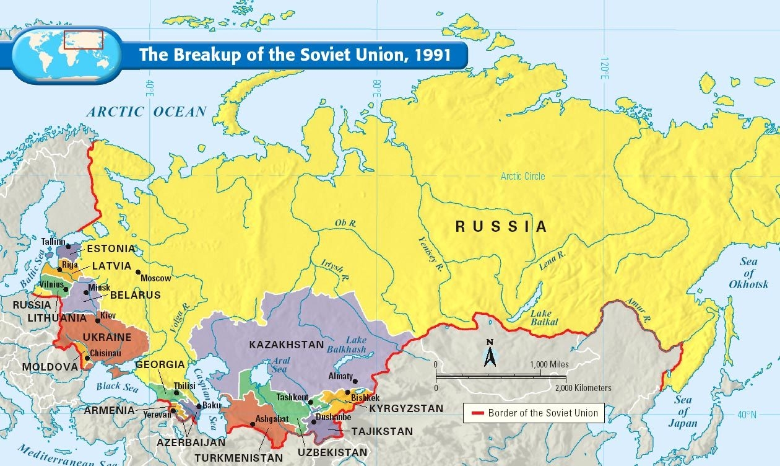
THE COLLAPSE OF COMMUNISM IN USSR
Between 1989 and 1991, the Cold War ended and Communism disappeared from Europe

Slide 4
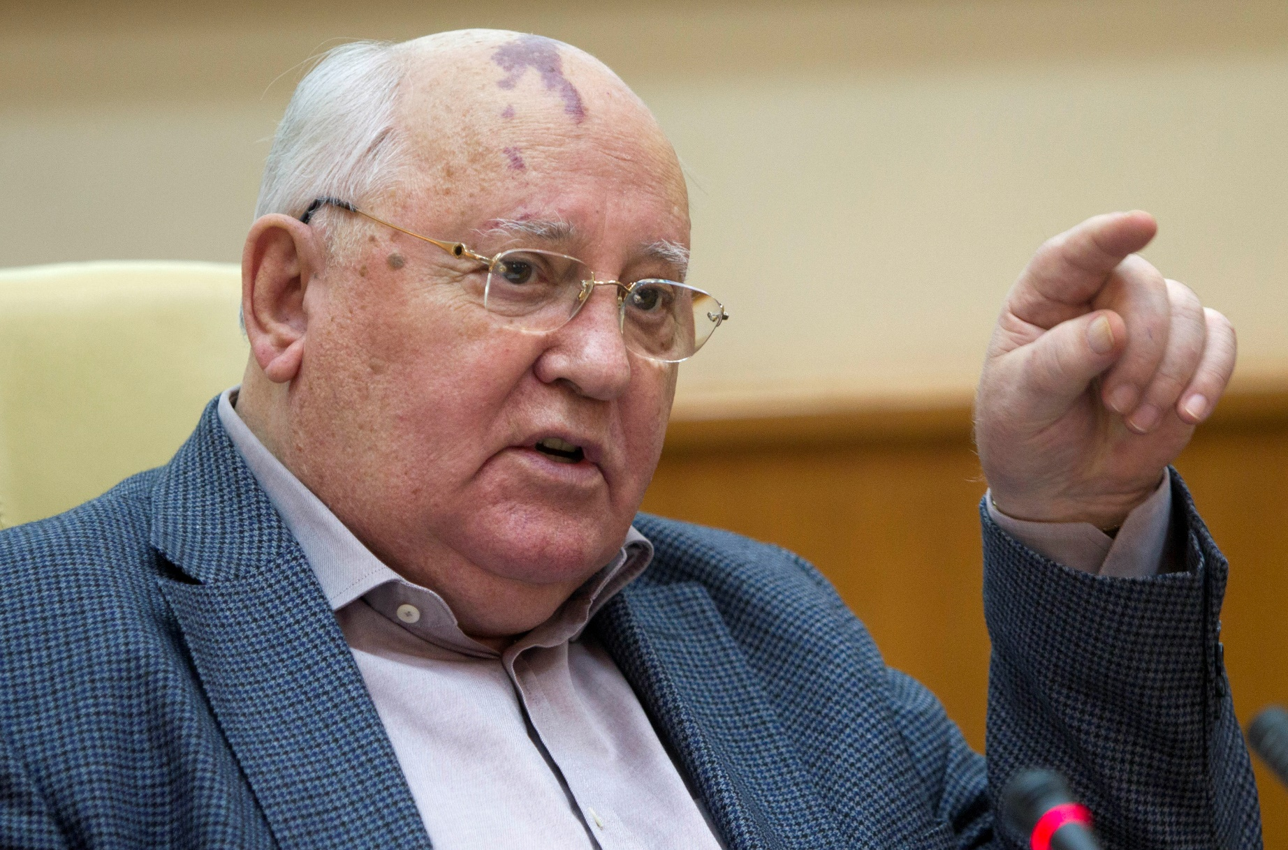
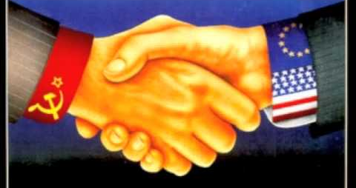
THE COLLAPSE OF COMMUNISM IN USSR
Mikhail Gorbachev
Wanted to end Cold War tensions
Reformed government and economy
Perestroika: USSR changes from communist to capitalist
Glasnost: allowed more freedom of speech in USSR
Soviet leader when USSR falls apart

Slide 5
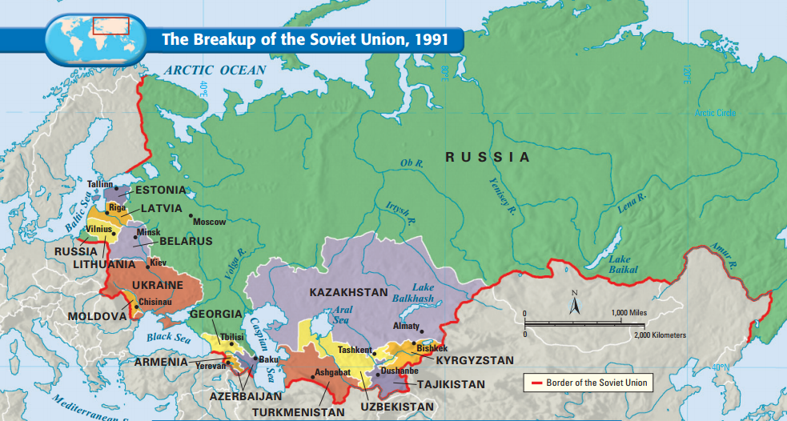
THE COLLAPSE OF COMMUNISM IN USSR
​Timeline
1991- Soviet republics began regaining their independence​
These non-Russian republics opposed Russian domination​
Mid-1991- communists tried to overthrow Gorbachev​
Gorbachev’s reforms had helped to end communism throughout Eastern Europe and break up the Soviet Union

Slide 6
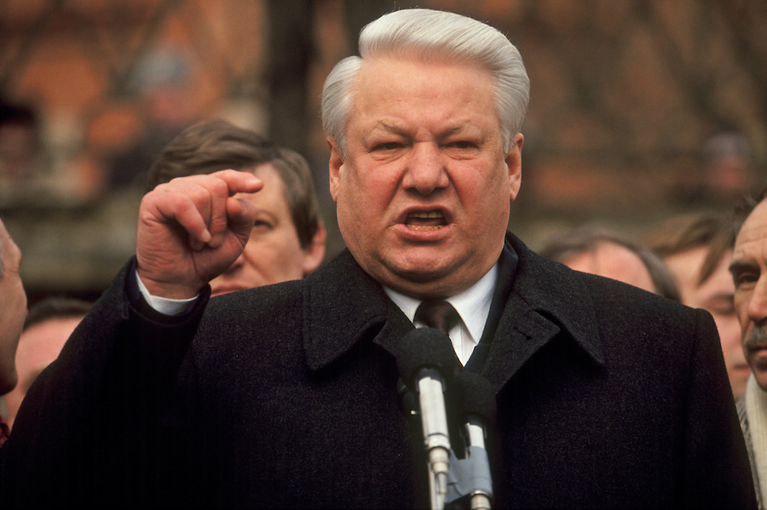
THE COLLAPSE OF COMMUNISM IN USSR
Boris Yeltsin
First democratically elected leader of the USSR
Struggled to make transition from communism to democracy​
Industries and farms were privatized​
Economy still suffered

Slide 7
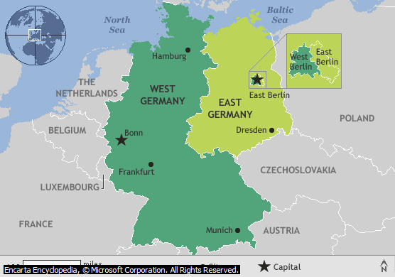
THE COLLAPSE OF COMMUNISM IN GERMANY
Throughout the Cold War, Germany had been divided into two nations: East Germany and West Germany

Slide 8
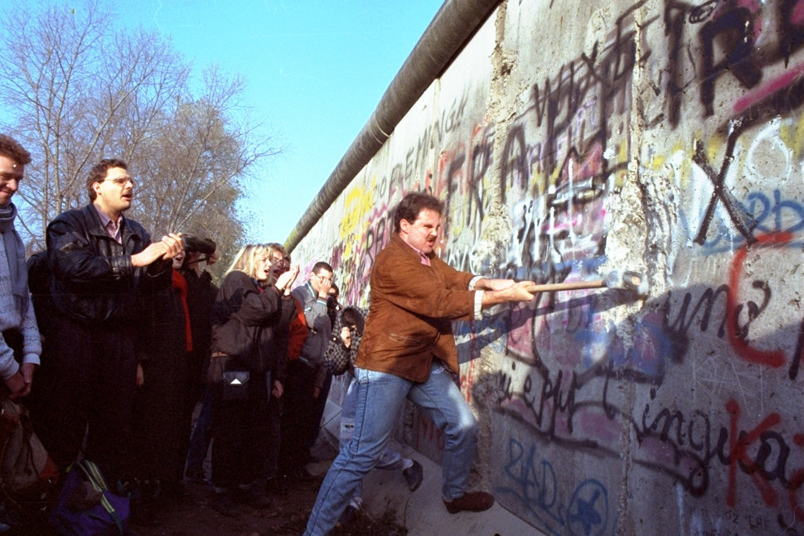
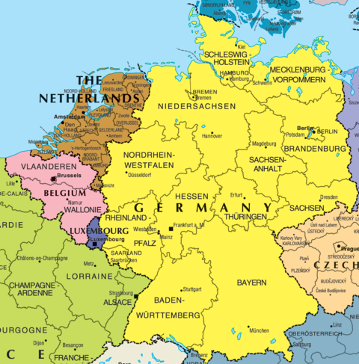
THE COLLAPSE OF COMMUNISM IN GERMANY
1989: Fall of the Berlin Wall
Symbolic fall of Communism and USSR
1990: Germany is reunited
End of Cold War division

