Slide 1
Eight Features of Civilization

Slide 2
DIN:
What do you think classifies a group of people as “civilized”? Create a list.

Slide 3
Development of Civilization
Nomads settled into villages
Villages grew into cities where people began to divide the work
Cities developed into civilizations with organized government, religion, job specialization, etc.

Slide 4
The Features of Civilization
Cities
Government
Religion
Job specialization
Social hierarchy
Technology
Writing

Slide 5
Do you live in a civilization?
Complete the activity in Canvas titled “Do you live in a civilization?”
For each of the characteristics of civilizations, provide evidence from the town, city, state, and/or country in which you live in to prove that you live in a civilization.

Slide 6
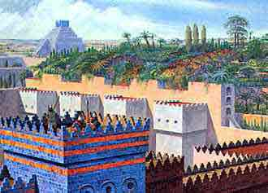
Cities
Surplus of food led to growth of population and growth of cities
Had high walls, temples and palaces and areas for public ceremonies

Slide 7
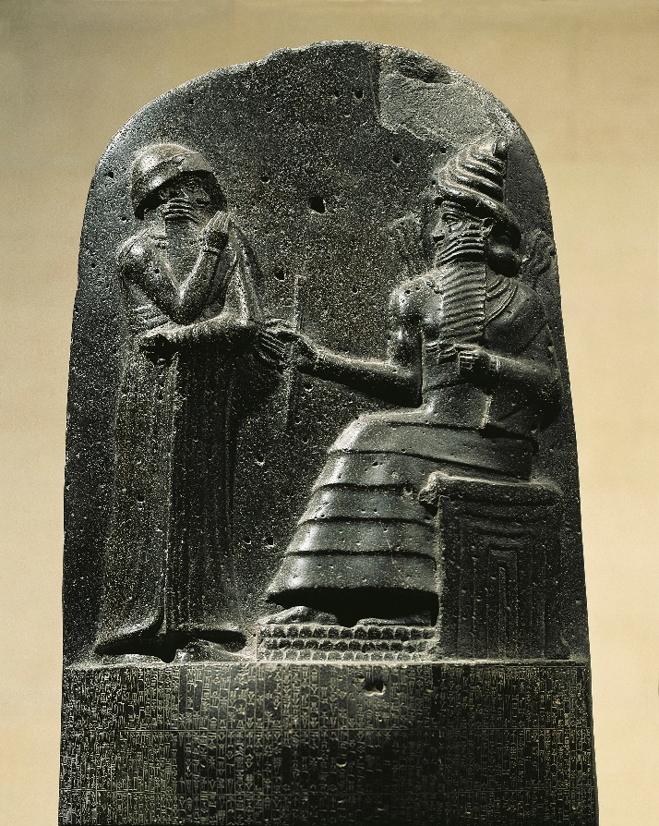
Government
Maintain order and provide defense
Make laws
Priests and warrior kings became leaders

Slide 8
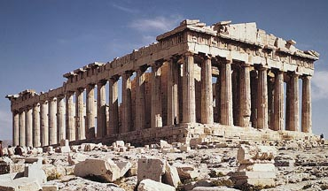
Religions
Polytheistic
Built temples to worship gods

Slide 9
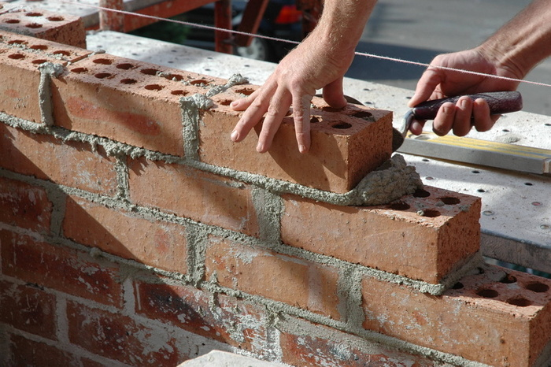
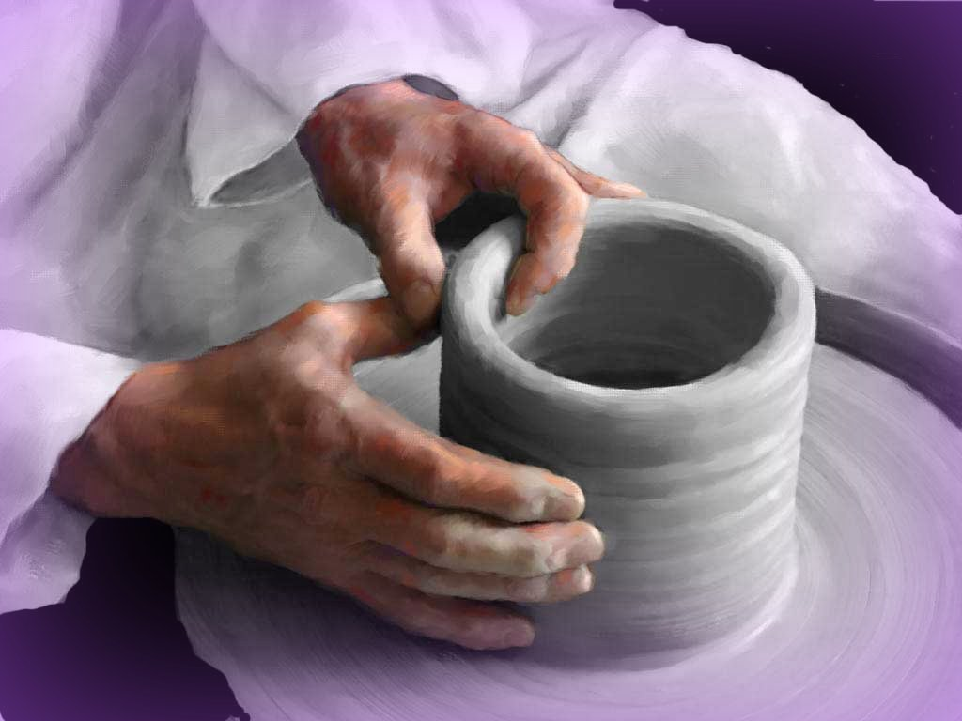
Job Specialization
People were responsible for specific jobs
Artisans- Ex. Bricklayer, potter
Soldier
merchant

Slide 10
Social Class
Priests and
nobles
People are divided into different groups based on the amount of power they have and occupation
Wealthy Merchants
Artisans
Peasant Farmers
Slaves

Slide 11
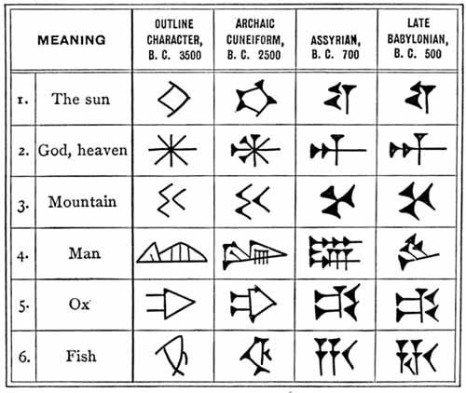
Language/Writing System
Pictograms
Used for communication and record keeping

Slide 12
Technology
Tools and skills people use to meet their basic needs
Irrigation
Paper
pottery

Slide 13
Reflection
Daily Reflection

